Slide 1
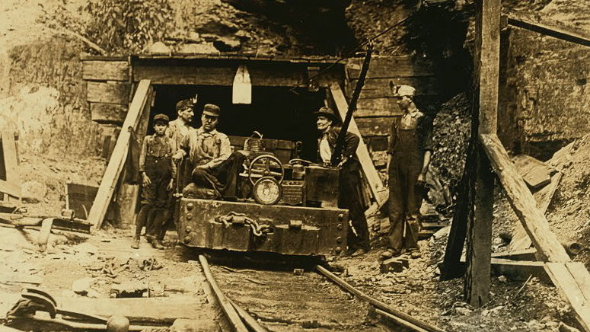
Class 8:
Mining
Cryptocurrency Cabal
cs4501 Fall 2015
David Evans and Samee Zahur
University of Virginia

Slide 2
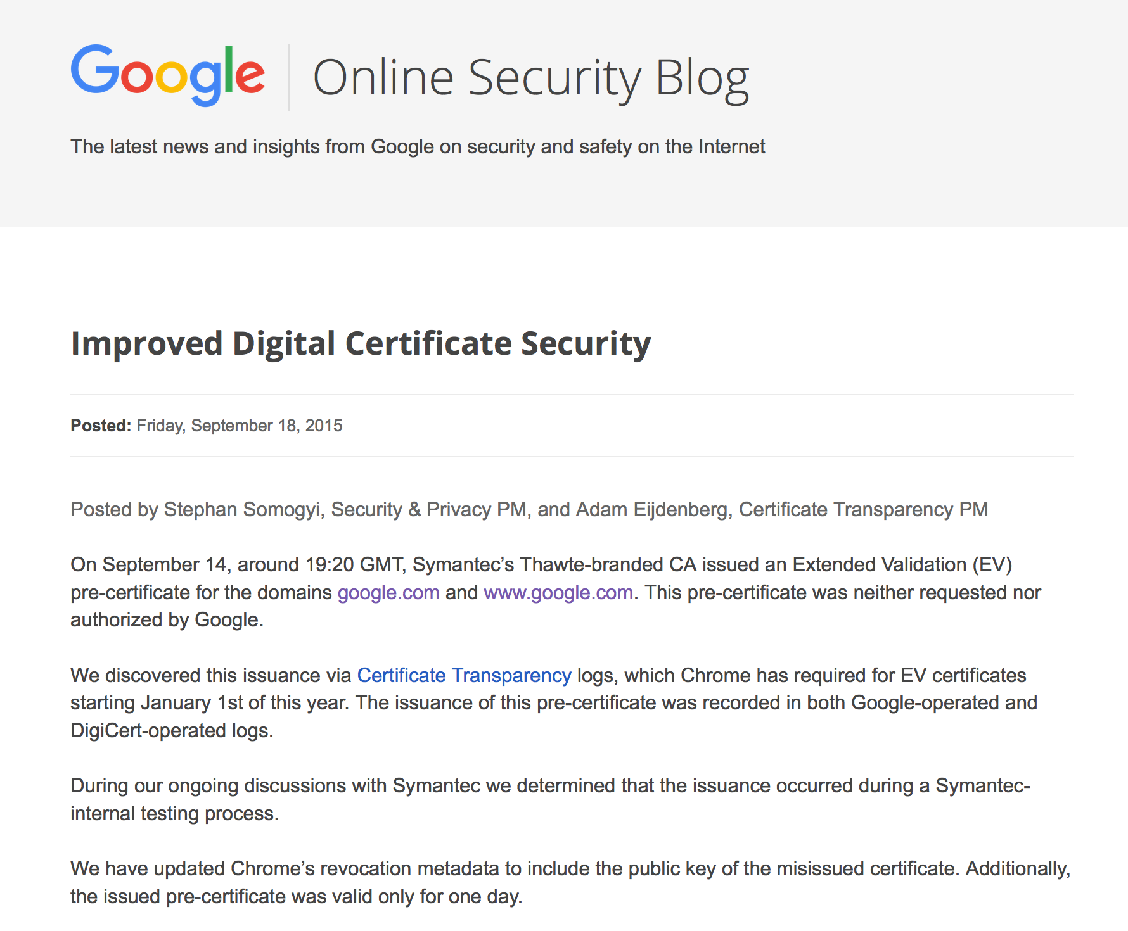
In the News…

Slide 3
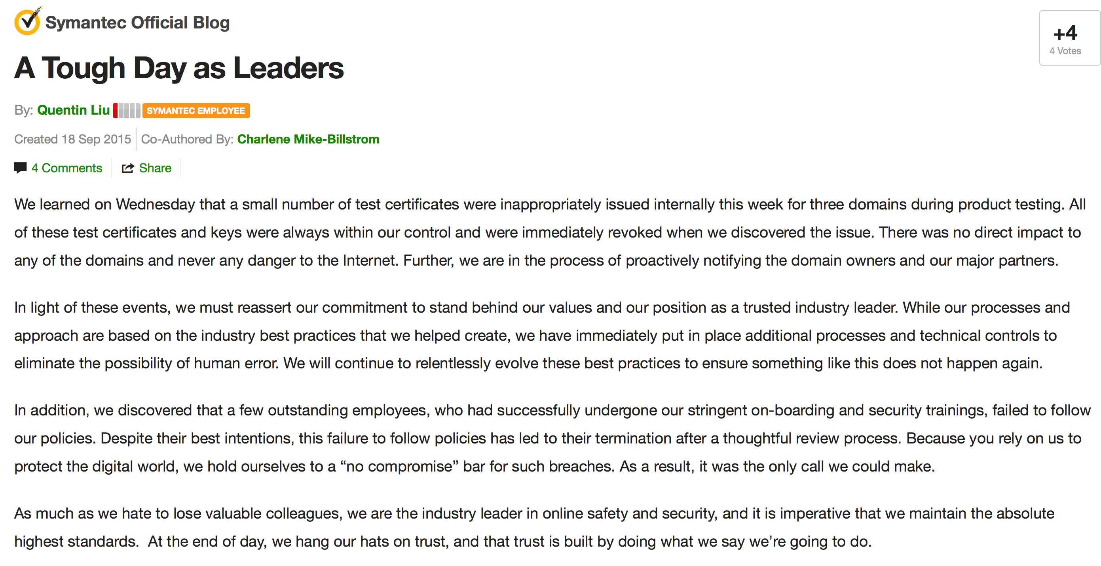

Slide 4
Plan
Blockchain
What’s in a Block
Merkle Trees
Mining
Checkup 2 is Wednesday
covers all readings
classes 1-8, PS1
discussion of Checkup 1

Slide 5
Blockchain Recap
B0
H(B0)
Nonce
H(B1)
Nonce
H(B2)
Nonce
Transactions
Transactions
Transactions
Find a nonce x such that:
SHA-256(SHA-256(r || x)) < T/d
r = header includes H(previous block)

Slide 6
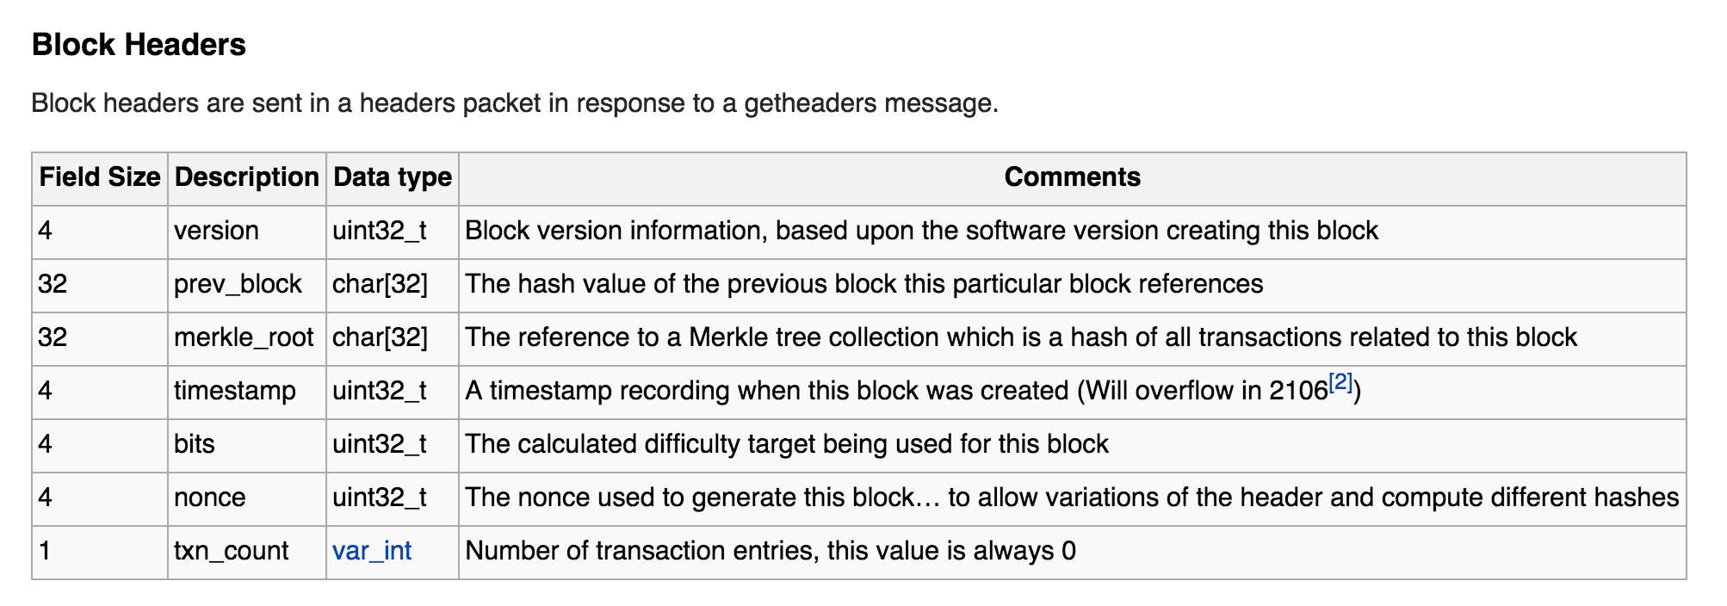
Actual Bitcoin Block
https://en.bitcoin.it/wiki/Protocol_documentation#Block_Headers

Slide 7
Let’s Look at Some Blocks…
https://blockexplorer.com/blocks
http://blockexplorer.com/b/0
https://blockexplorer.com/rawblock/0000000000000000080baee7ff8e34ee47a9212e53f5c6a6382d11e3ce14adba

Slide 8
Recording Transactions
Mining next block:
Find a nonce x such that:
SHA-256(SHA-256(r + x)) < T/d
H(B2)
Nonce
Transactions
r depends on the actual transactions…which keep happening!

Slide 9
Bad Idea #1?
transactions = H(tx₀ || tx₁ || tx₂ || … || tx_{n})

Slide 10
Bad Idea #2?
transactions = H(tx₀) || H(tx₁) || H(tx₂) || … || H(tx_{n})

Slide 11
Slightly Better Idea
transactions = H(tx_{n} || H(tx_{n-1} || H(tx_{n-2} || … || H(tx₁))))))

Slide 12
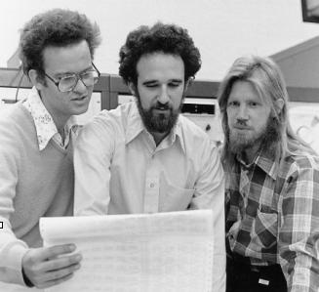
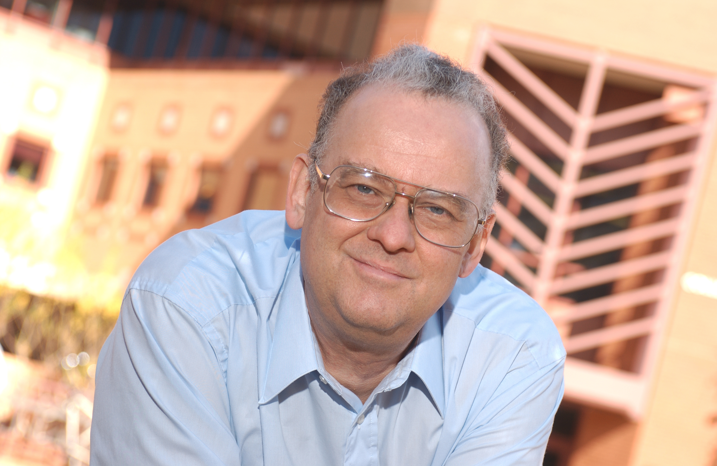
Merkle Trees
Ralph Merkle with
Martin Hellman, Whitfield Diffie (1977)
Diffie-Hellman(-Merkle) Key Exchange (1976)

Slide 13
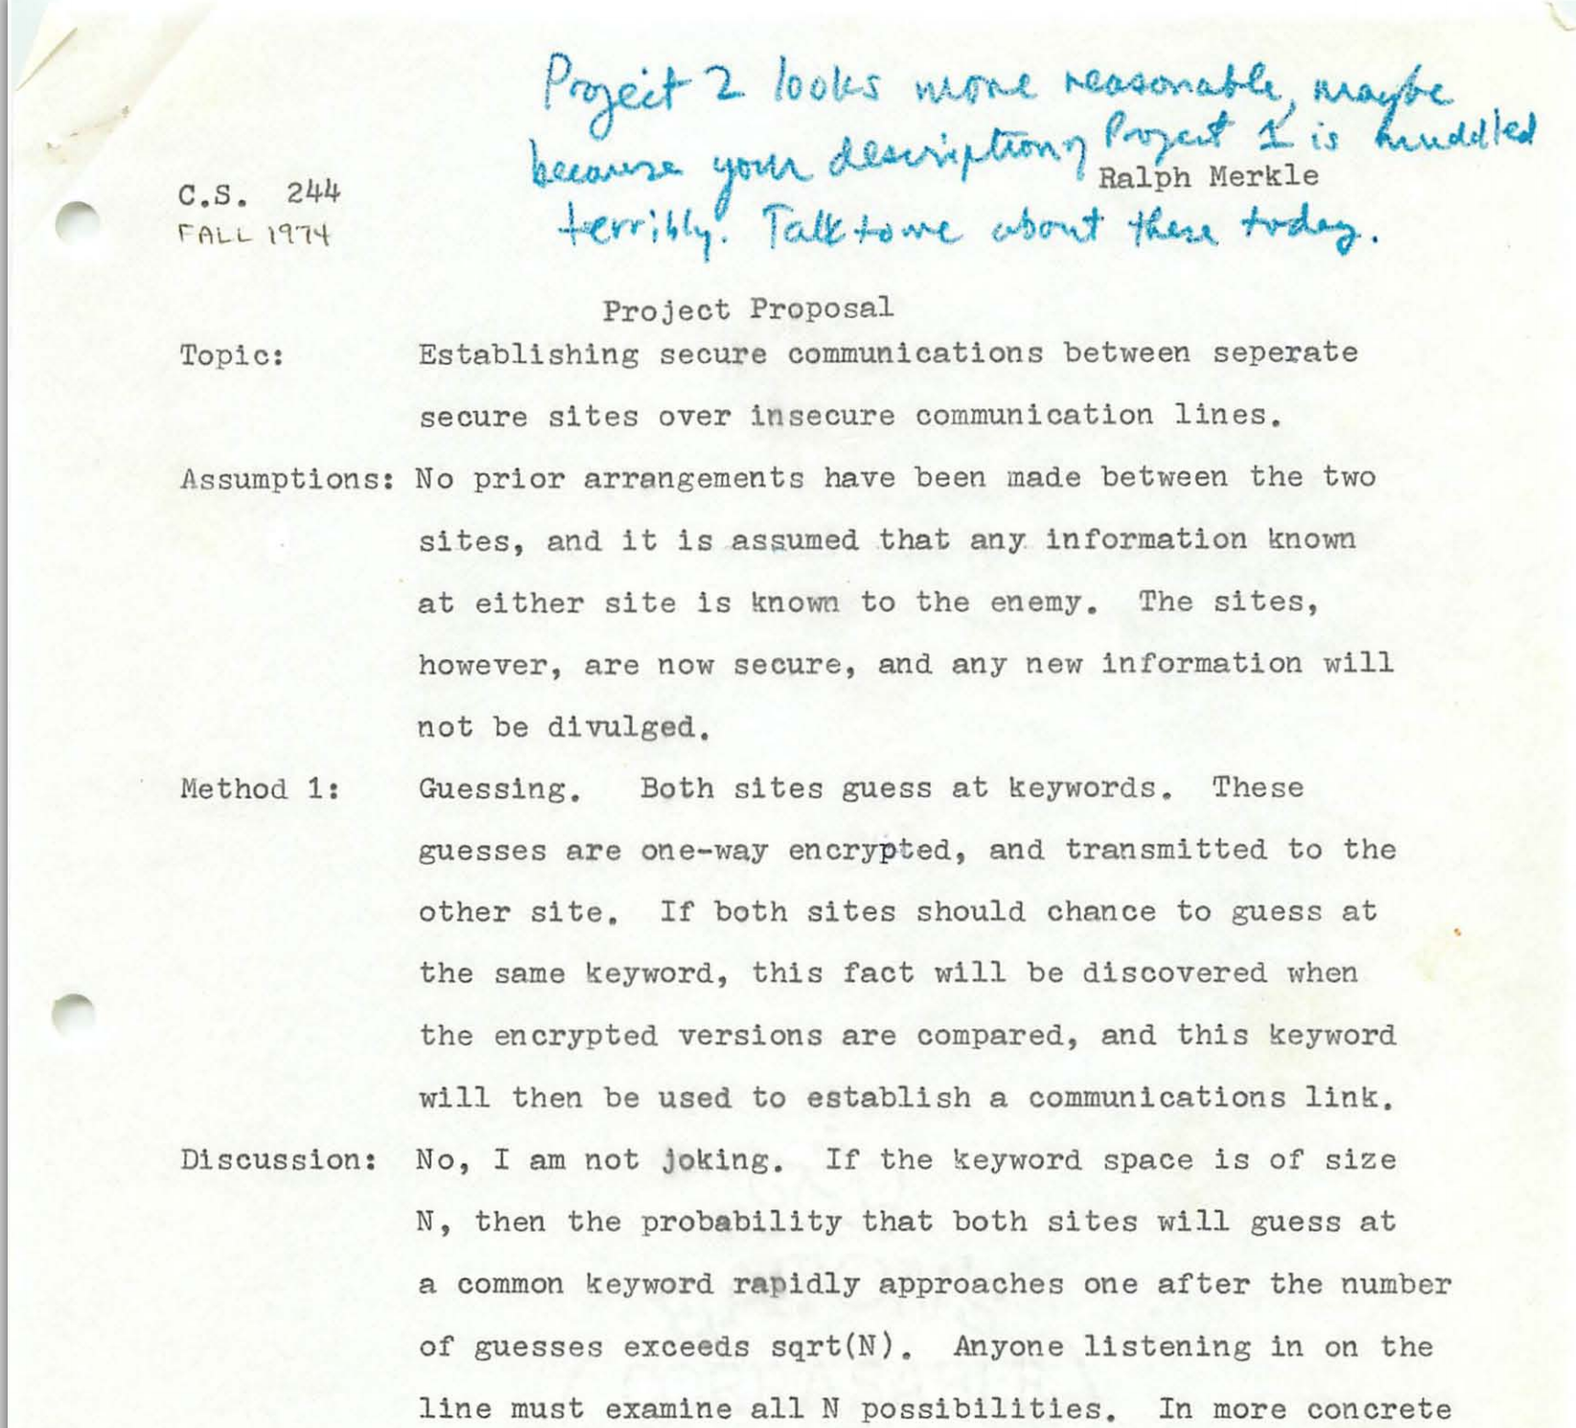
Merkle’s Puzzles

Slide 14
Merkle Trees

Slide 15
H_{root}= h(H₁₂ + H₃₄)
H₁₂= h(H₁ + H₂)
H₃₄= h(H₃ + H₄)
H₁ = h(T₁)
H₂= h(T₂)
H₃=h(T₃)
H₄=h(T₄)
T₁
T₂
T₃
T₄

Slide 16
Mining
B0
H(B0)
Nonce
H(B1)
Nonce
H(B2)
Nonce
Transactions
Transactions
Transactions
Find a nonce x such that:
SHA-256(SHA-256(r || x)) < T/d
r = header includes H(previous block)
root of Merkle tree of transactions

Slide 17
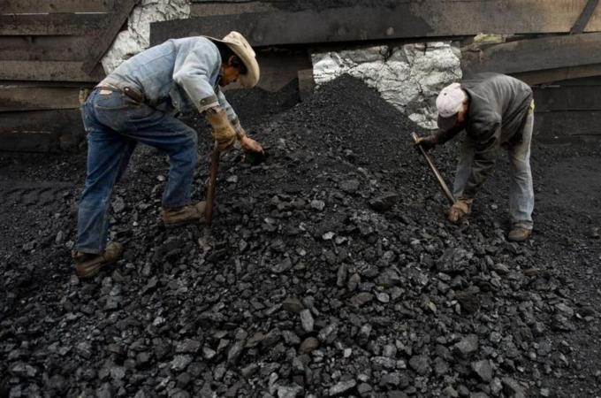
Why Mine?

Slide 18
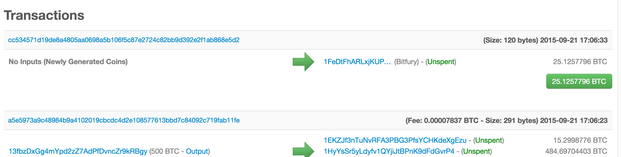
Coinbase Transaction!

Slide 19
Mining Pseudo Algorithm
Setup:
block := construct next block header
difficulty := next difficulty
// look for nonce
while true {
block.Header.nonce += 1 // guess next nonce
hash, _ = block.Header.BlockSha()
if hash < difficulty { Success! }
}

Slide 20
package main
import "github.com/PointCoin/fastsha256"
import "log"
import "time"
func main() {
msg := "test"
hasher := fastsha256.New()
hasher.Write([]byte (msg))
starttime := time.Now()
num := 10000000
for i := 0; i < num; i++ {
hasher.Sum(nil) // ignore result
}
elapsed := time.Since(starttime)
log.Printf("Total time: %s", elapsed)
log.Printf("Average hashing time: %d ns", elapsed.Nanoseconds() / int64(num))
}

Slide 21
ubuntu@ip-172-31-39-215:~/template_miner$ go build timer.go
ubuntu@ip-172-31-39-215:~/template_miner$ ./timer
2015/02/11 16:50:42 Result: 9f86d081884c7d659a2feaa0c55ad015a3bf4f1b2b0b822cd15d6c15b0f00a08
2015/02/11 16:50:50 Total time: 7.650548619s
2015/02/11 16:50:50 Average hashing time: 765 ns
ubuntu@ip-172-31-39-215:~/template_miner$ time ./timer
2015/02/11 16:50:55 Result: 9f86d081884c7d659a2feaa0c55ad015a3bf4f1b2b0b822cd15d6c15b0f00a08
2015/02/11 16:51:03 Total time: 7.676091298s
2015/02/11 16:51:03 Average hashing time: 767 ns
real 0m7.681s
user 0m8.541s
sys 0m0.131s
2.5 GHz processor on
M3.large EC2 node

Slide 22
Cost of Mining
Setup:
block := construct next block header
difficulty := next difficulty
One attempt:
block.Header.nonce += 1 // guess next nonce
hash, _ = block.Header.BlockSha()
if hash < difficulty { Success! }
How long will it take to find a block using free EC2 nodes?

Slide 23
Probability of Success
Assume: SHA-256 produces uniform random output
SHA-256(x) ⬅ [0, 2²⁵⁶)
Target = T_{max} / Difficulty
T_{max} ≈ 2²²⁴
Difficulty = 59,335,351,234
https://bitcoinwisdom.com/bitcoin/difficulty

Slide 24
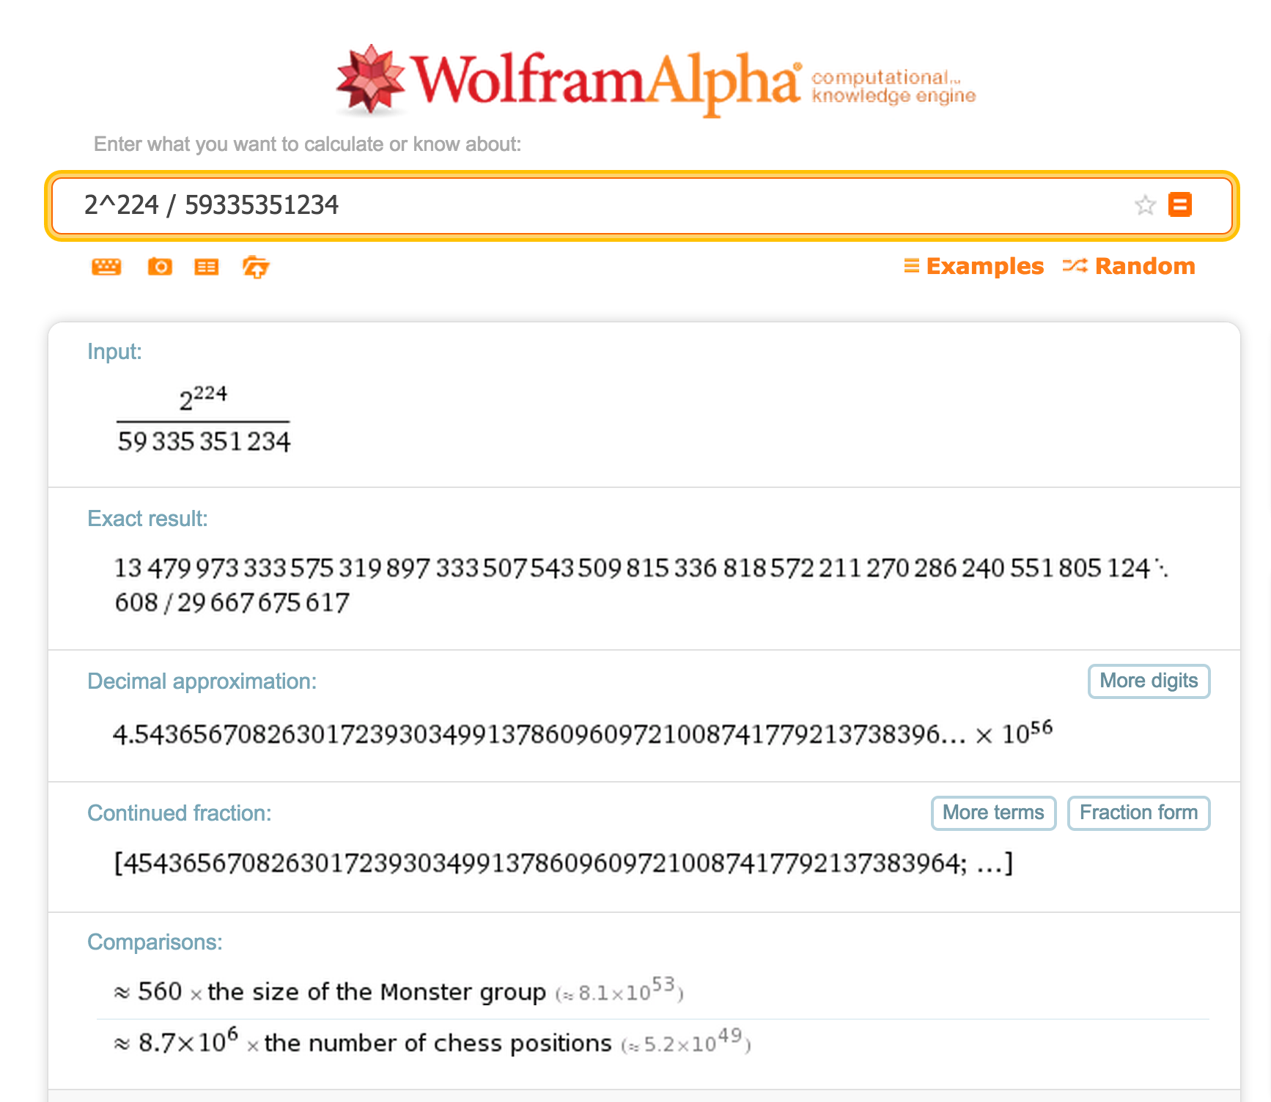

Slide 25
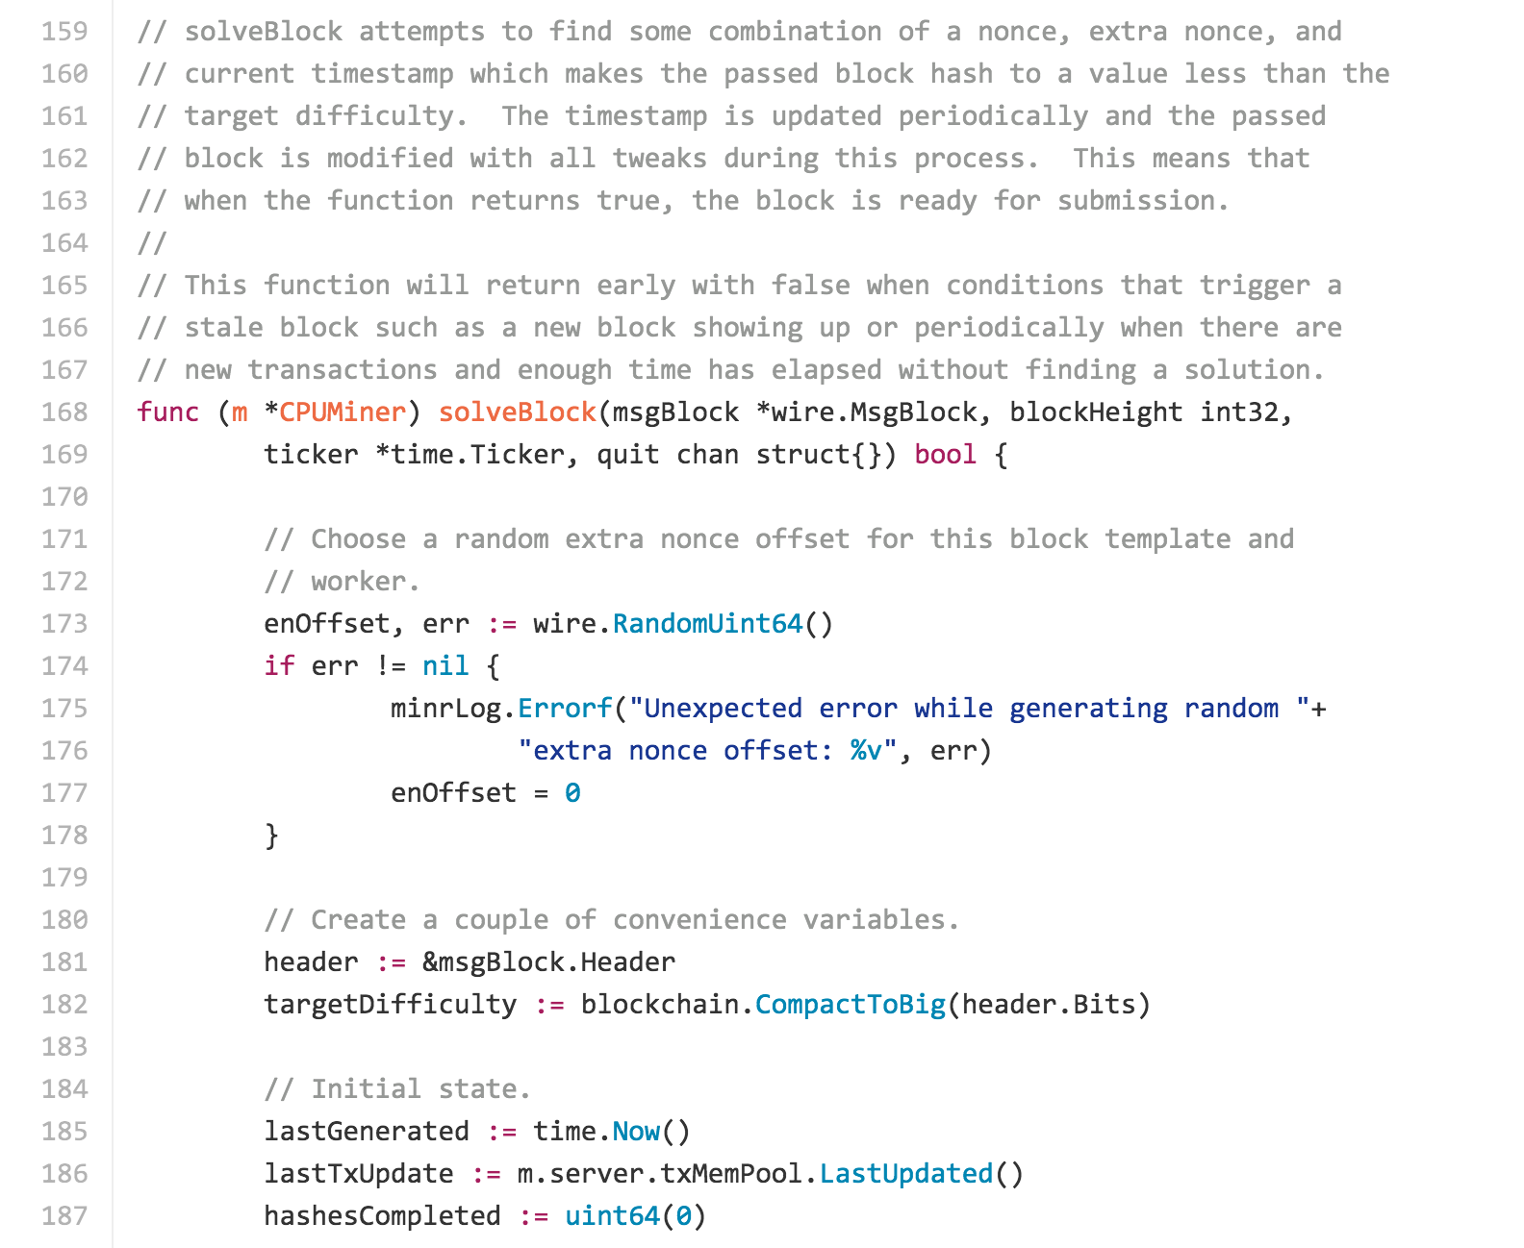
https://github.com/btcsuite/btcd/blob/master/cpuminer.go

Slide 26
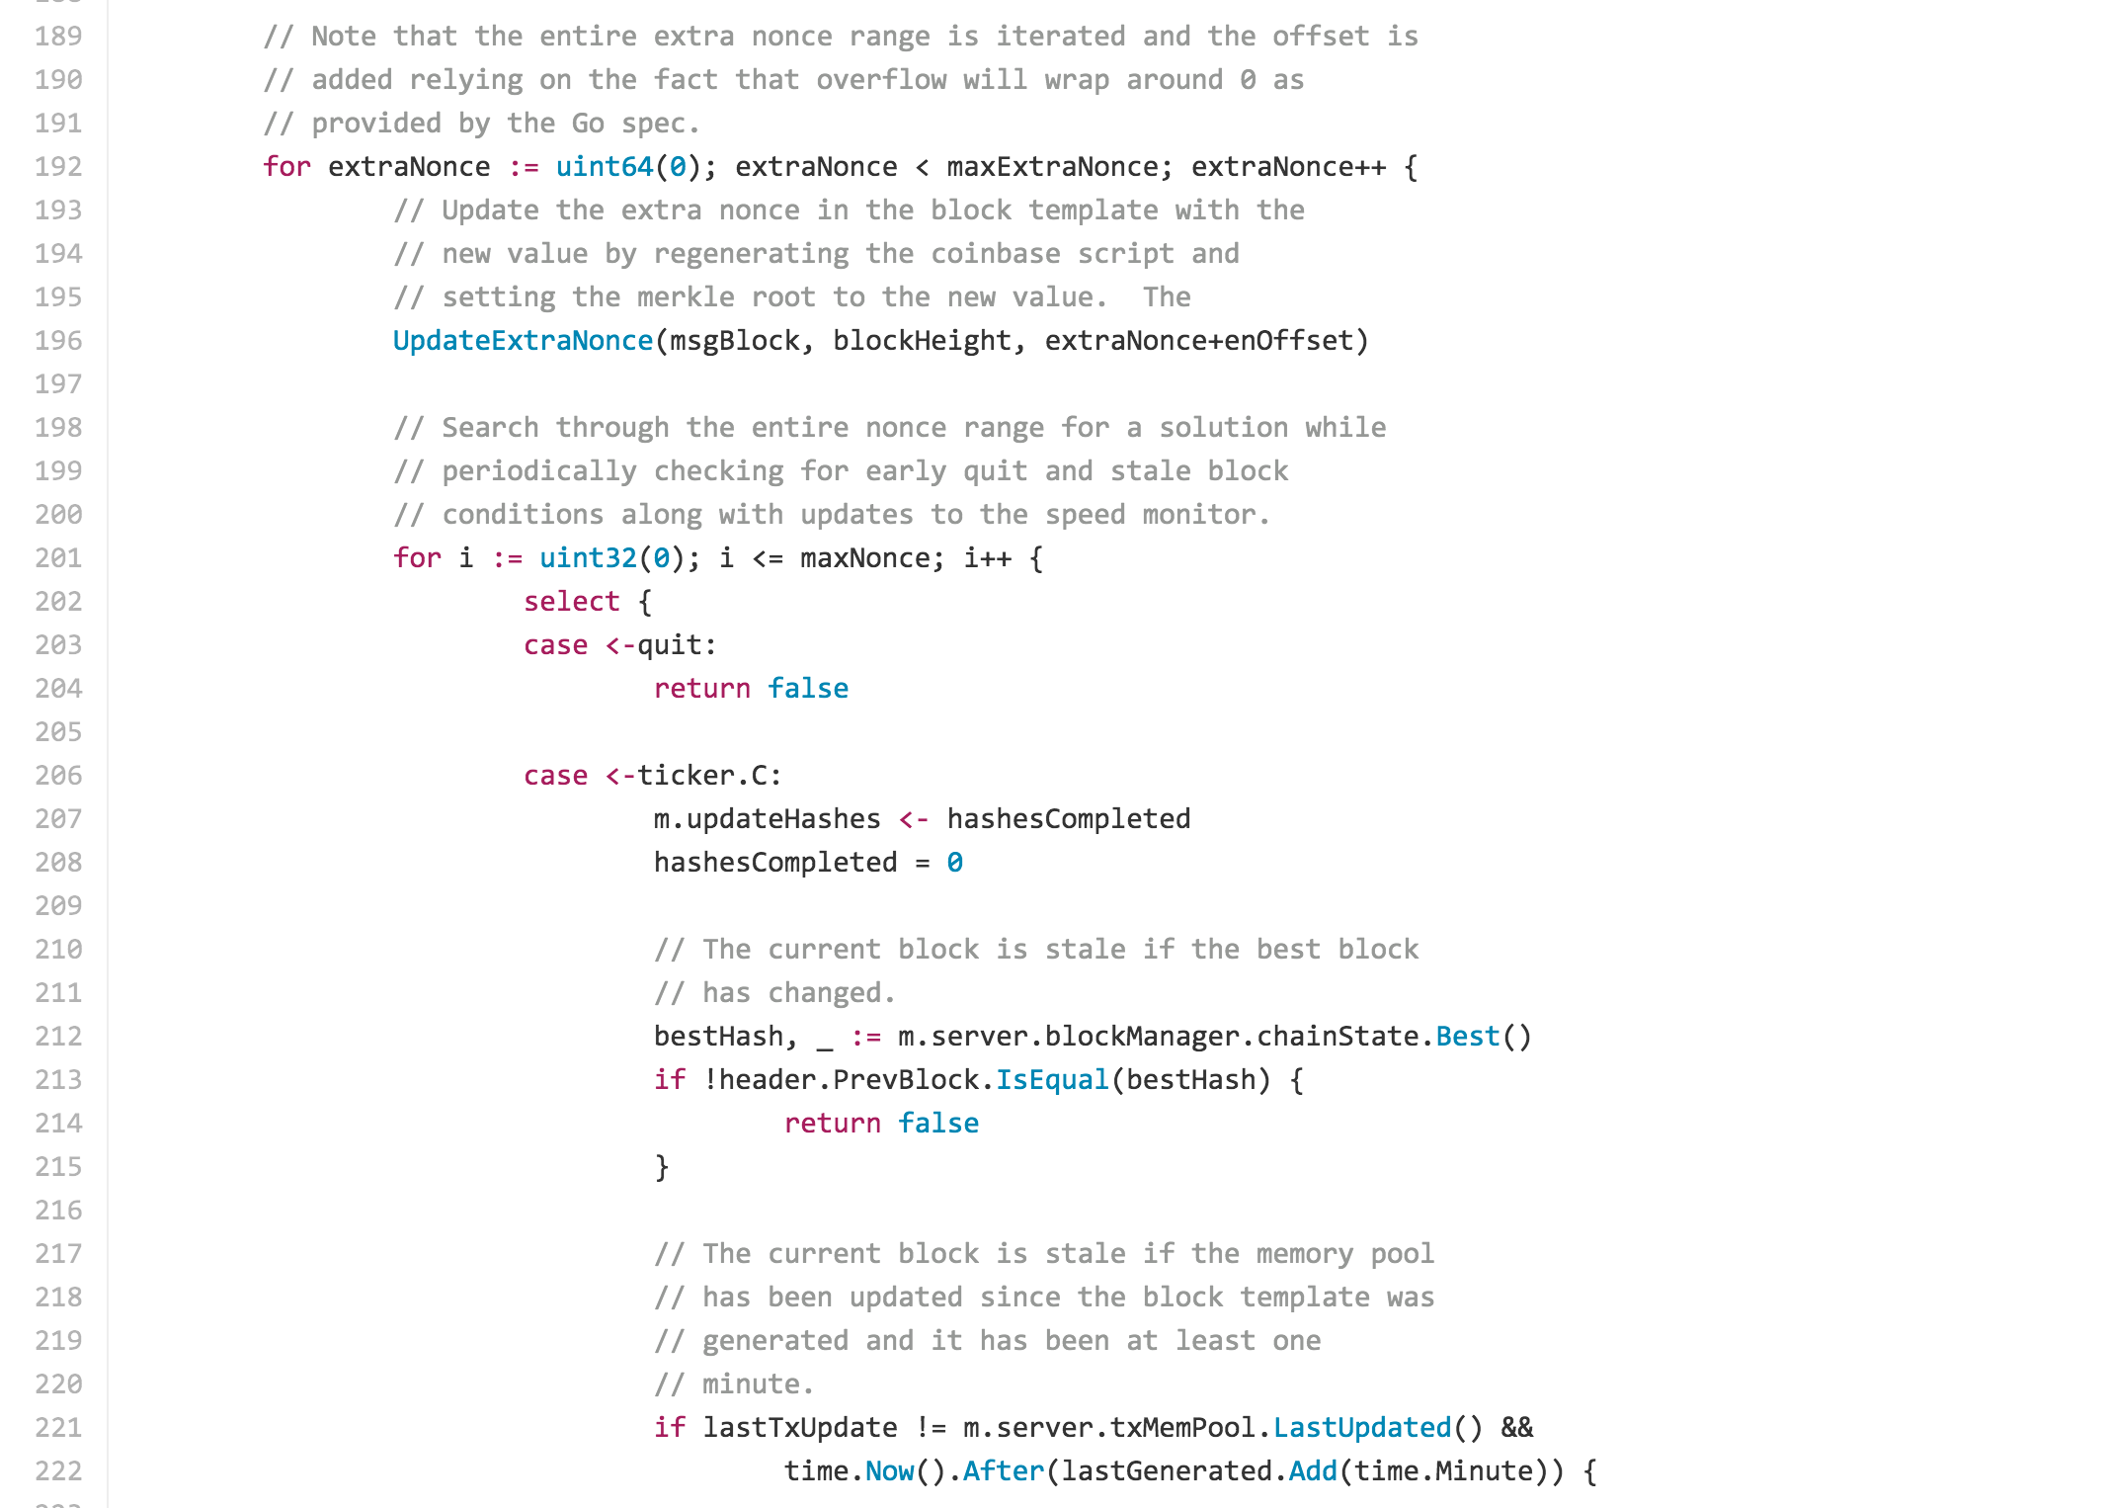

Slide 27
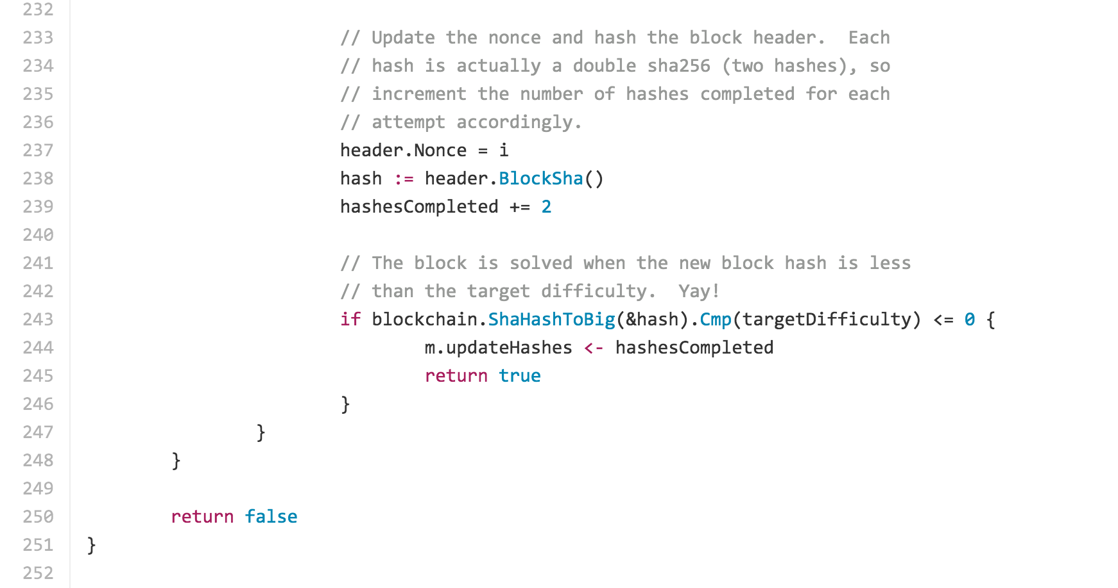

Slide 28
Free Money?
>>> difficulty = 59335351234
>>> target = 2 ** 224 / difficulty
>>> success_probability = target / 2**256
3.9239785189045e-21
>>> expected_hashes = 1 / success_probability
2.5484339304670328e+20
>>> nanos_needed = expected_hashes * 760
>>> seconds_needed = nanos_needed / 10**9
>>> years = seconds_needed / (60 * 60 * 24 * 365)
6141583.546280267
>>> years * 2
12283167.092560533
Expect to mine one block in 12M years (assuming no increase in difficulty!)

Slide 29
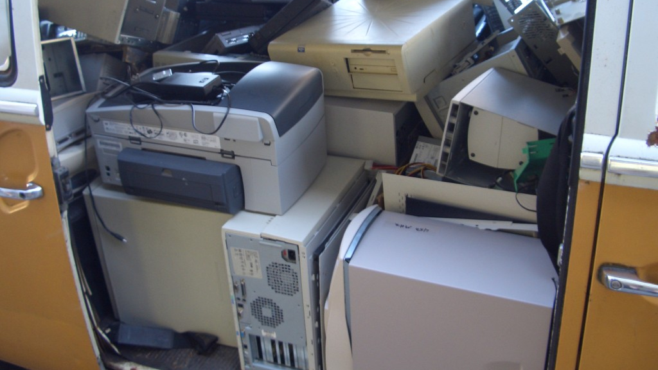
Why are computers so useless?

Slide 30
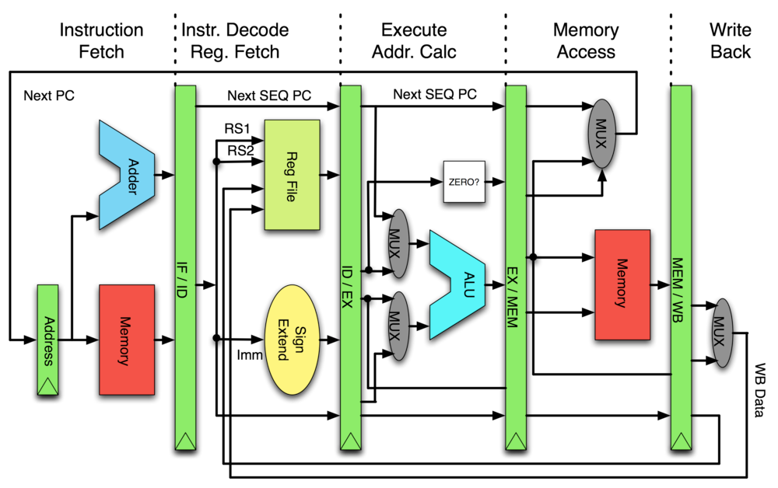
XOR two 32-bit values in CPU

Slide 31
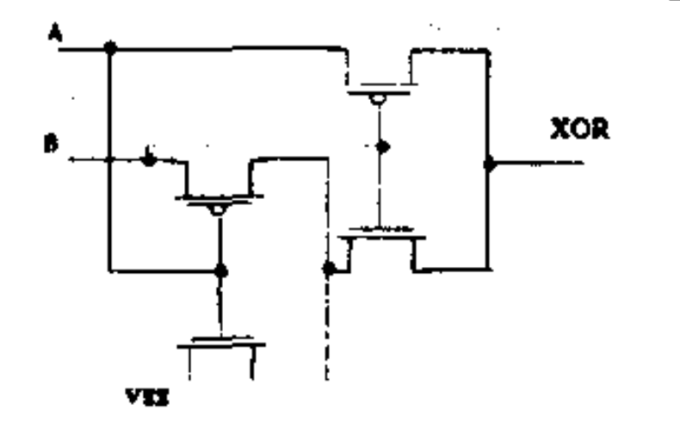
4 transistors XOR design
XOR two 32-bit values in CPU
XOR two 32-bit values in ASIC

Slide 32
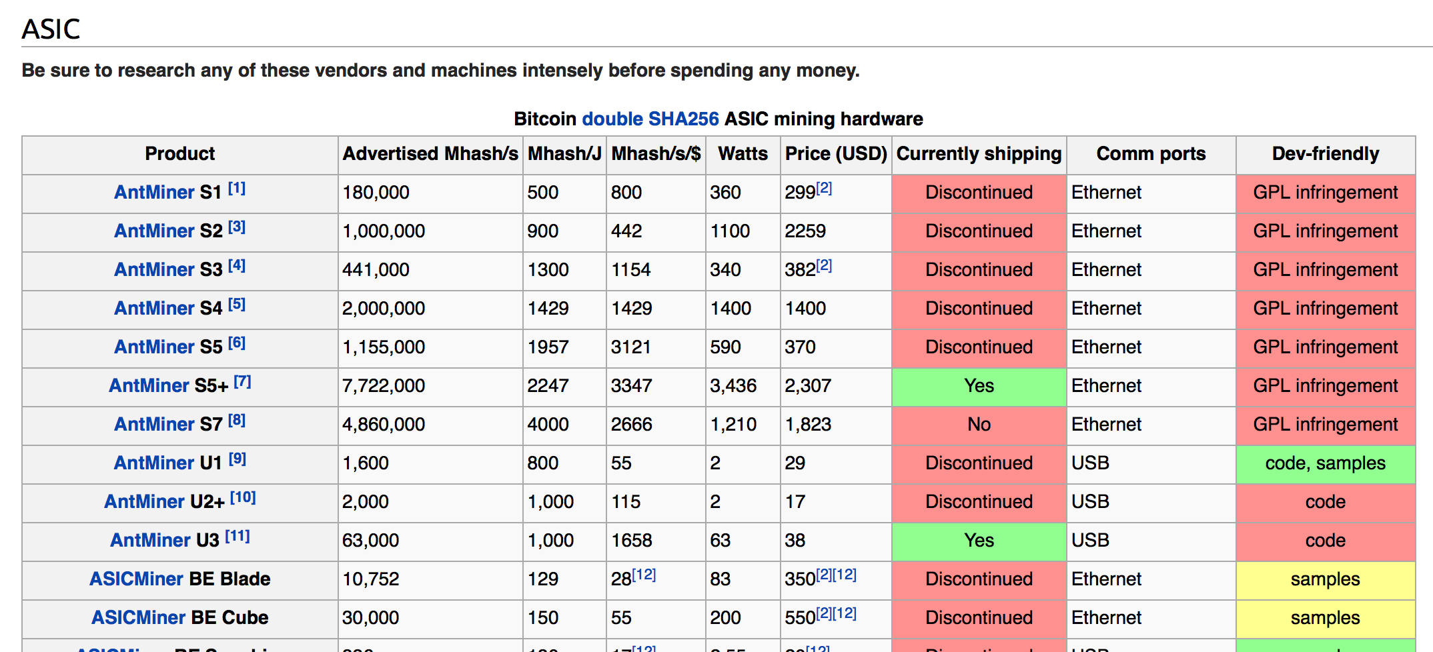
https://en.bitcoin.it/wiki/Mining_hardware_comparison
1J ~ “lift an apple one meter”

Slide 33
Charge
Return PS1:
Red/Pink - full credit
Purple – one major unsatisfactory issue
Blue – major problems or incomplete
Checkup 2 is Wednesday
covers all readings
classes 1-8, PS1
discussion of Checkup 1

