Slide 1
Class 20:
Hidden Services,
Zero Knowledge
Cryptocurrency Cabal
cs4501 Fall 2015
David Evans and Samee Zahur
University of Virginia

Slide 2
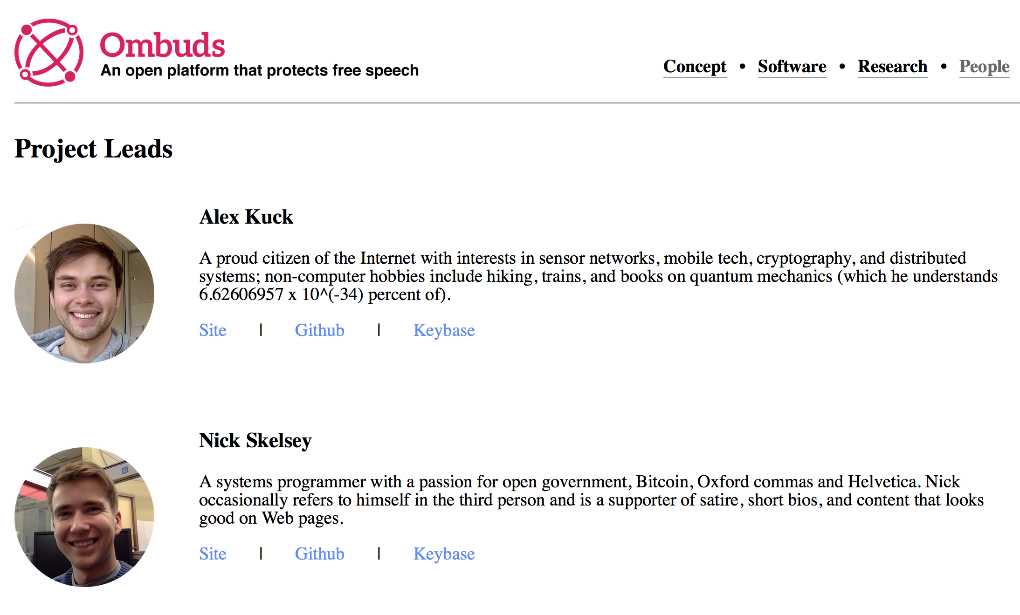
Plan for Today
Monday’s class:
Hidden Services using Tor
Zero Knowledge
(today and next Weds)
PS3 is Due Sunday, 8:29pm
Office Hours:
After class today: Samee (Rice 442)
Thursday, 2:30-3:30: Dave (Rice 507)

Slide 3
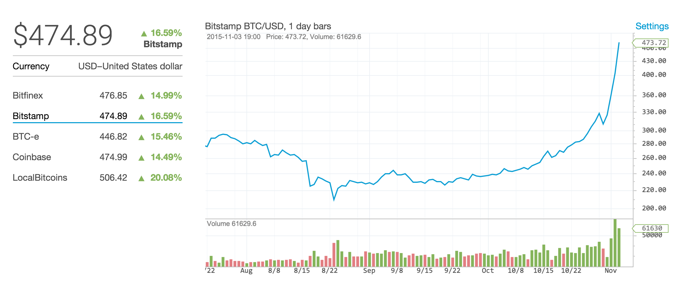
What’s going on!???!?
August 26, 2015
BTC: $225

Slide 4
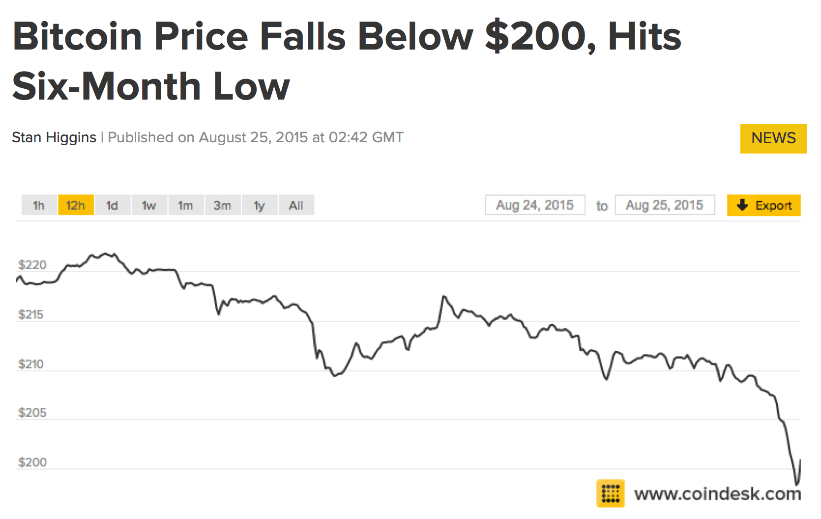
(Day before class started)

Slide 5
(Day before class started)

Slide 6
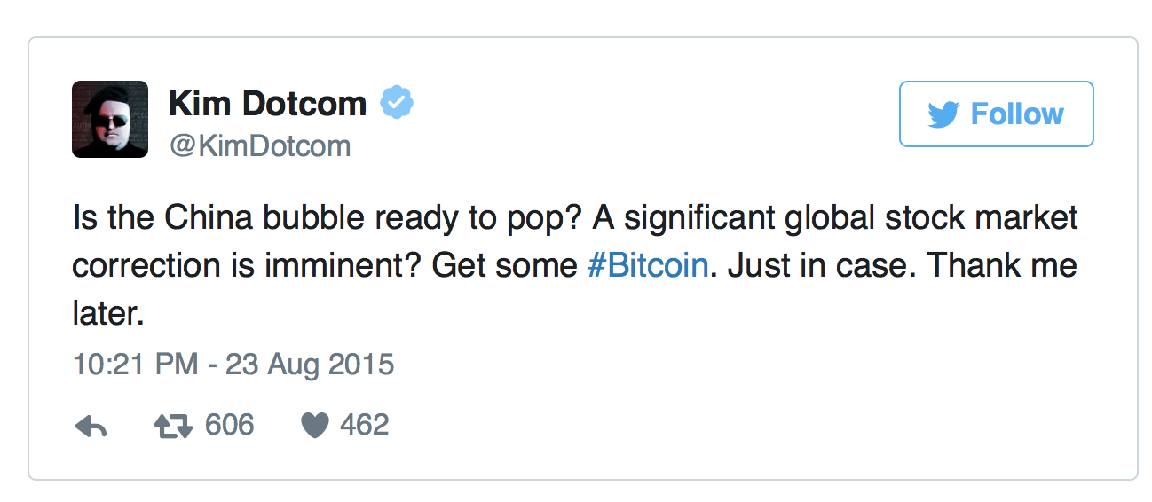
(Day before class started)

Slide 7
Why the big increase?

Slide 8
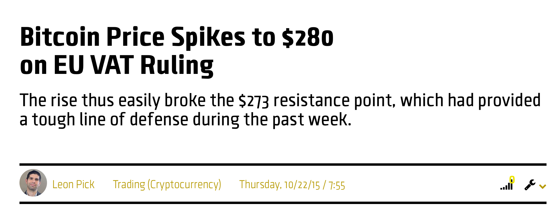
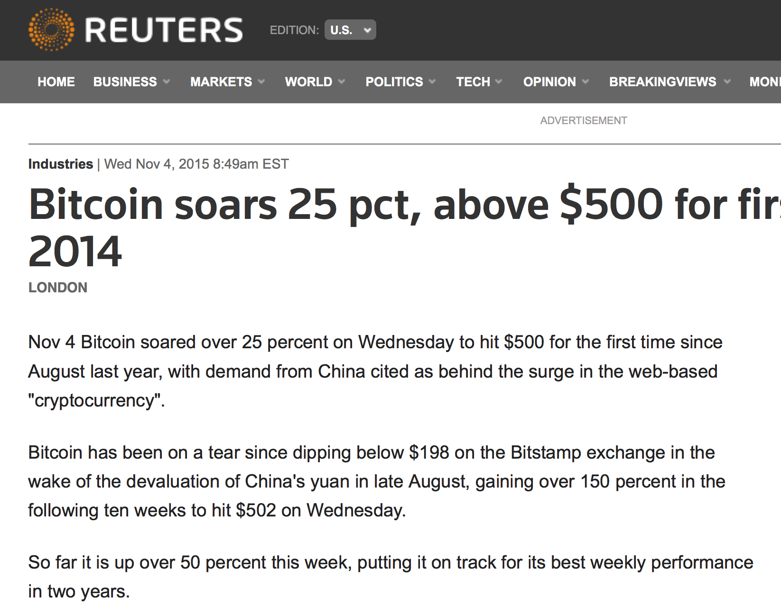
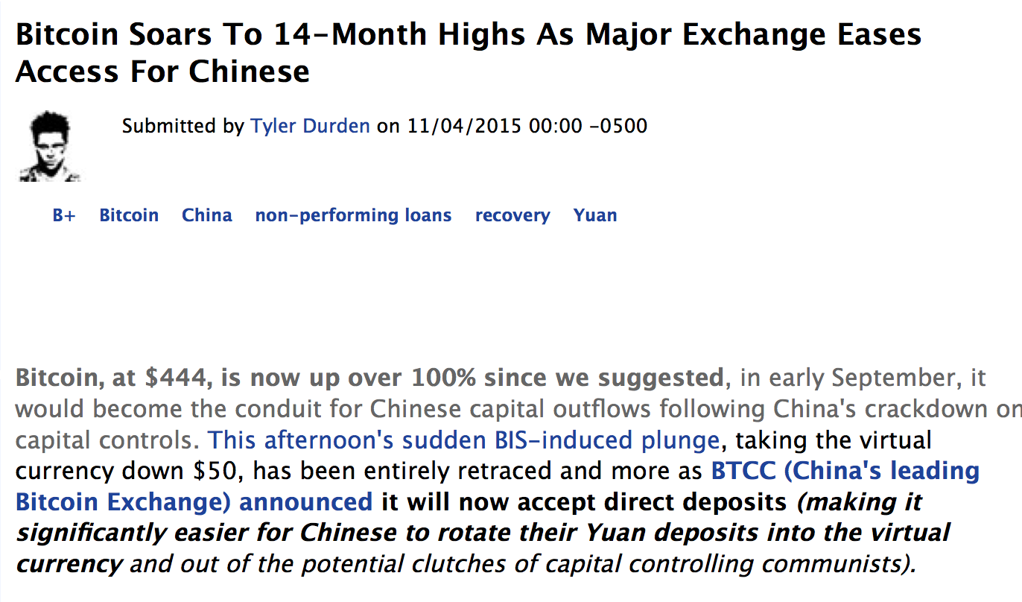

Slide 9
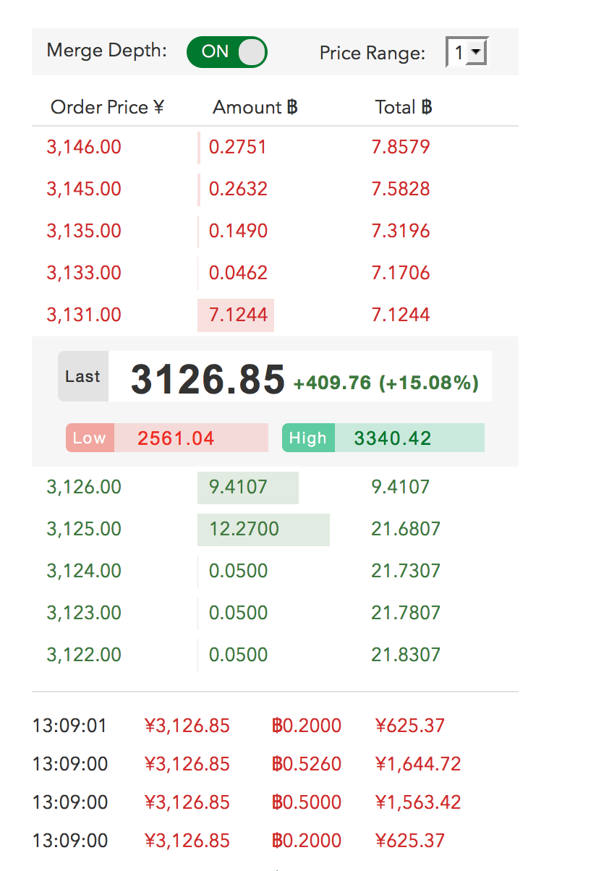

Slide 10
Anonymous Communication
Node A
Server
Client
Node C
Node B

Slide 12
address = first 10 bytes of H(public)
Generate key pair
silkroadvb5piz3r.onion
facebookcorewwwi.onion
private
public

Slide 13
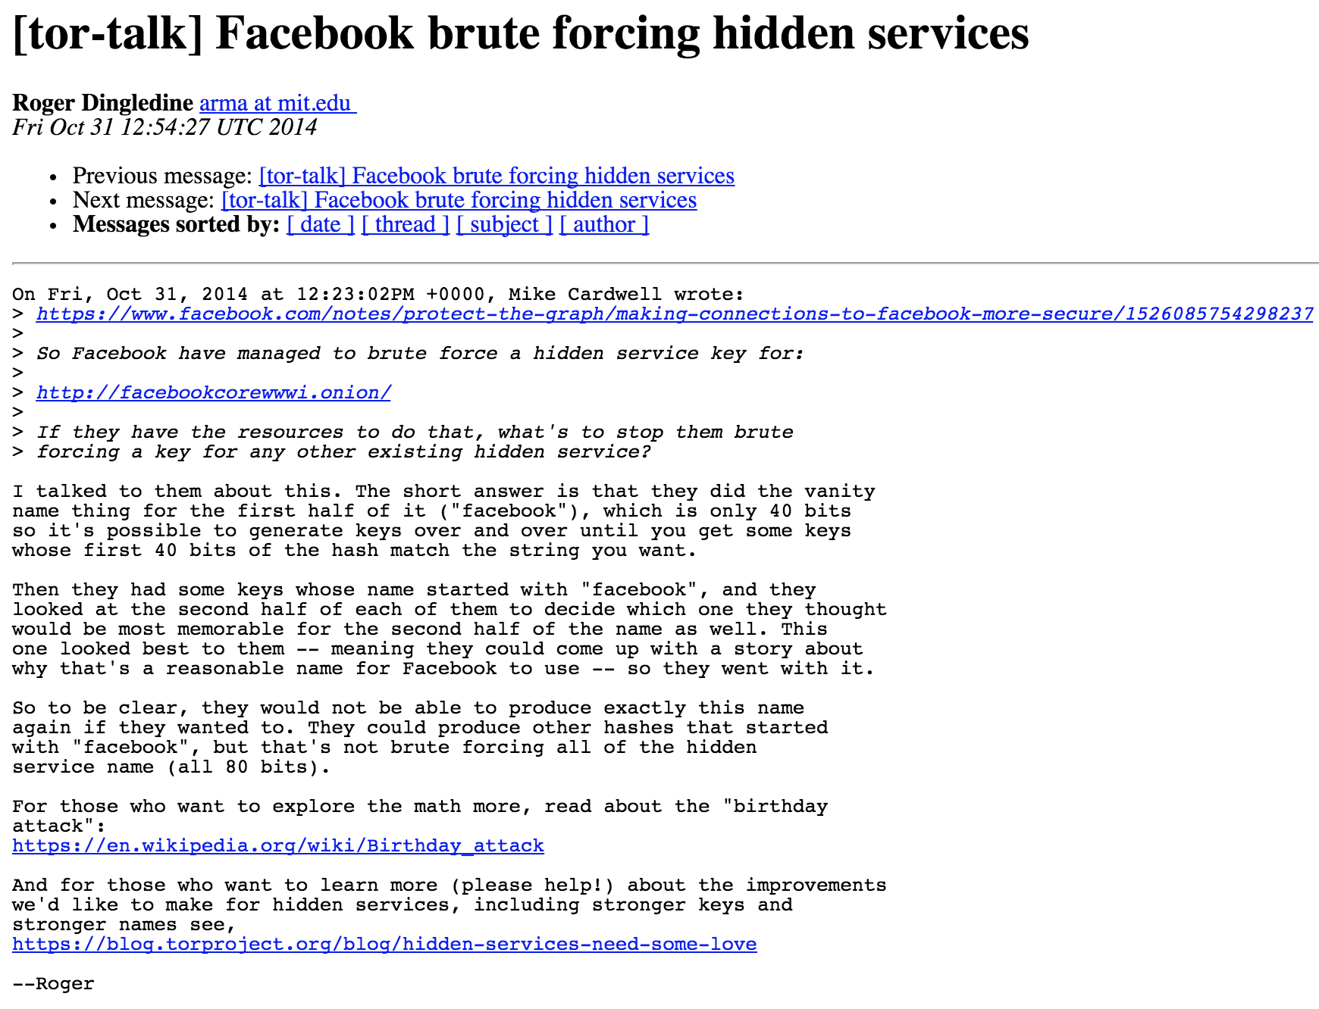
address = first 10 bytes of H(public)
Generate key pair
silkroadvb5piz3r.onion
facebookcorewwwi.onion
private
public

Slide 14
Hidden Server
2
Directory Service
Tor Link
Introduction Point (Tor Relay)
1
3
Client

Slide 15
Hidden Server
2
Directory Service
Tor Link
Introduction Point (Tor Relay)
1
3
Client
Rendezvous Point
(selected by Client)
4

Slide 16
Hidden Server
2
Directory Service
Tor Link
Introduction Point (Tor Relay)
1
3
Client
5
Rendezvous Point
(selected by Client)
4

Slide 17
Hidden Server
2
Directory Service
1
Tor Link
Introduction Point (Tor Relay)
3
Client
6
5
Rendezvous Point
(selected by Client)
4

Slide 18
Hidden Server
2
Directory Service
1
Tor Link
Introduction Point (Tor Relay)
3
Client
6
5
channel between client and server,
both only learn Rendezvous Point IP
4
Rendezvous Point
(selected by Client)

Slide 19
IEEE Security and Privacy 2006

Slide 20
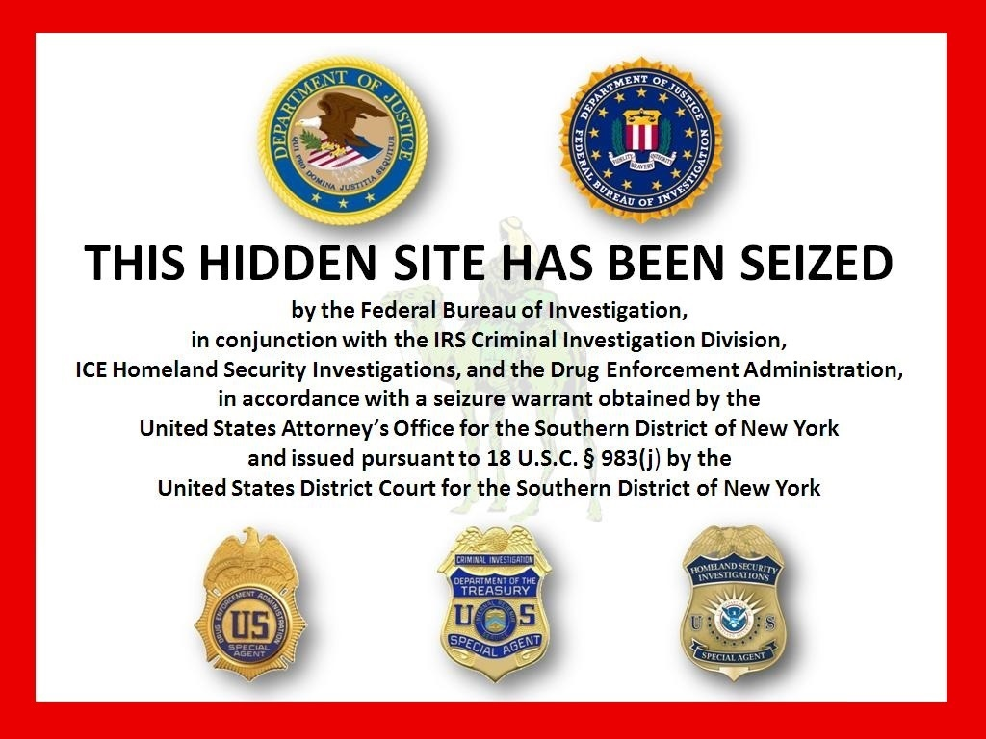
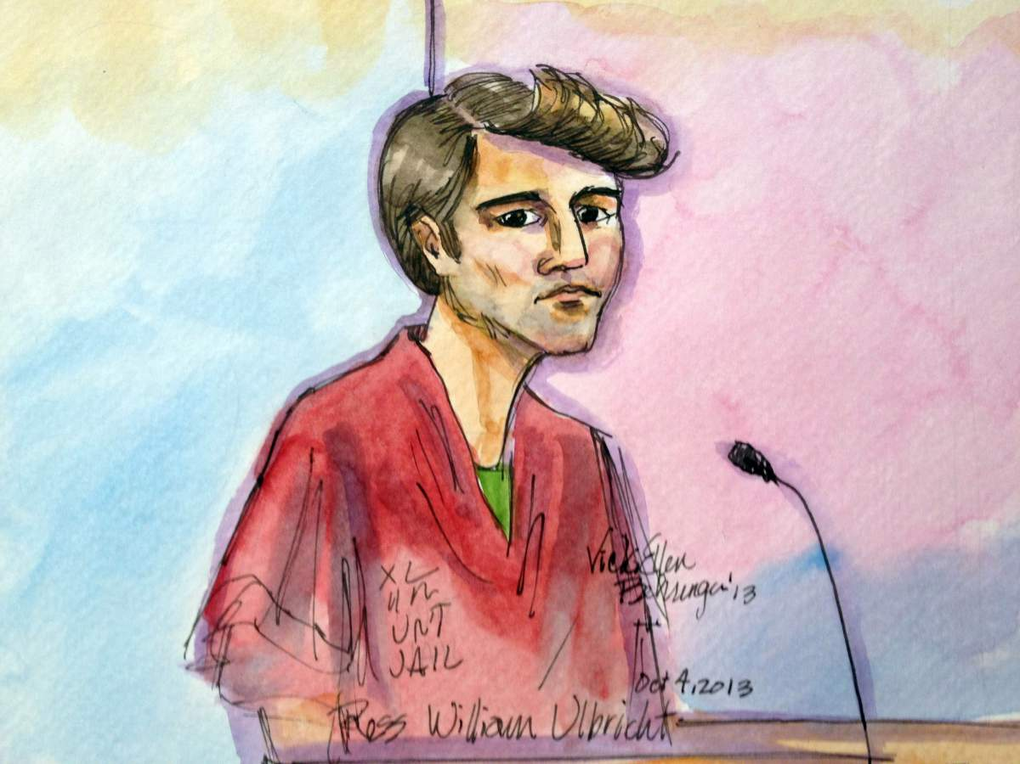
How did the FBI find the Silk Road Server?

Slide 21
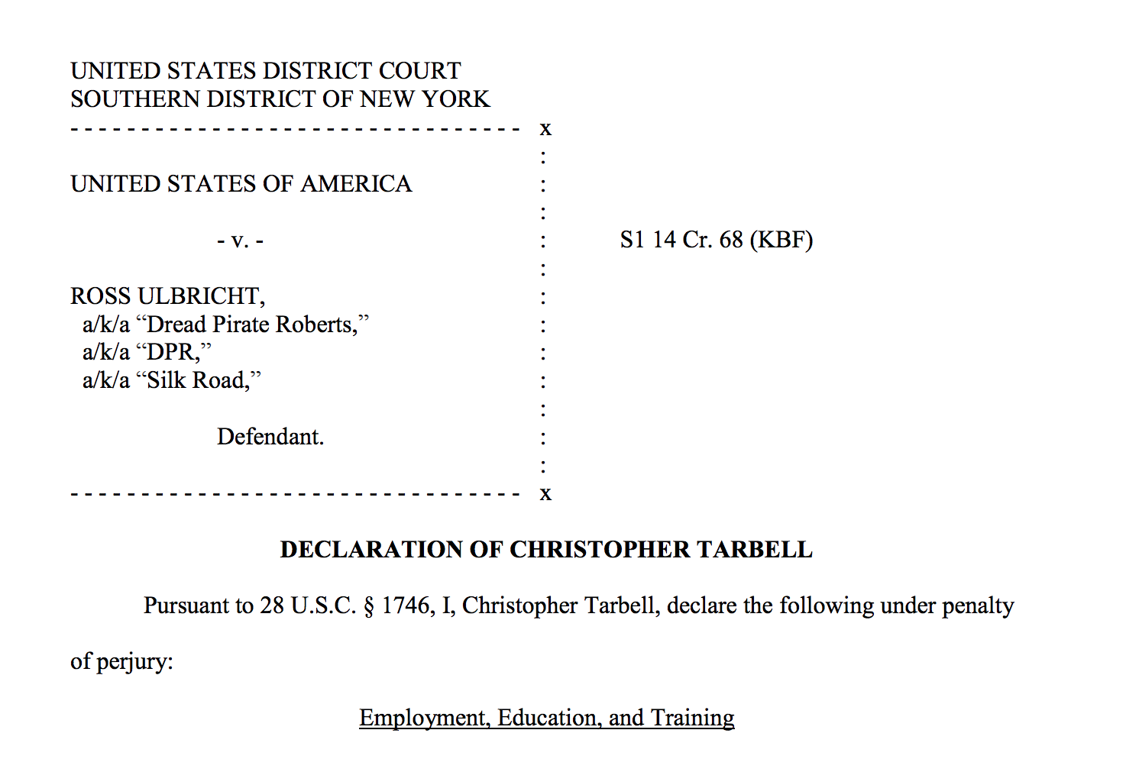

Slide 22
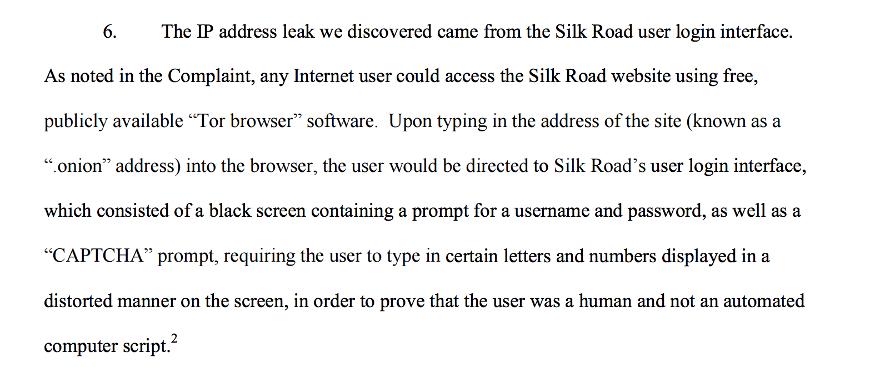
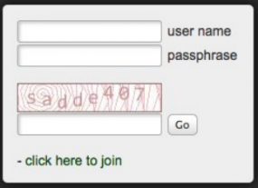

Slide 23
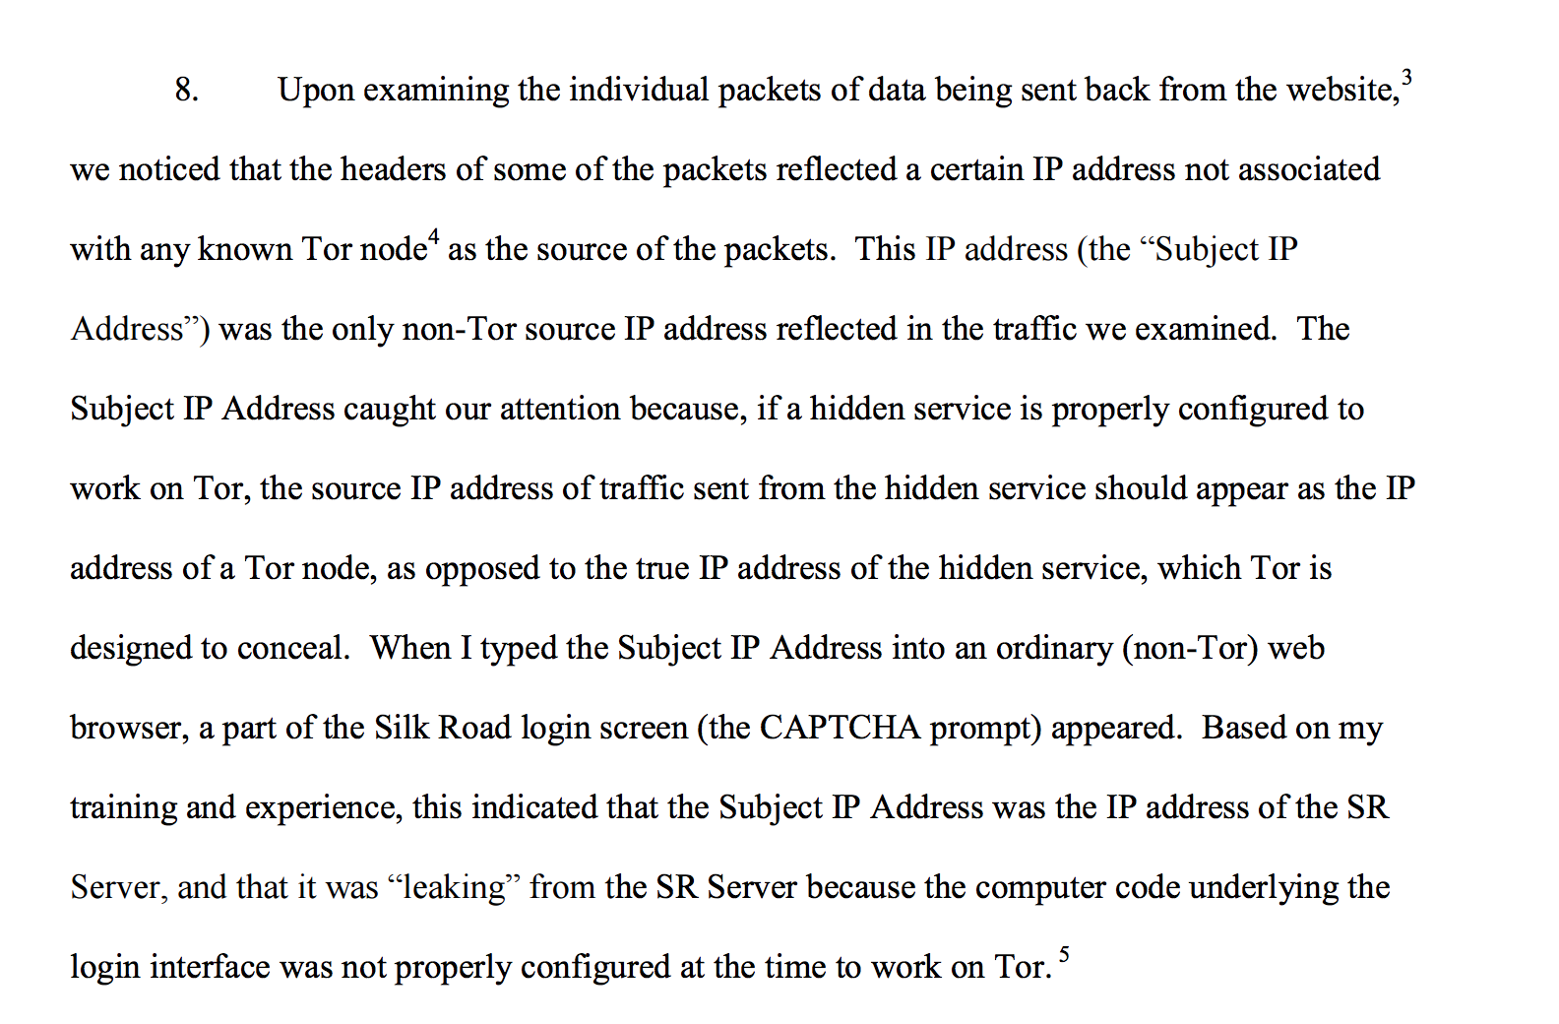

Slide 24
Architecture of Silk Road

Slide 25
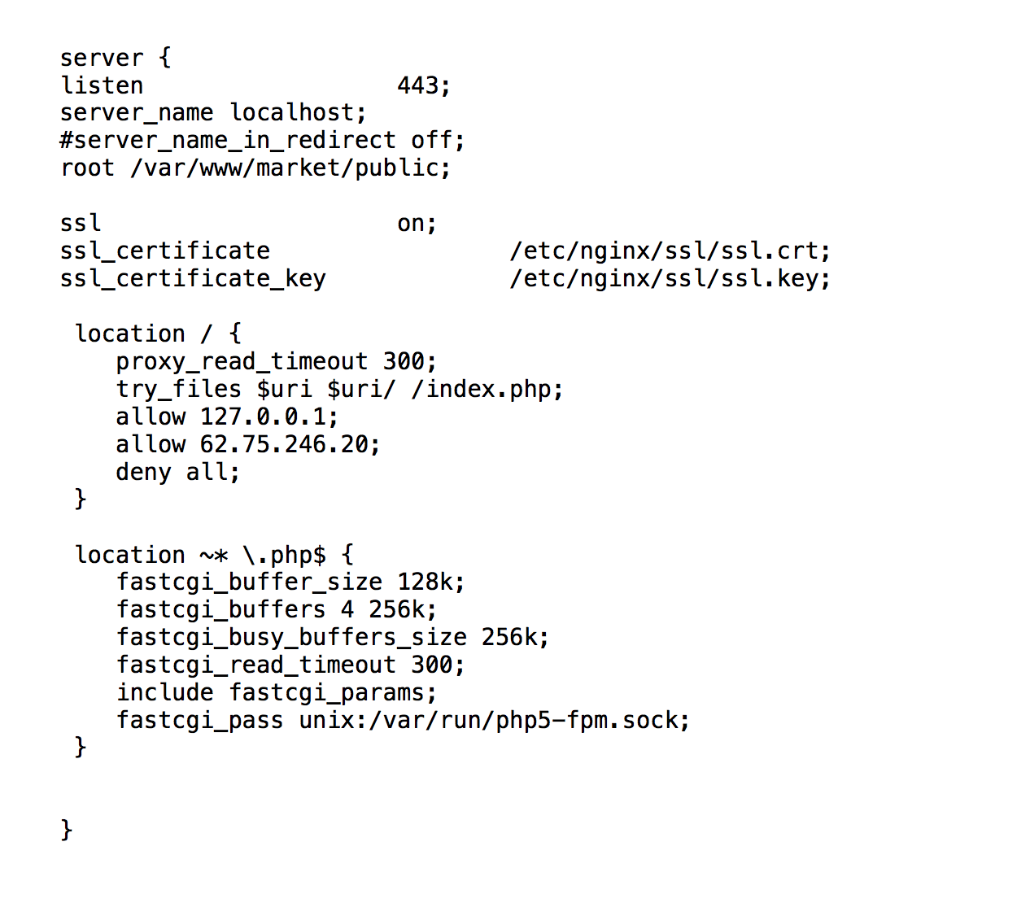
Back end server configuration:
(released by FBI)

Slide 26
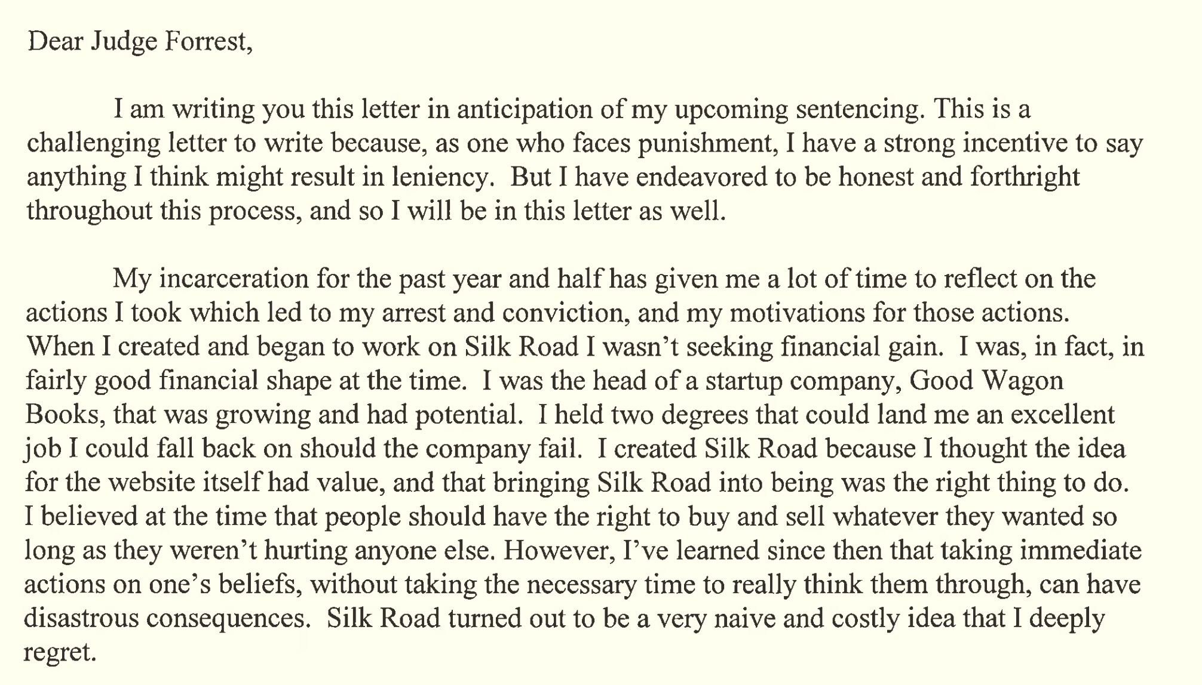
Ross Ulbrict’s sentencing letter

Slide 27
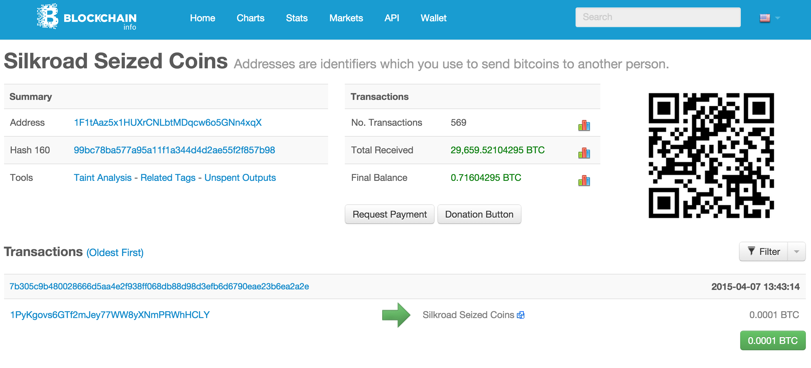
https://blockchain.info/address/1F1tAaz5x1HUXrCNLbtMDqcw6o5GNn4xqX

Slide 28
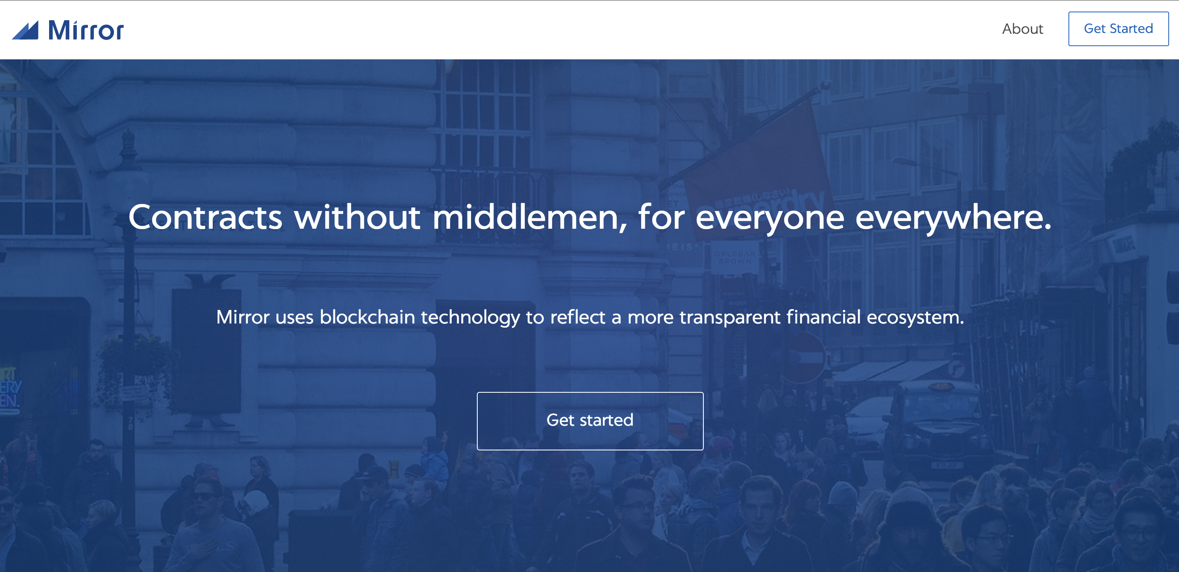
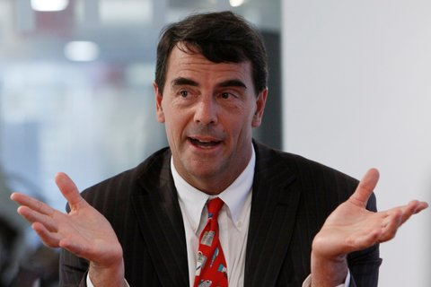
https://blockchain.info/address/1F1tAaz5x1HUXrCNLbtMDqcw6o5GNn4xqX
Tim Draper (VC) ~$19M?

Slide 29
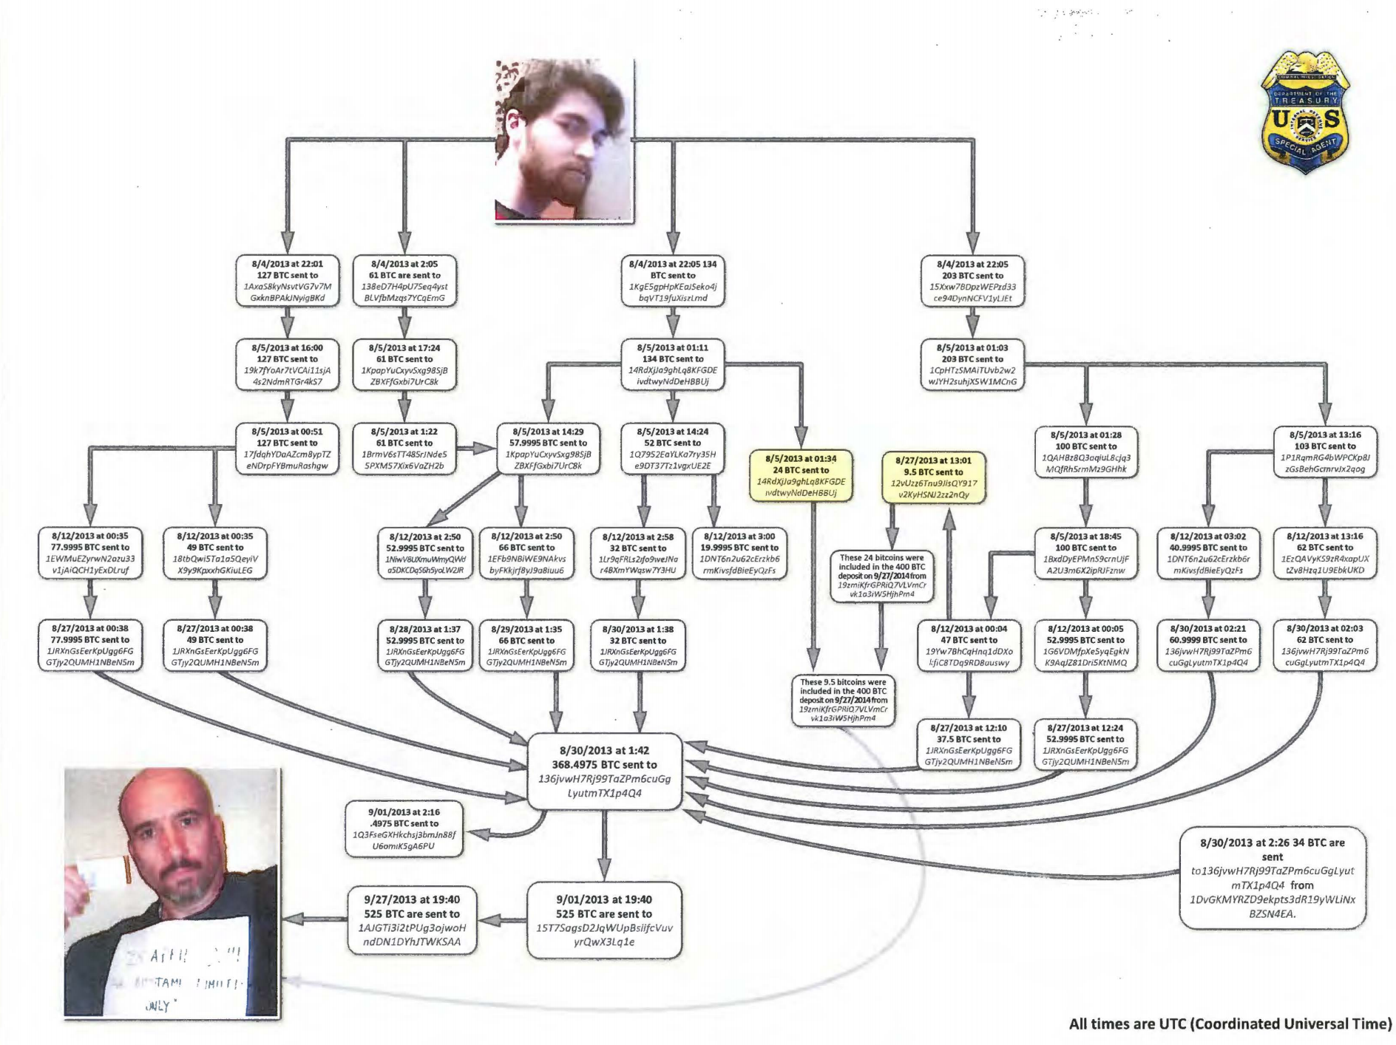
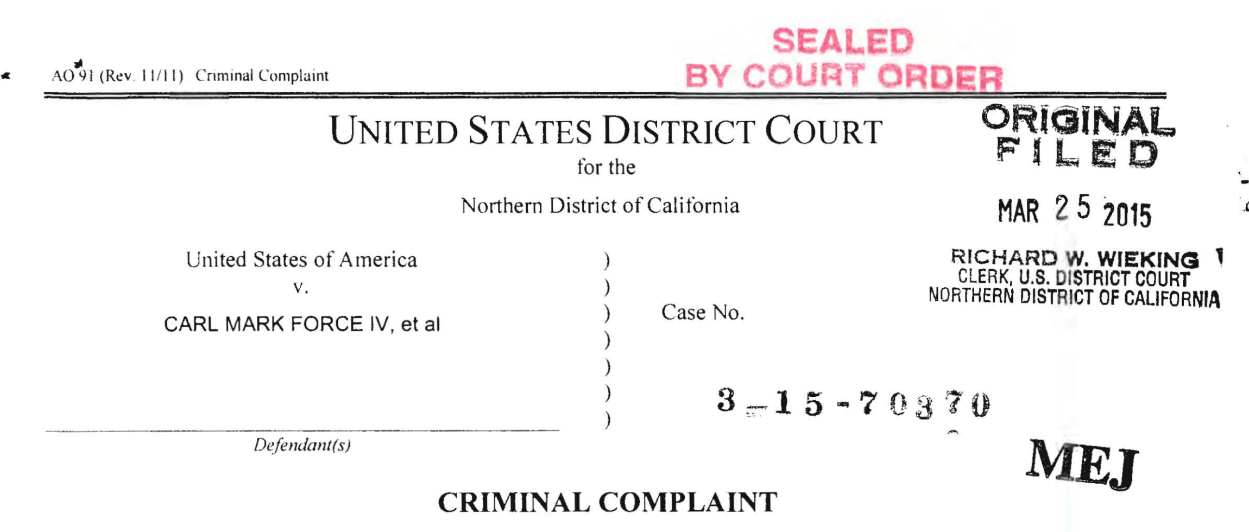
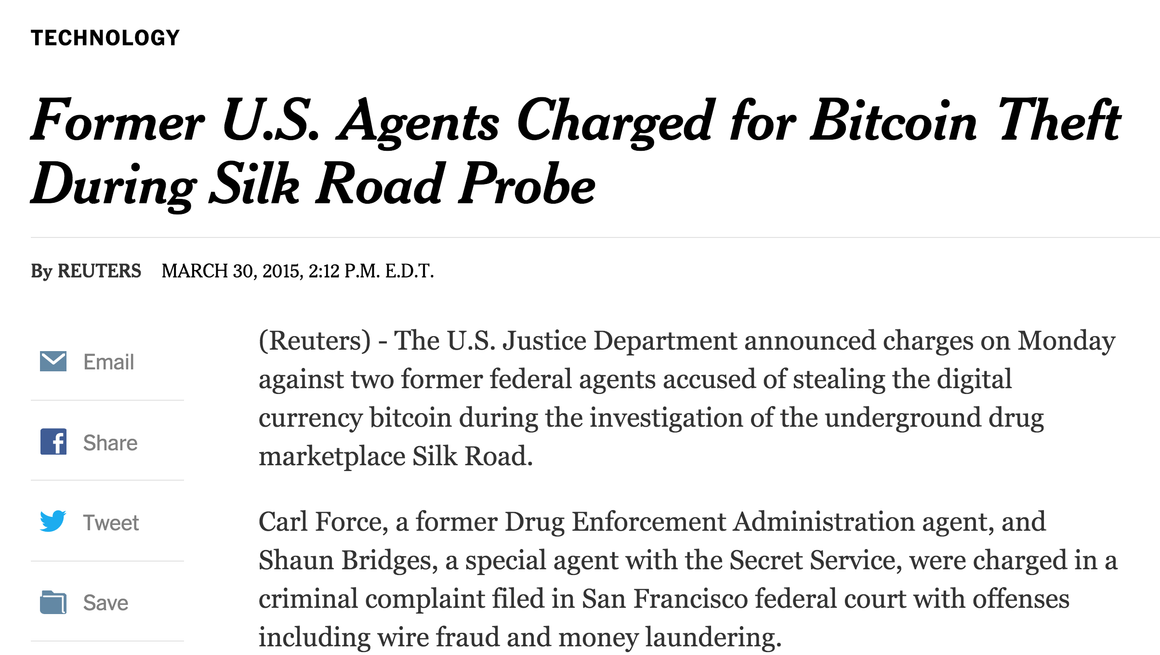
Exhibit B
Life in Prison
78 months

Slide 30
Zero Knowledge

Slide 31
Charge
Problem Set 3 due Sunday
Upcoming office hours:
Now: 3:30-4:30pm (Samee, Rice 442)
Thursday: 2:30-3:30pm (Dave, Rice 507)

