Slide 1
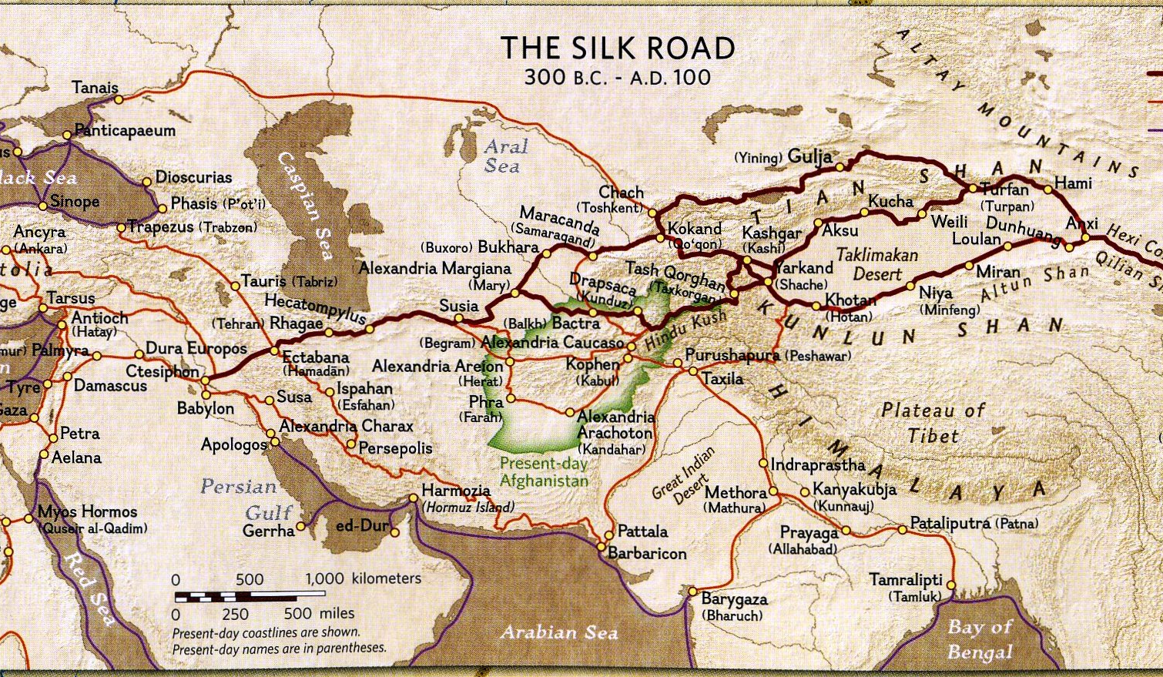
Class 19:
Anonymity in Bitcoin
Cryptocurrency Cabal
cs4501 Fall 2015
David Evans and Samee Zahur
University of Virginia

Slide 2
What is anonymity?
anonymous
pseudonymous
unlinkable

Slide 3
Unlinkability of Bitcoin Transactions
If Alice conducts two bitcoin transactions using different bitcoin addresses (“pseudonyms”), how hard is it for those transactions to be linked?

Slide 4
Linking Transactions
https://blockchain.info/tx/0197dabc3c31c8221b5d7883a9d03240bcf7a3042e1bf6dcc26c8d3aa60c58ab

Slide 5
Confounding Transaction Tracers
"CoinJoinExample" by MARIODOESBREAKFAST - Image drawn for CoinJoin article. Licensed under CC BY-SA 3.0 via Wikipedia - https://en.wikipedia.org/wiki/File:CoinJoinExample.svg#/media/File:CoinJoinExample.svg

Slide 6
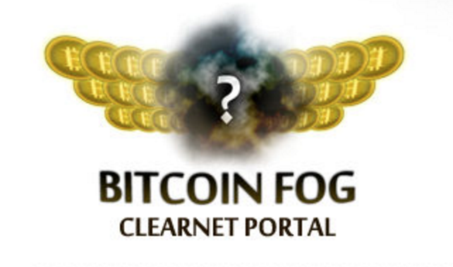
Mixers

Slide 7
Mixer Design

Slide 8
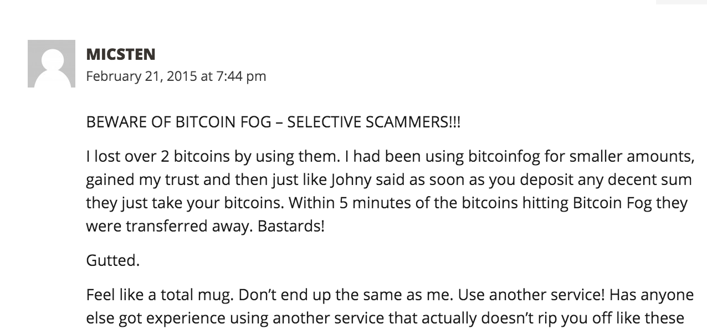

Slide 9
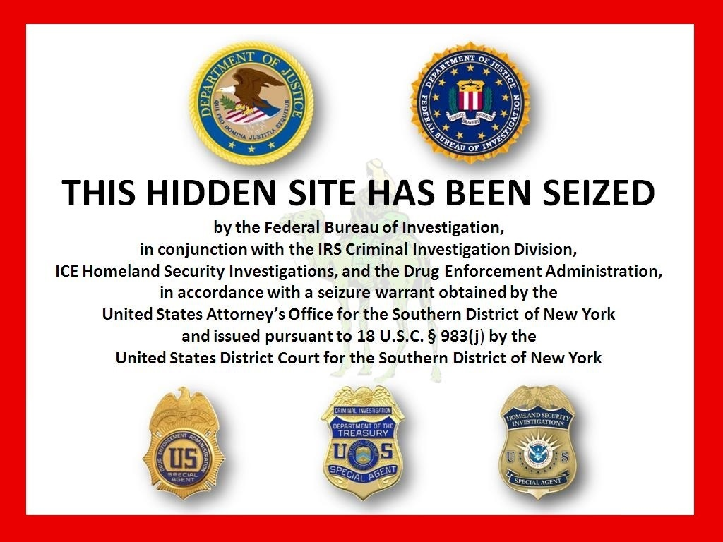
Silk Road

Slide 10
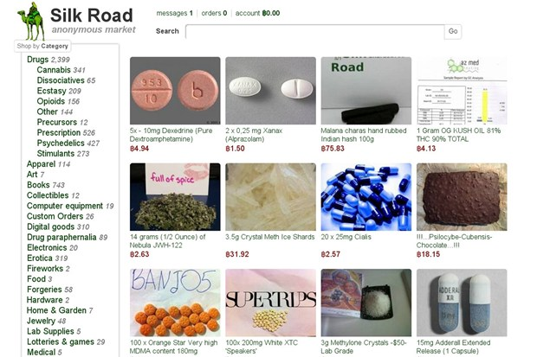

Slide 11
Illegal drugs are illegal and can rot your brain and destroy your (and others) lives!

Slide 12
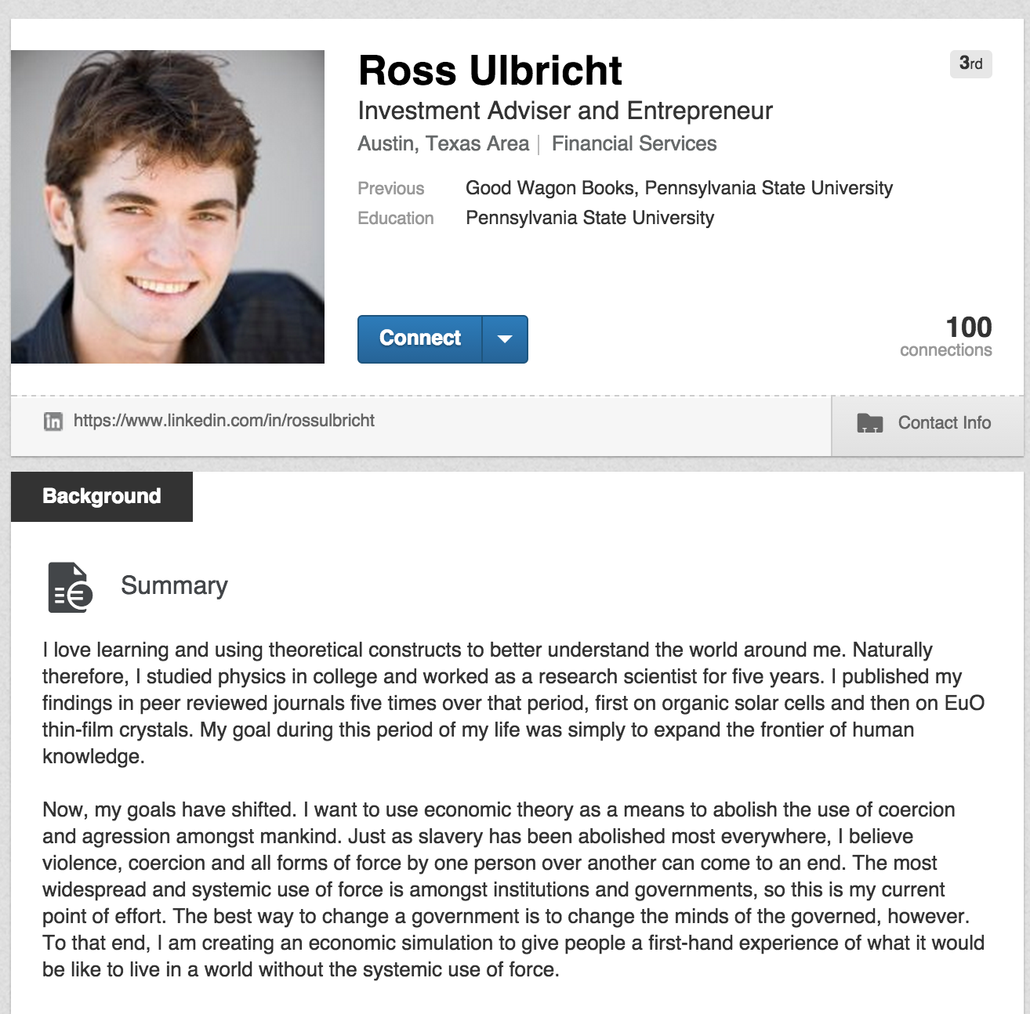
This is current!
https://www.linkedin.com/in/rossulbricht
My goal during this period of my life was simply to expand the frontier of human knowledge.
Now, my goals have shifted. I want to use economic theory as a means to abolish the use of coercion and agression amongst mankind. … To that end, I am creating an economic simulation to give people a first-hand experience of what it would be like to live in a world without the systemic use of force.

Slide 13
Silk Road Transactions

Slide 14
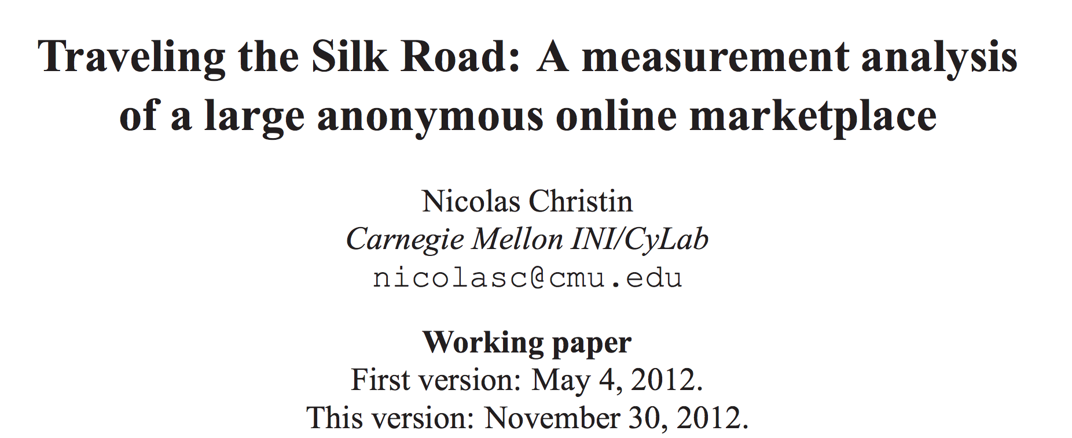
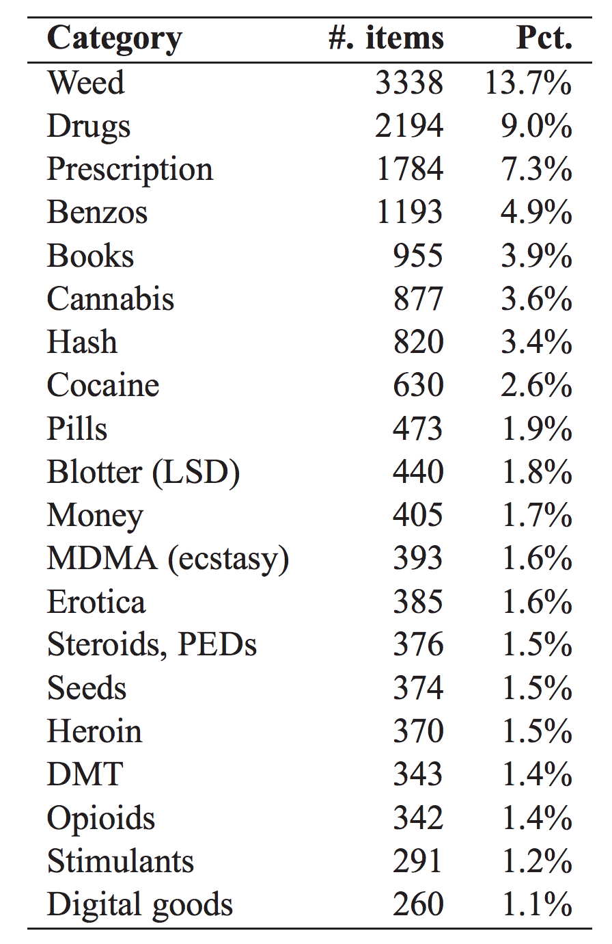

Slide 15
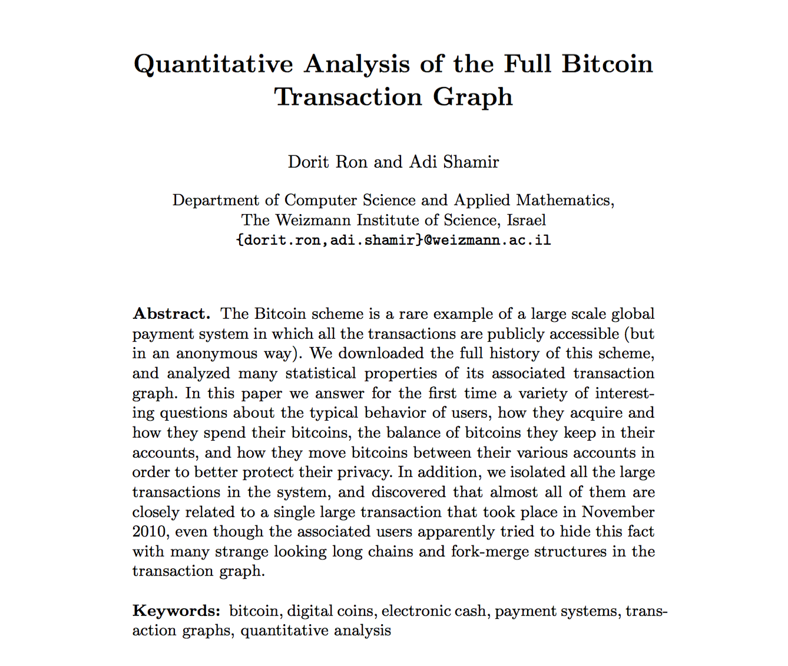

Slide 16
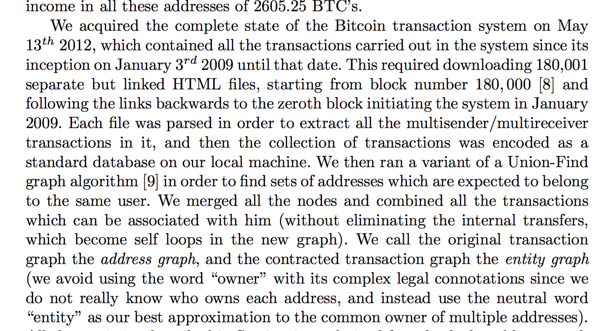

Slide 17
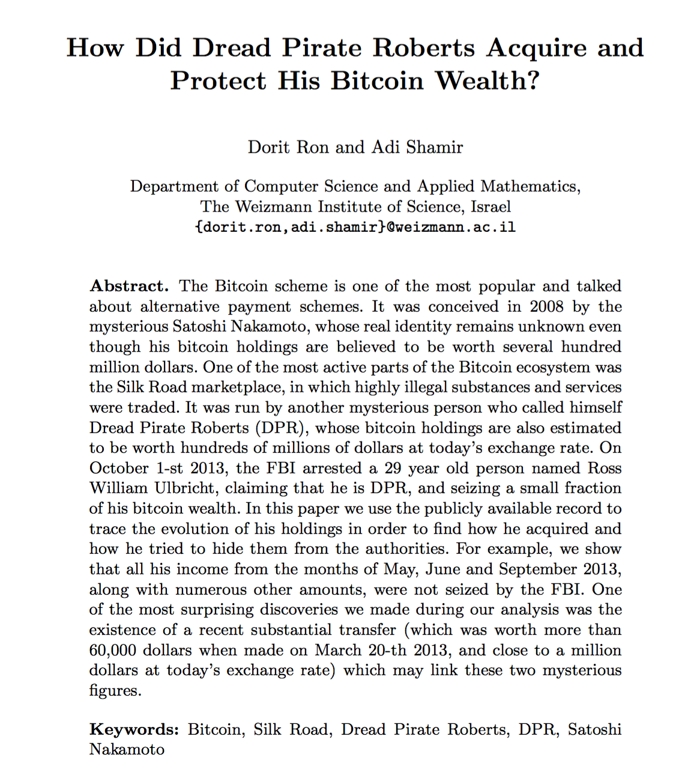

Slide 18
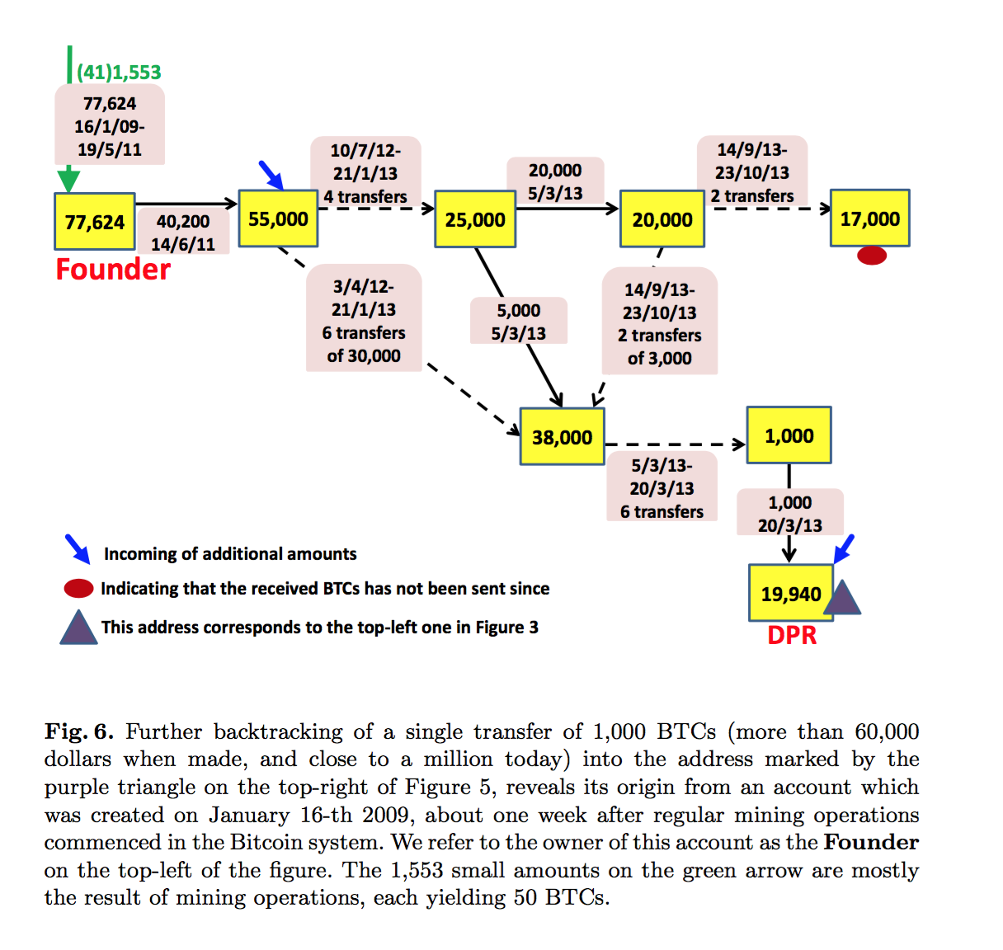

Slide 20
Threats to Validity

Slide 21
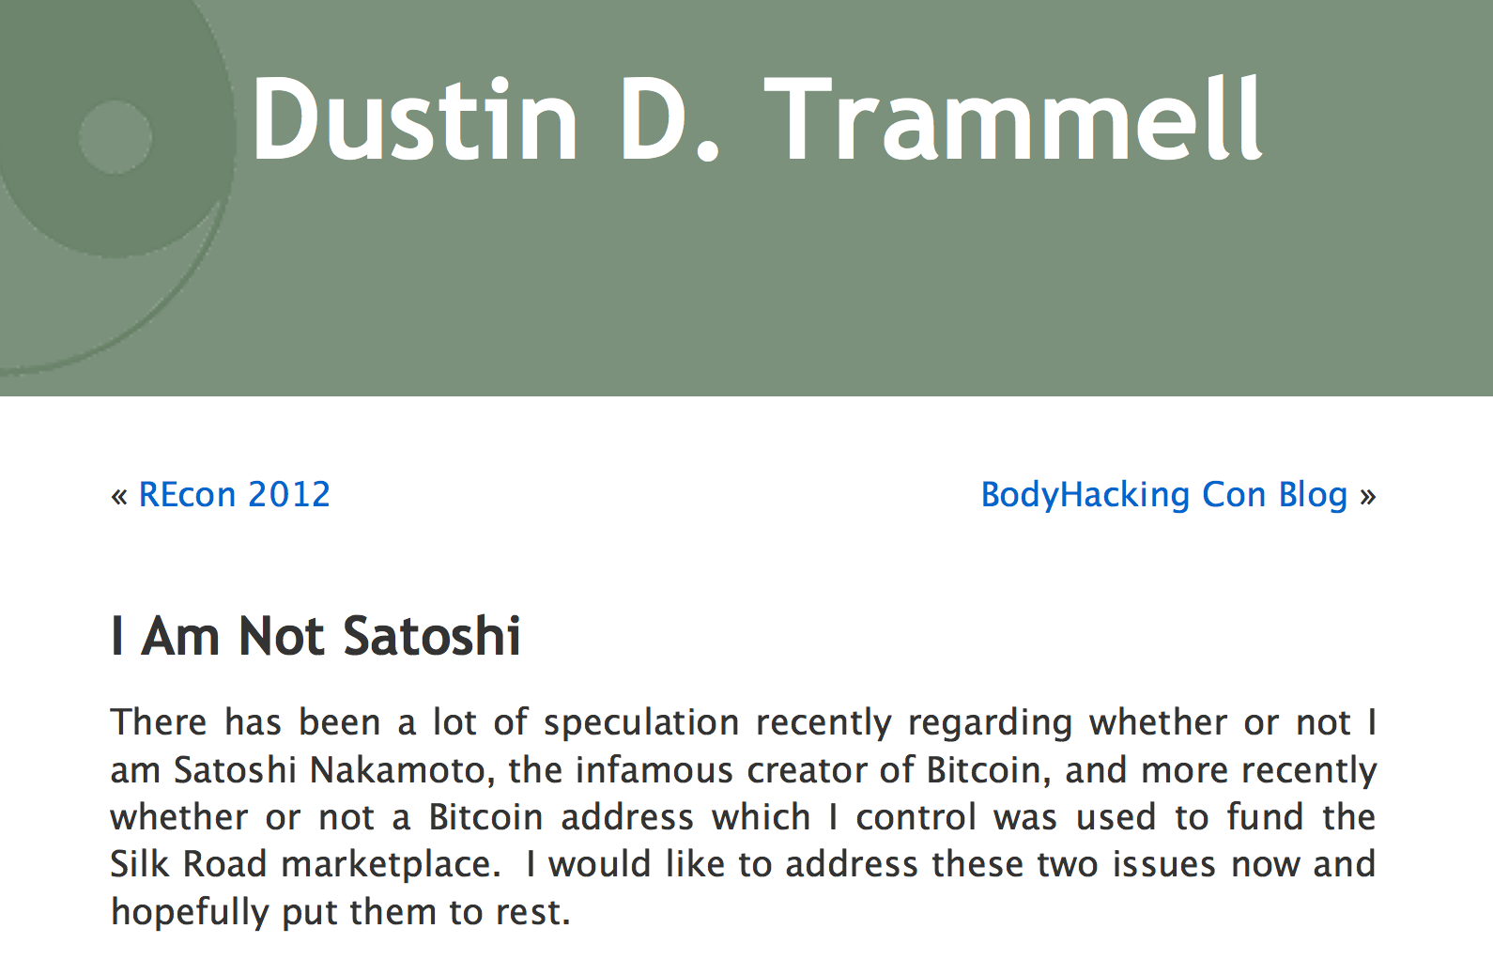
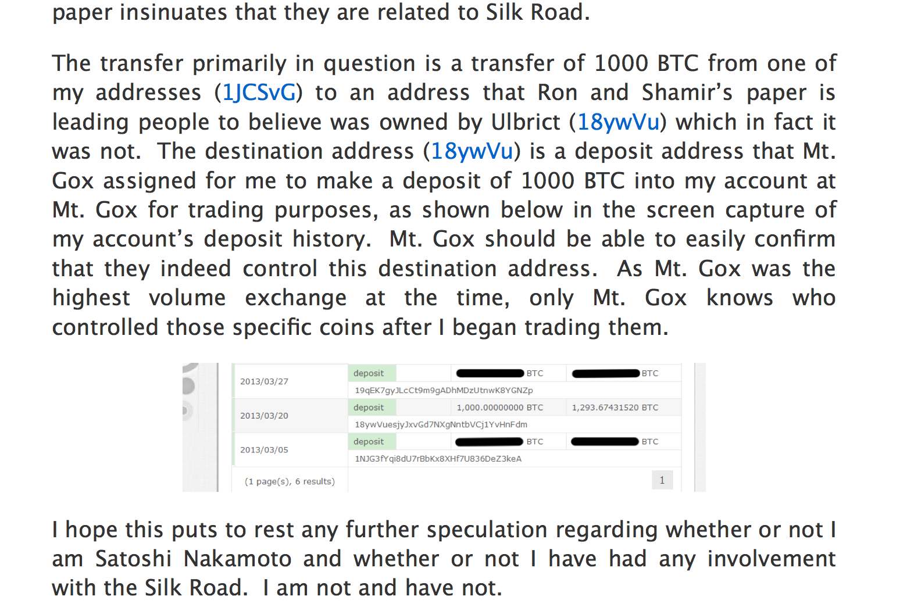

Slide 22
Communication Privacy

Slide 23
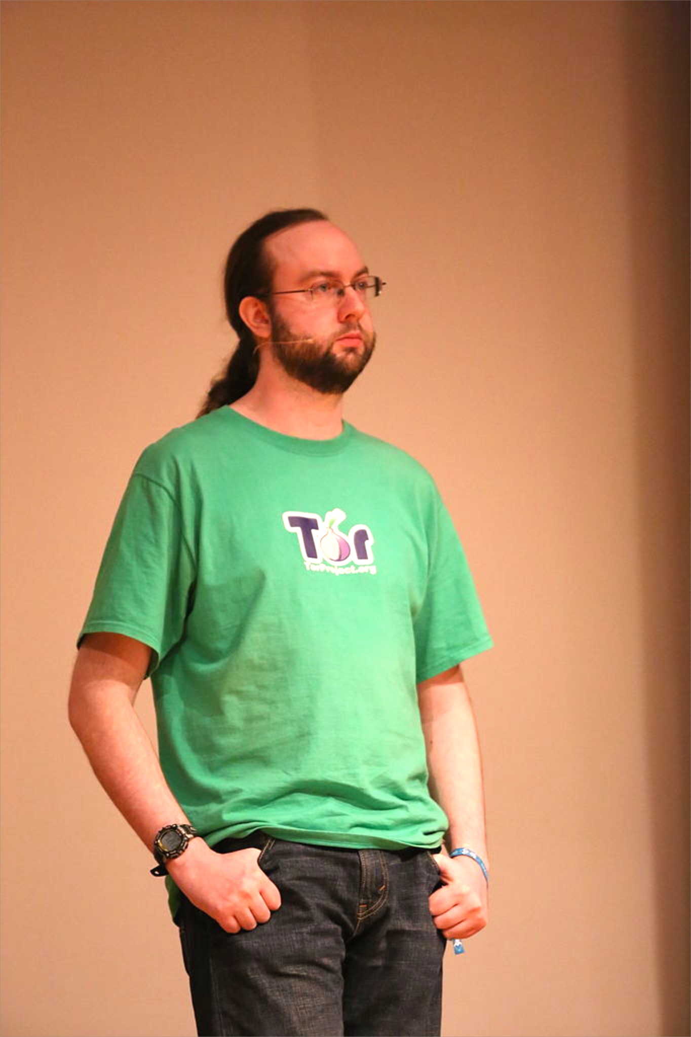
USENIX Security 2004

Slide 24
Onion Routing

Slide 25
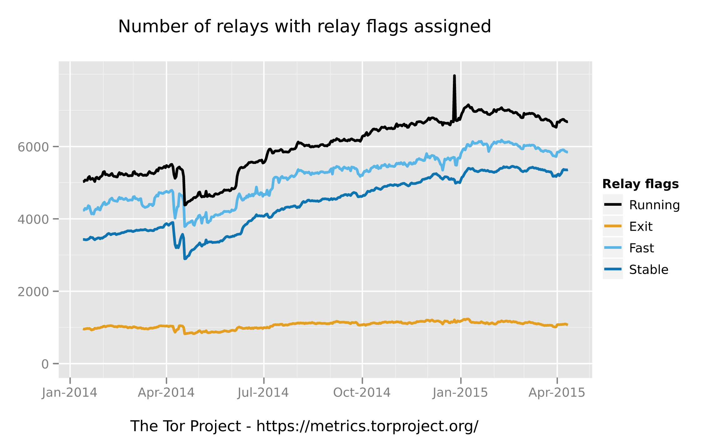

Slide 26
Charge
Problem Set 3 due Sunday
Upcoming office hours:
Today: 5-6:30pm (Ori, Rice 442)
Wednesday: 3:30-4:30pm (Samee, Rice 442)
Thursday: 2:30-3:30pm (Dave, Rice 507)

