Slide 1
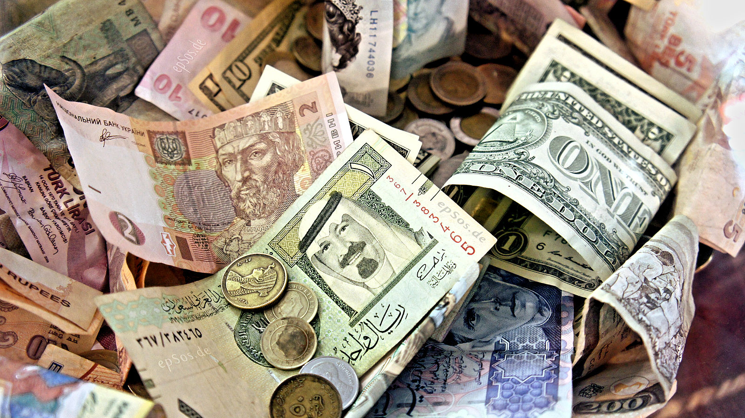
Class 23:
Before Bitcoin
Cryptocurrency Cabal
cs4501 Fall 2015
David Evans and Samee Zahur
University of Virginia

Slide 2
Plan
Projects
Elevator Speeches start Wednesday
In the News:
Graph Isomorphism
Tor Attack
Chaum’s Digicash
(Post-Bitcoin Alternatives)

Slide 3
Projects
Lots of interesting ideas: check out course site
Elevator Pitches
Up to 2 minutes
Can project something (but must be from URL)
Explain:
- Purpose (what problem are you solving)
- What are you doing
- Why should we care
Teams will be pseudo-randomly selected to give project pitches during class starting Wednesday. Be prepared to do this!

Slide 4
Progress Reports
Due: Next Monday (8:29pm)
See course site for details:
Link to project website
What has changed since preliminary proposal
Description of progress
Plan to finish project
Any questions you have

Slide 5
Is Graph Isomorphism Hard?

Slide 6
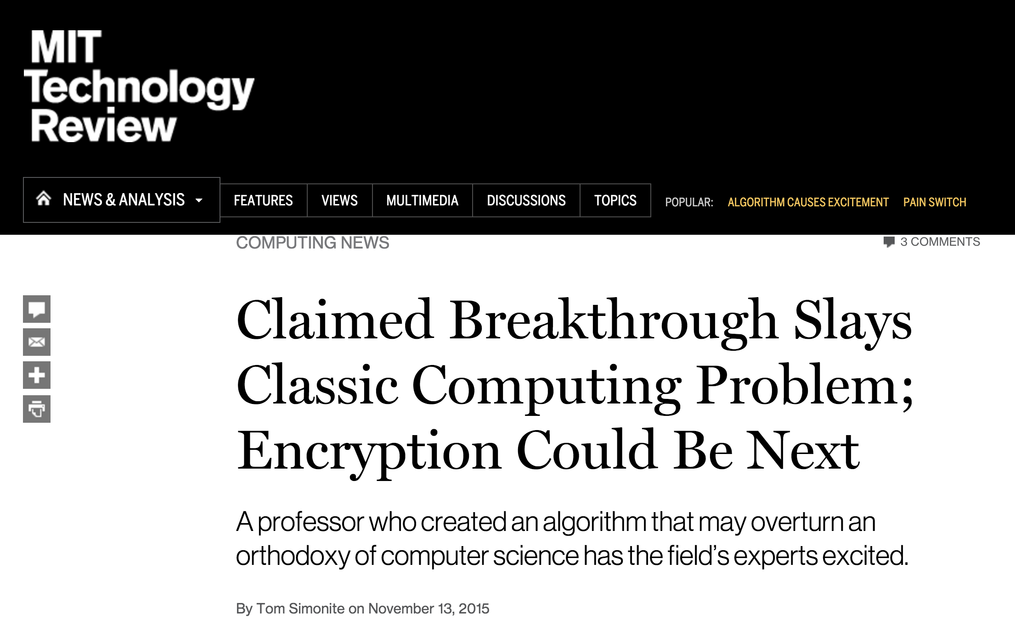

Slide 7
Photo: Jeremy Kun

Slide 8
Complexity of Graph Isomorphism
Best previously known:
Laszlo Babai’s (claimed) result:
How close is this to polynomial time?

Slide 9
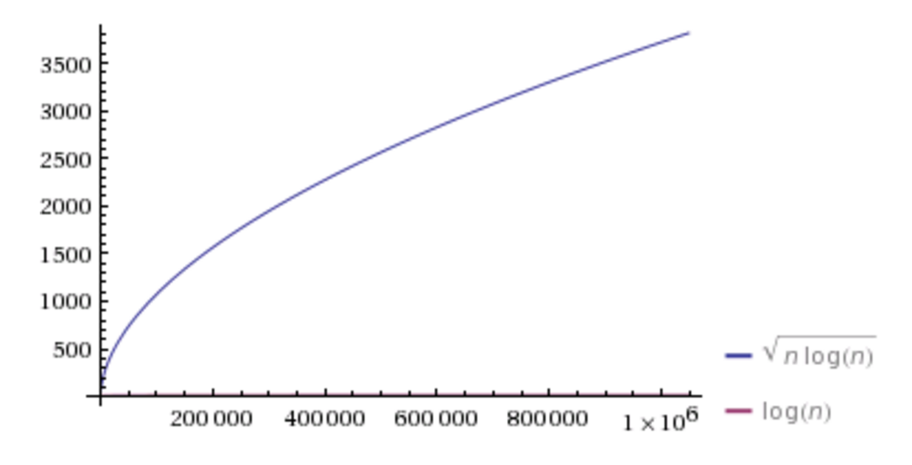

Slide 10
Does this matter in practice?
Image from Botao Hu
http://amber.botao.hu/works/research/de-anonymizingsocialnetworks

Slide 11
Should we be worried?

Slide 12
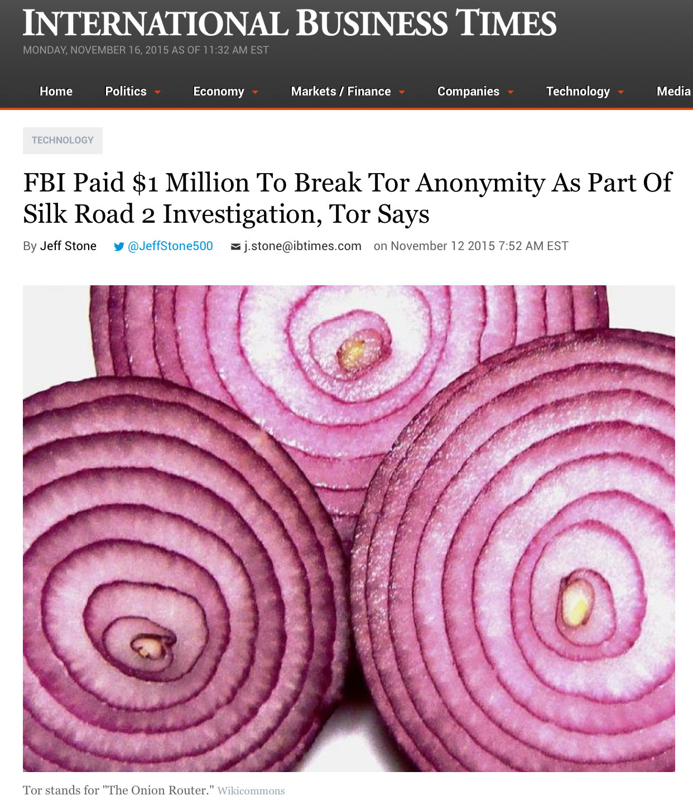
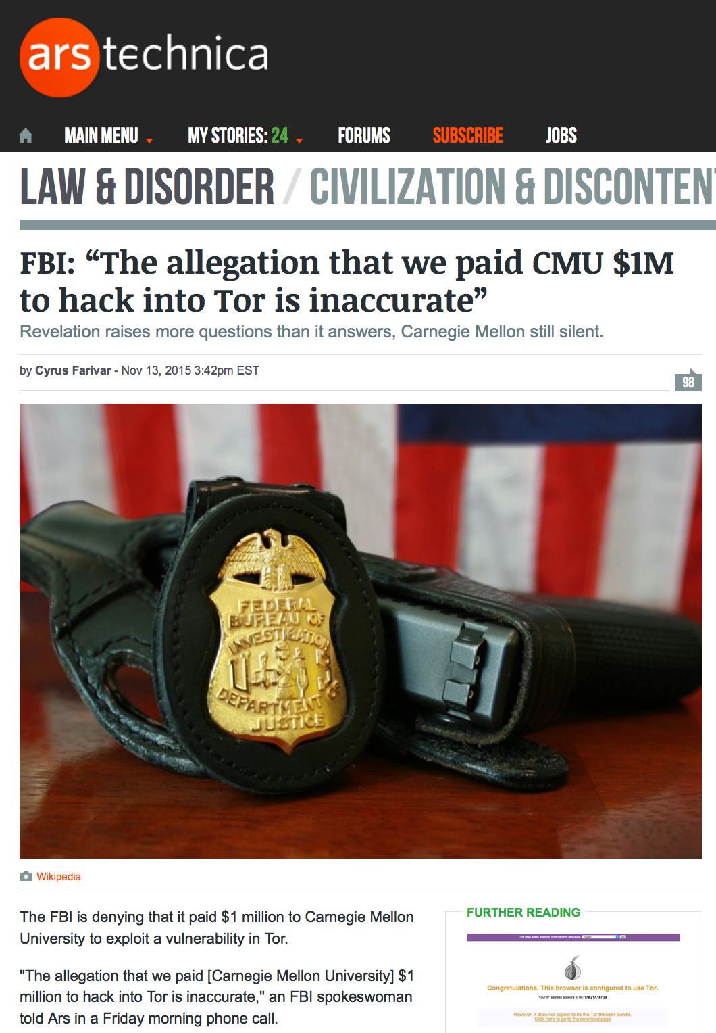
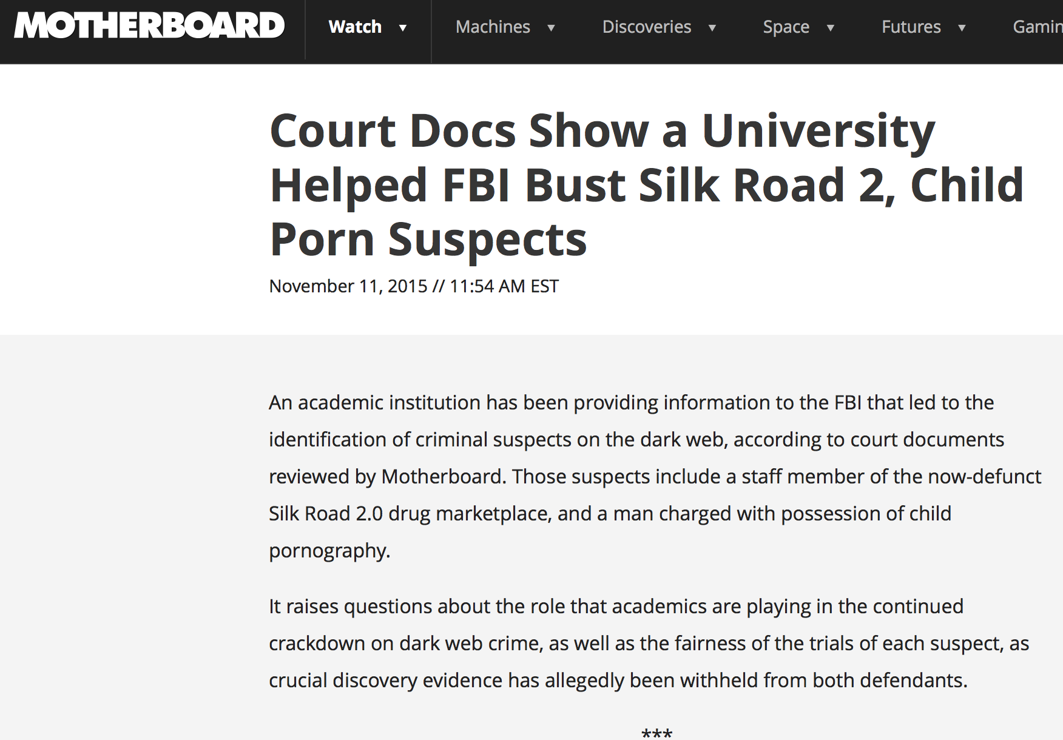
Tor, CMU, and the FBI?

Slide 13
Operation Onymous (Nov 2014)
Shutdown dark markets (including “Silk Road 2.0”)
414 .onion domains seized
17 Arrests
17 Countries involved

Slide 14
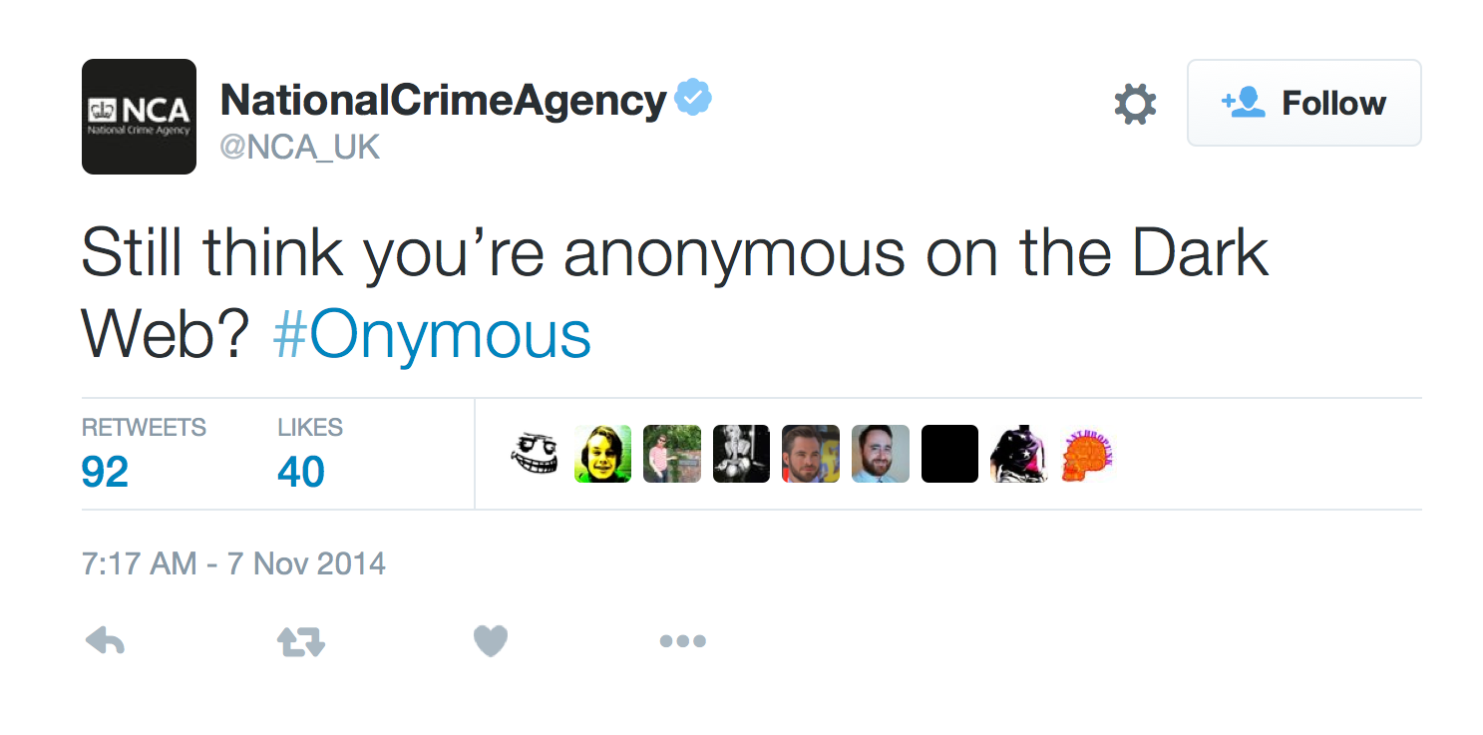

Slide 15
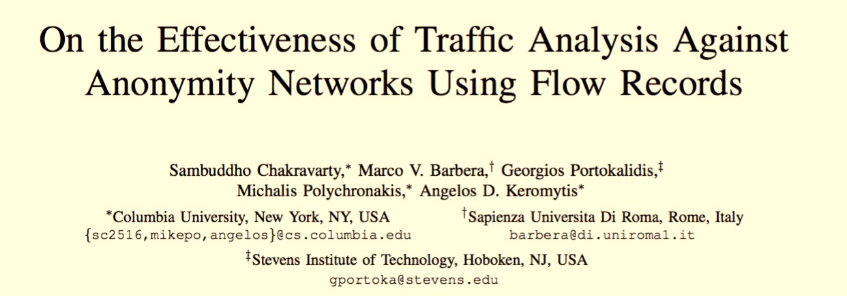
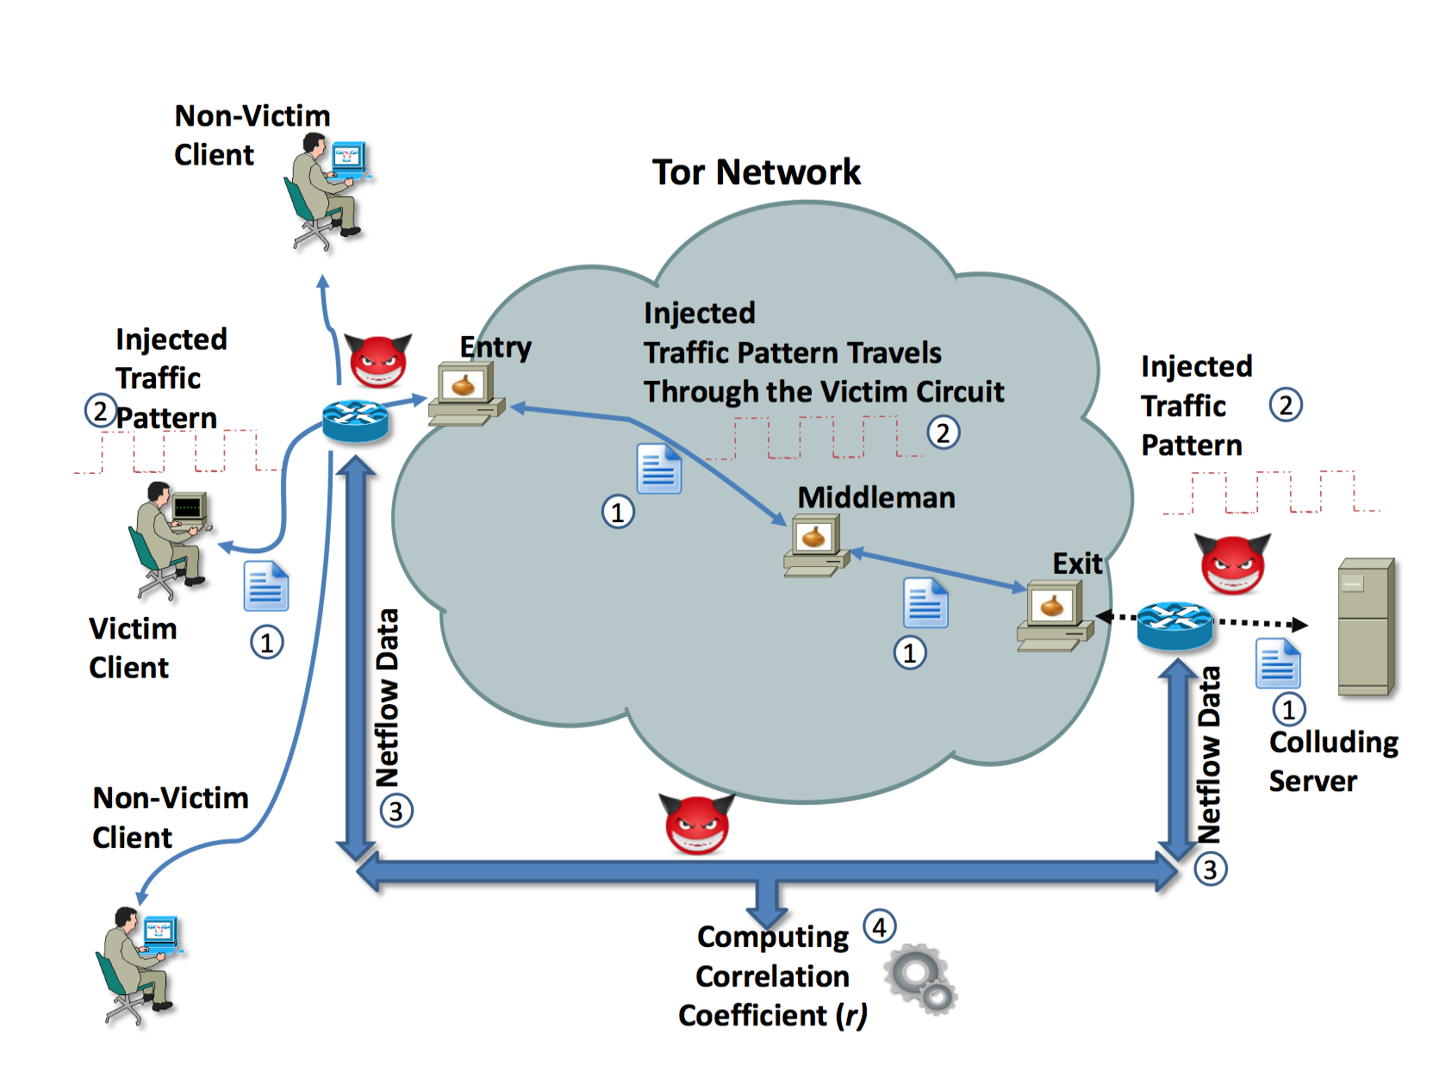

Slide 16
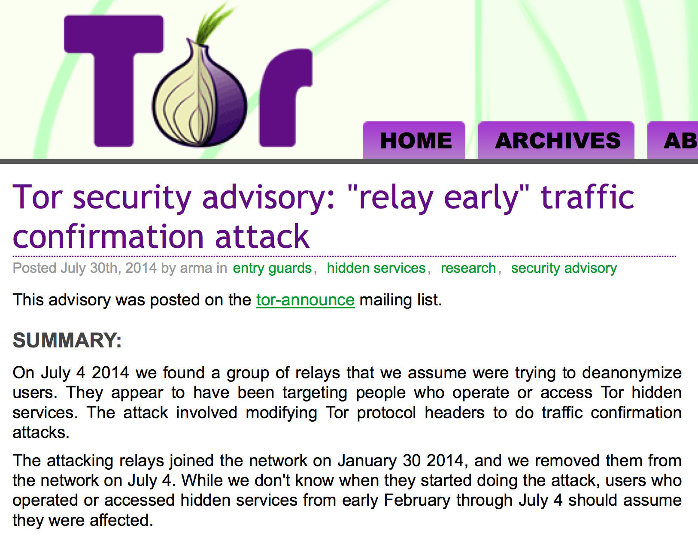

Slide 18
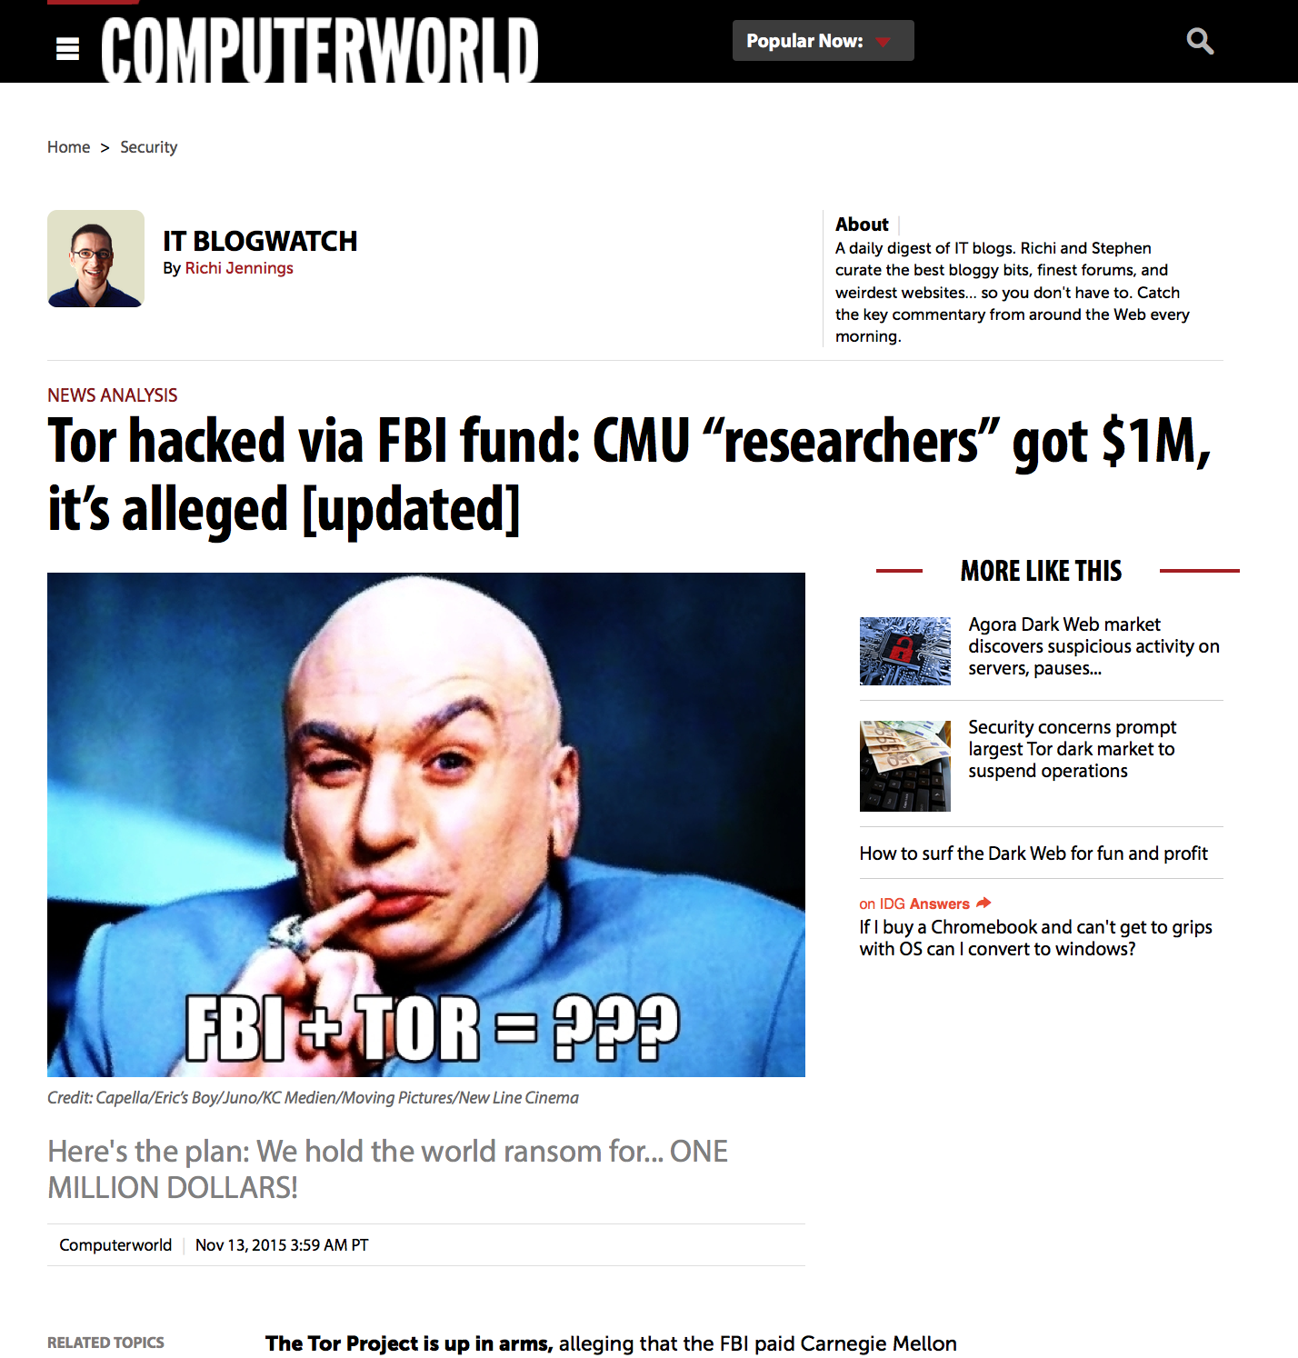

Slide 19
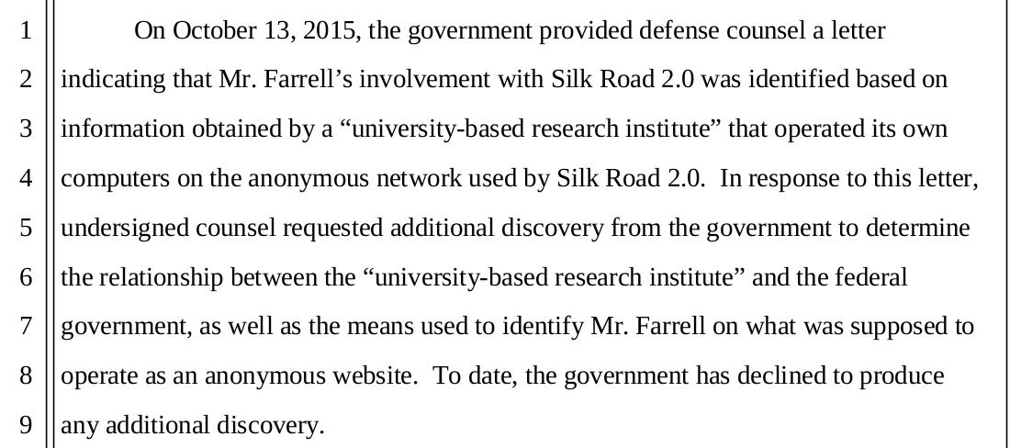

Slide 20
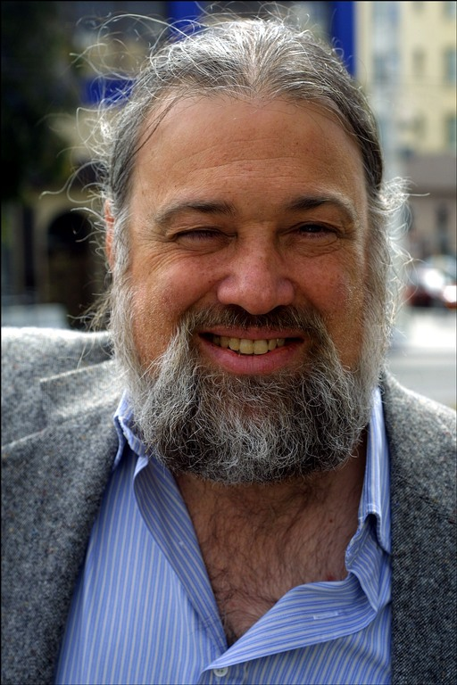
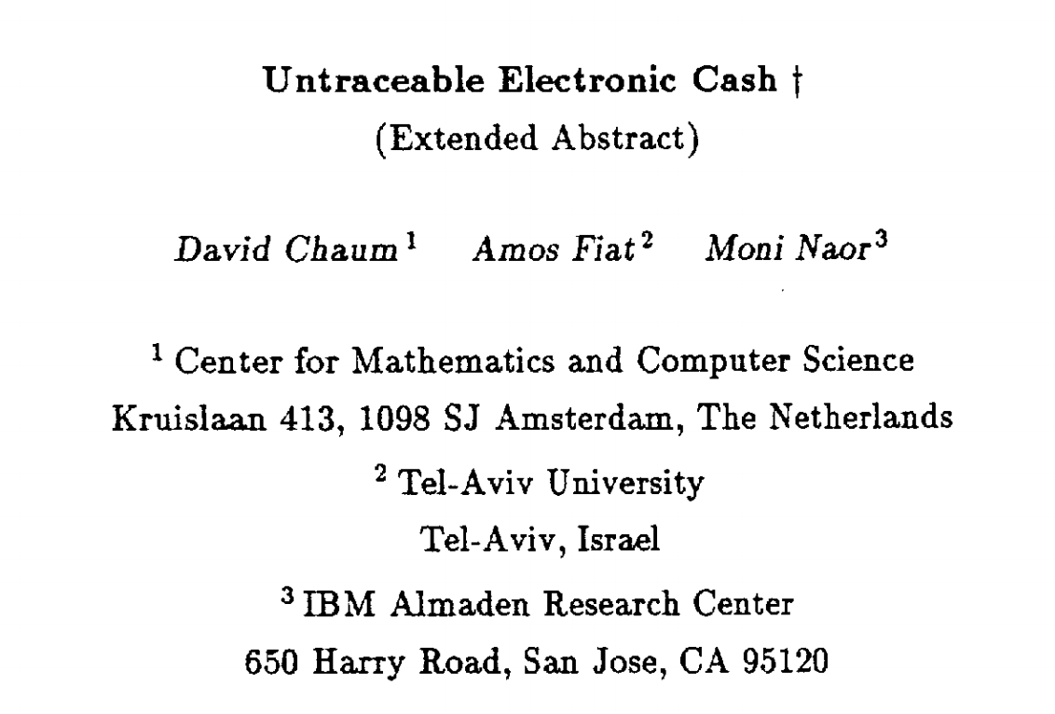
CRYPTO 1988
David Chaum
Photo: Declan McCullagh (2002)

Slide 21
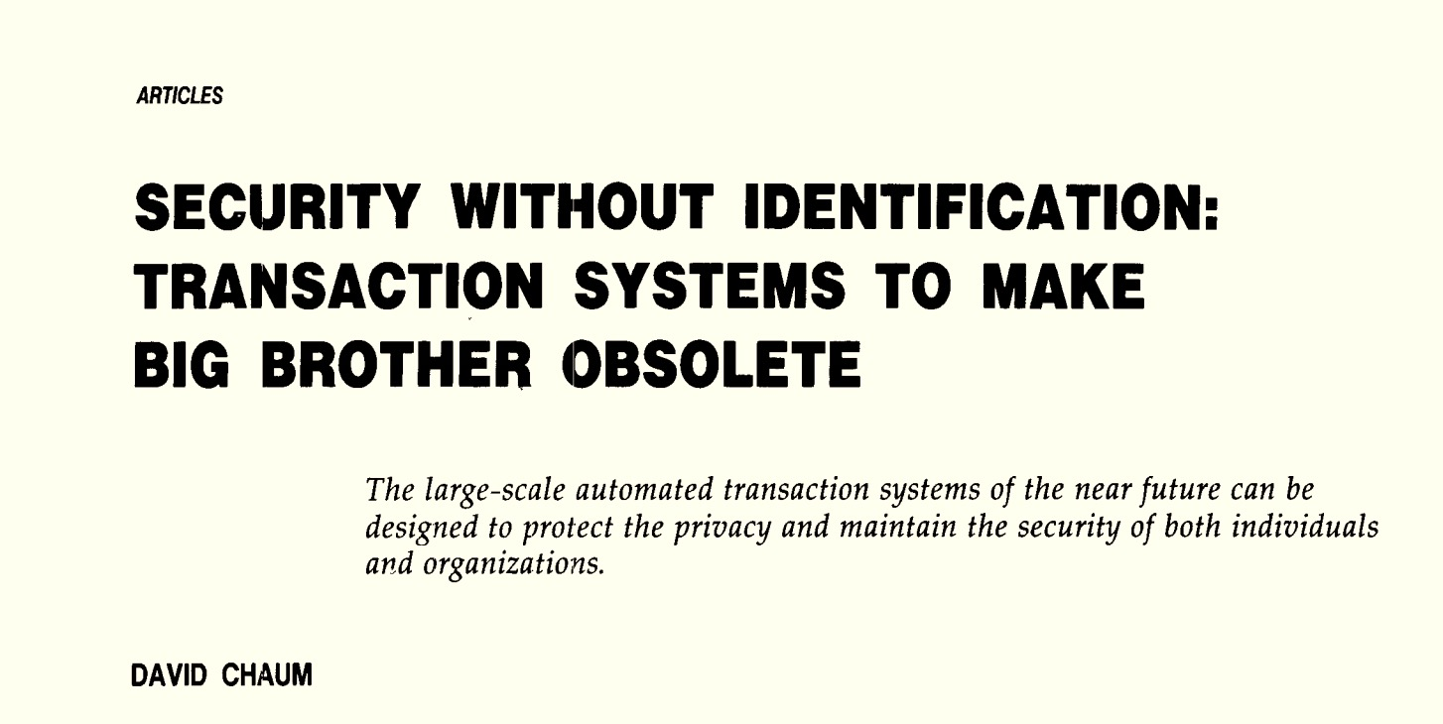
Communications of the ACM
October 1985

Slide 22
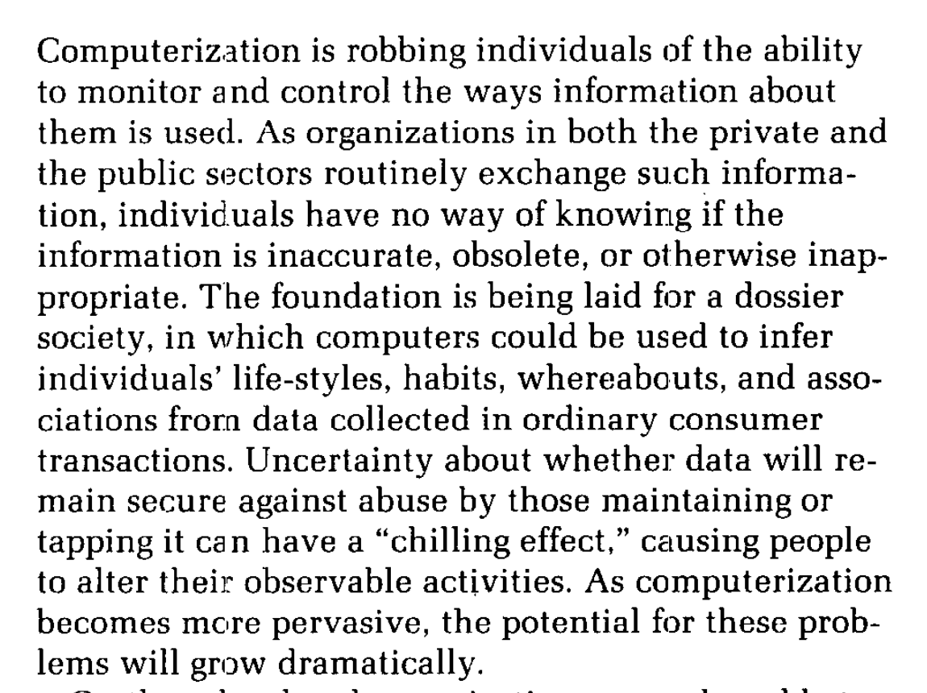
Communications of the ACM
October 1985

Slide 23
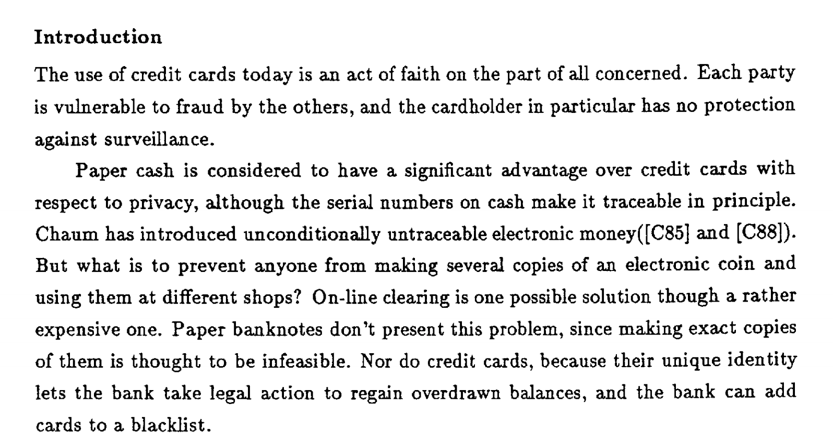
CRYPTO 1988

Slide 24
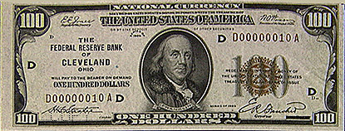
Bank IOU Protocol
High
Trust
Bank
Alice
{KU_{A}, KR_{A}}
M
E_{KRTB}[H(M)]
M = “The High Trust Bank owes the holder of this message $100.”
{KU_{TB}, KR_{TB}}

Slide 25
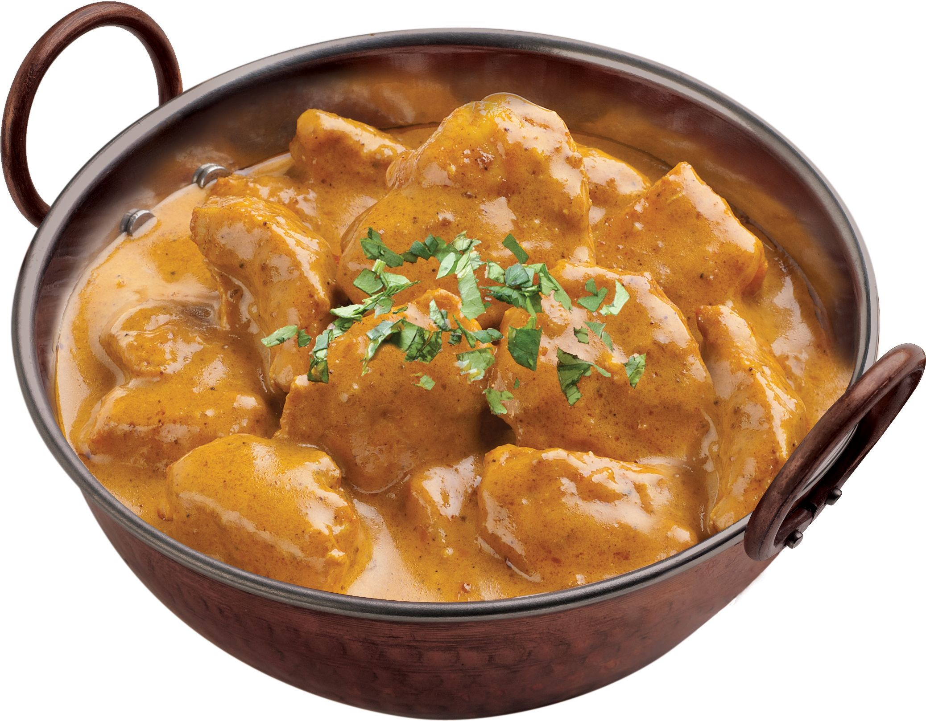
High
Trust
Bank
Alice
M
E_{KRTB}[H(M)]
Bob
M = “The High Trust Bank owes the holder of this message $100.”
{KU_{TB}, KR_{TB}}

Slide 26
High
Trust
Bank
Alice
M
E_{KRTB}[H(M)]
Bob
M
E_{KRTB}[H(M)]
M = “The High Trust Bank owes the holder of this message $100.”
{KU_{TB}, KR_{TB}}
E_{KUA}[secret curry recipe]

Slide 27
High
Trust
Bank
Alice
M
E_{KRTB}[H(M)]
Bob
M
E_{KRTB}[H(M)]
M = “The High Trust Bank owes the holder of this message $100.”
{KU_{TB}, KR_{TB}}
E_{KUA}[secret curry recipe]
M
E_{KRTB}[H(M)]

Slide 28
High
Trust
Bank
Alice
Both Alice and Bob can attempt to redeem the IOU (multiple times).
M
E_{KRTB}[H(M)]
Bob
M
E_{KRTB}[H(M)]
M = “The High Trust Bank owes the holder of this message $100.”
{KU_{TB}, KR_{TB}}
E_{KUA}[secret curry recipe]
M
E_{KRTB}[H(M)]

Slide 29
Add Unique Identifiers
Bear’s
Turns
Bank
M
E_{KRTB}[H(M)]
M = “Bill #51342: Bear’s Turns Bank owes the holder of this message $100.”
Alice
{KU_{TB}, KR_{TB}}
{KU_{A}, KR_{A}}

Slide 30
Add Unique Identifiers
Bill can only be redeemed once.
Bear’s
Turns
Bank
Bank cannot tell if it is Alice or Bob who cheated (first redeemer wins?)
M
E_{KRTB}[H(M)]
M = “Bill #51342: Bear’s Turns Bank owes the holder of this message $100.”
Alice
{KU_{TB}, KR_{TB}}
{KU_{A}, KR_{A}}
Not anonymous; tracable

Slide 31
Untraceable Cash
Can we make untraceable digital banknotes that can only be spent once?

Slide 32
Key Technology: Blind Signatures
Bank’s public key: (e, n)
Bank’s private key: d
Goal: Blind Signatures:
Alice selects message m
Alice obtains S_{M}
Bank doesn’t learn m
Normal RSA Signatures:
Alice selects message m
Sends m to bank
Bank returns signature:
S_{M} = m^{d} mod n

Slide 33
Key Technology: Blind Signatures
Bank’s public key: (e, n)
Bank’s private key: d
Blind Signatures:
Alice selects message m
Picks random k in [1, n)
Sends bank t = mk^{e} mod n
Bank signs:
t^{d} = (mk^{e} mod n)^{d} mod n
Alice computes m^{d} mod n:
= (mk^{e})^{d} mod n ≡ m^{d}k^{ed} mod n
divide by k = m^{d} mod n
Normal Signatures:
Alice selects message m
S_{M} = m^{d} mod n

Slide 34
Client-Selected Identifiers
M^{k}
Bear’s
Turns
Bank
E_{KRTB}[M^{k}]
M = “Bill #51342: Bear’s Turns Bank owes the holder of this message $100.”
{KU_{TB}, KR_{TB}}

Slide 35
Client-Selected Identifiers
M^{k}
Bear’s
Turns
Bank
E_{KRTB}[M^{k}]
M = “Bill #51342: Bear’s Turns Bank owes the holder of this message $10000000.”
{KU_{TB}, KR_{TB}}

Slide 36
Cut-and-Choose
M_{i} = “Bill #[r_{i}] : Bear’s Turns Bank owes the holder of this message $100.”
M₁^{k1}
M₂^{k2}
…
M₂₅₆^{k256}

Slide 37
Cut-and-Choose
M_{i} = “Bill #[r_{i}] : Bear’s Turns Bank owes the holder of this message $100.”
M₁^{k1}
M₂^{k2}
Alice generate N different messages, and blinds each with different k. Sends all of them to Bank.
…
Bank randomly selects N-1 of them, and challenges Alice to unblind.
M₂₅₆^{k256}
If all are okay, Bank (blindly) signs the one un-opened message, and returns it to Alice.

Slide 38
Cut-and-Choose
Alice generate N different messages, and blinds each with different k. Sends all of them to Bank.
M₁^{k1}
M₂^{k2}
Bank randomly selects N-1 of them, and challenges Alice to unblind.
…
If all are okay, Bank (blindly) signs the one un-opened message, and returns it to Alice.
M₂₅₆^{k256}
What is probability Alice can cheat without getting caught?

Slide 39
Add Unique Identifiers
Bill can only be redeemed once.
Bear’s
Turns
Bank
Bank cannot tell if it is Alice or Bob who cheated (first redeemer wins?)
M
E_{KRTB}[H(M)]
M = “Bill #51342: Bear’s Turns Bank owes the holder of this message $100.”
Alice
{KU_{TB}, KR_{TB}}
{KU_{A}, KR_{A}}
Not anonymous; tracable

Slide 40
Blinded Identifiers
Bill can only be redeemed once.
Bear’s
Turns
Bank
Bank cannot tell who cheated (first redeemer wins?)
M
E_{KRTB}[H(M)]
M = “Bill #51342: Bear’s Turns Bank owes the holder of this message $100.”
Alice
{KU_{TB}, KR_{TB}}
{KU_{A}, KR_{A}}
Anonymous and untraceable

Slide 41
Catching Cheaters
M
E_{KRTB}[H(M)]
M
E_{KRTB}[H(M)]
Bear’s
Turns
Bank
Spend a bill once: anonymity preserved
M
E_{KRTB}[H(M)]
Spend a bill twice: identity revealed

Slide 42
Identity Strings
I = “alice@alice.org”
M_{i} = “Bill #[r_{i}] : Bear’s Turns Bank owes the
holder of this message $100.”
+ identity strings:
I₁ = (h(I_{1L}), h(I_{1R}))
...
I_{n} = (h(I_{nL}), h(I_{nR}))
where h is a one-way hash function and each I_{iL} ⊕ I_{iR} = I
M₁^{k1}
M₂^{k2}
…
M₂₅₆^{k256}

Slide 43
Spending a Bill
M
E_{KRTB}[H(M)]
I = “alice@alice.org”
M_{i} = “Bill #[r_{i}] : Bear’s Turns Bank owes the
holder of this message $100.”
+ identity strings:
I₁ = (h(I_{1L}), h(I_{1R}))
...
I_{n} = (h(I_{nL}), h(I_{nR}))
where h is a one-way hash function and each I_{iL} ⊕ I_{iR} = I
Reveal request: LRRLRLR…
(randomly select L or R for each pair)
I_{1L}, I_{2R},I_{3R}, I_{4L},…
verifies hashes,
accepts bill

Slide 44
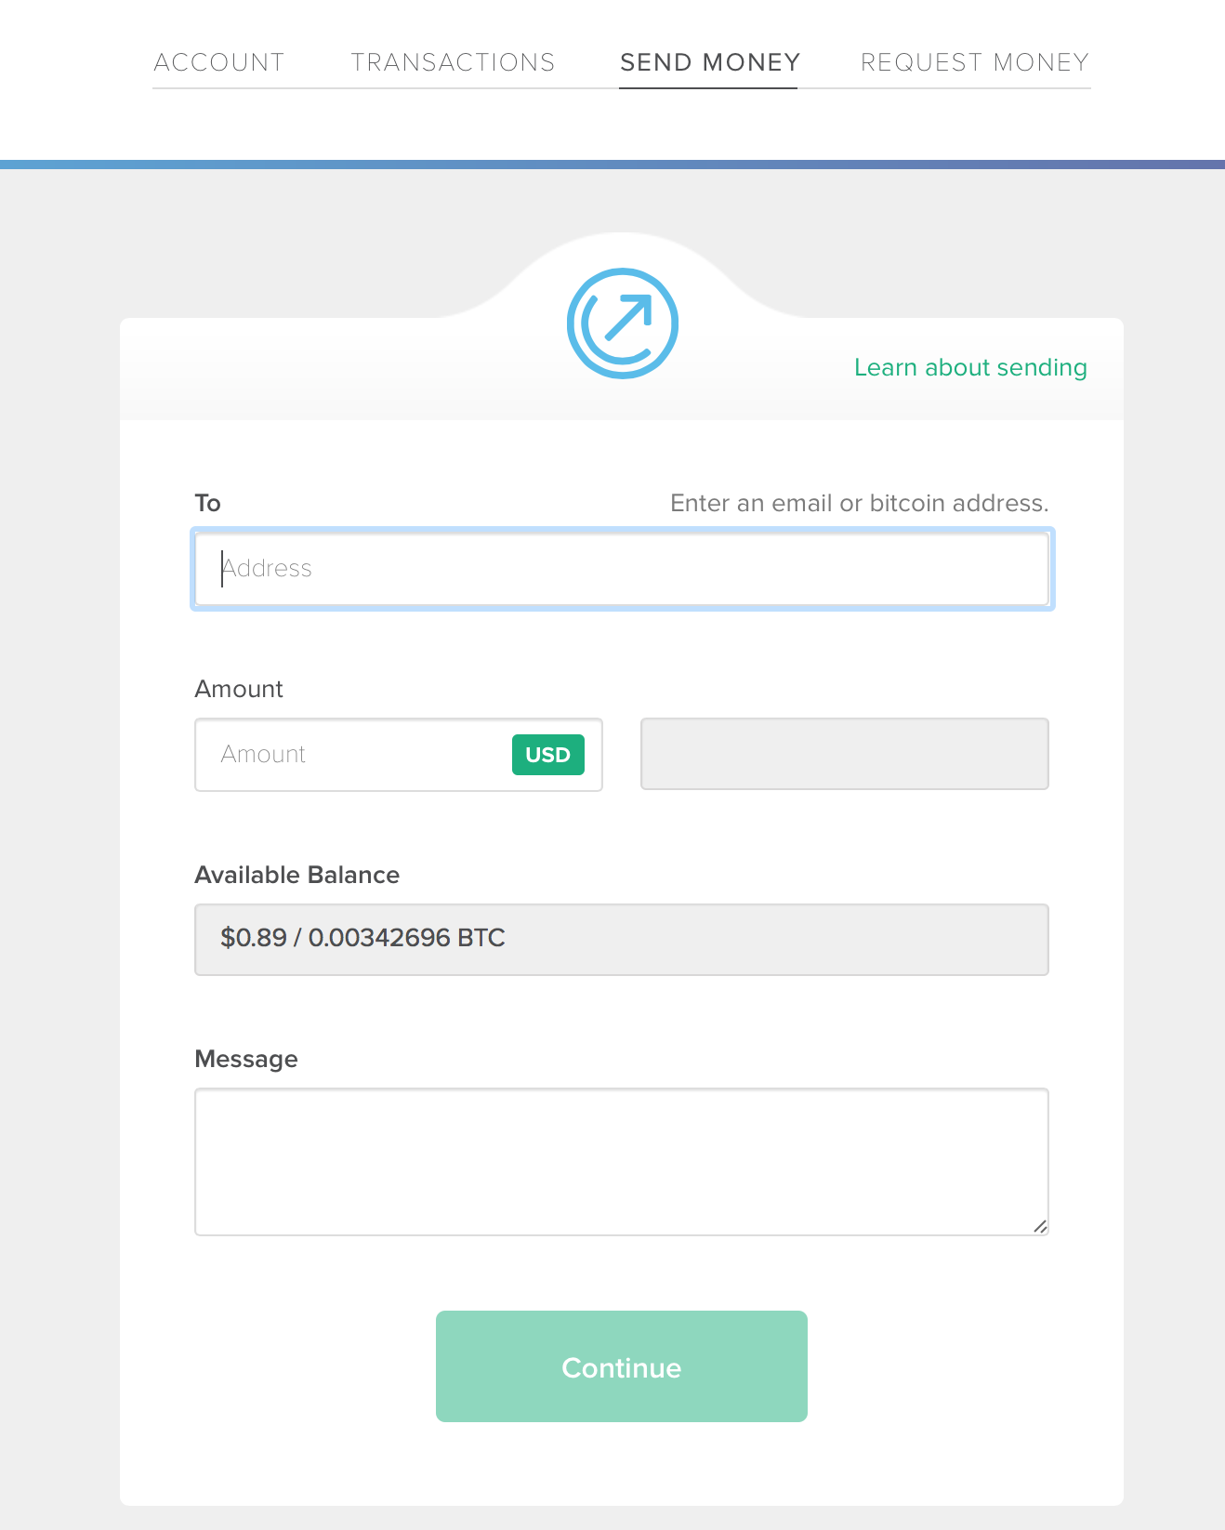
How well does this scheme work as a currency?

Slide 45
Rise of DigiCash
David Chaum

Slide 46
Collapse
Bankrupt, 1998

Slide 47
Charge
Be ready for project elevator pitches starting Wednesday!

