Slide 1
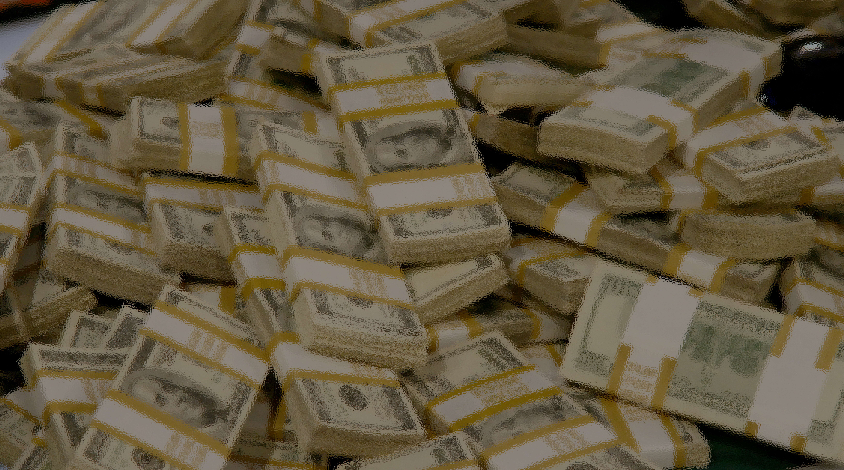
Class 1:
What is Money?
Cryptocurrency Cabal
cs4501 Fall 2015
David Evans and Samee Zahur
University of Virginia

Slide 2
Plan for Today
Money and Currency
Why a course on “bitcoin”?
Bitcoin Introduction

Slide 3
What is Money?

Slide 6
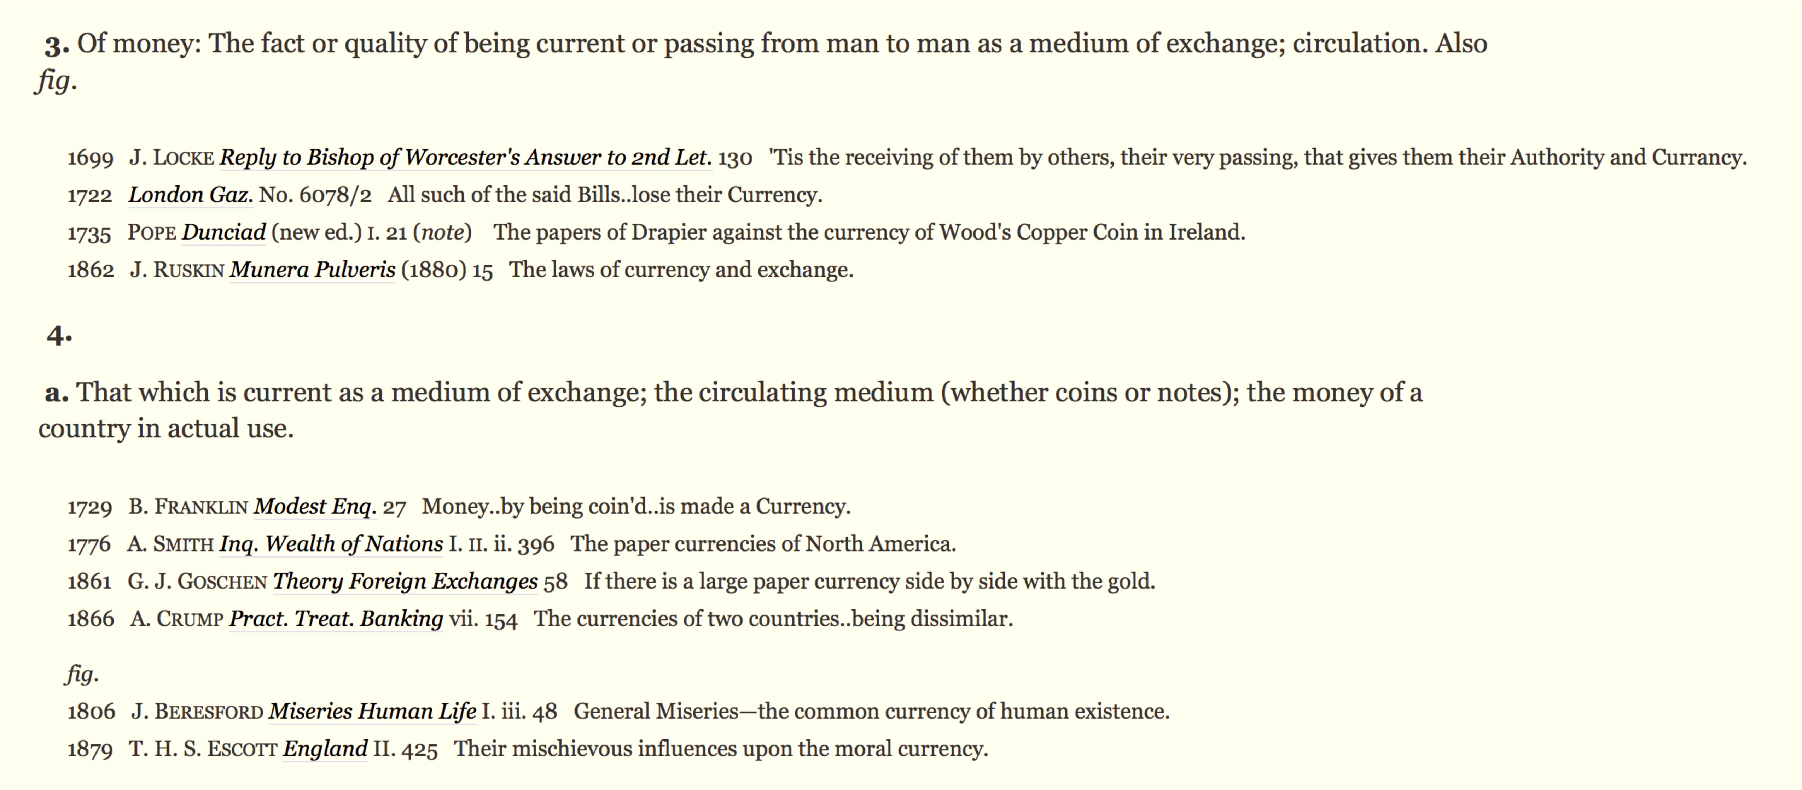

Slide 7
What Makes a “Good” Currency?

Slide 9
Possible Currency Desiderata
Universally Recognized (everyone accepts it)
Stable (value doesn't change)
Scarce (limited supply, difficult to duplicate)
Transferable (easy and inexpensive to exchange)
Persistent (can't be easily destroyed)
Centralized (authority controls money supply and integrity)
Untraceable (cannot trace through transactions)
Anonymous (cannot tell who is involved in a transaction)
Divisible (can subdivide into independent pieces)

Slide 10
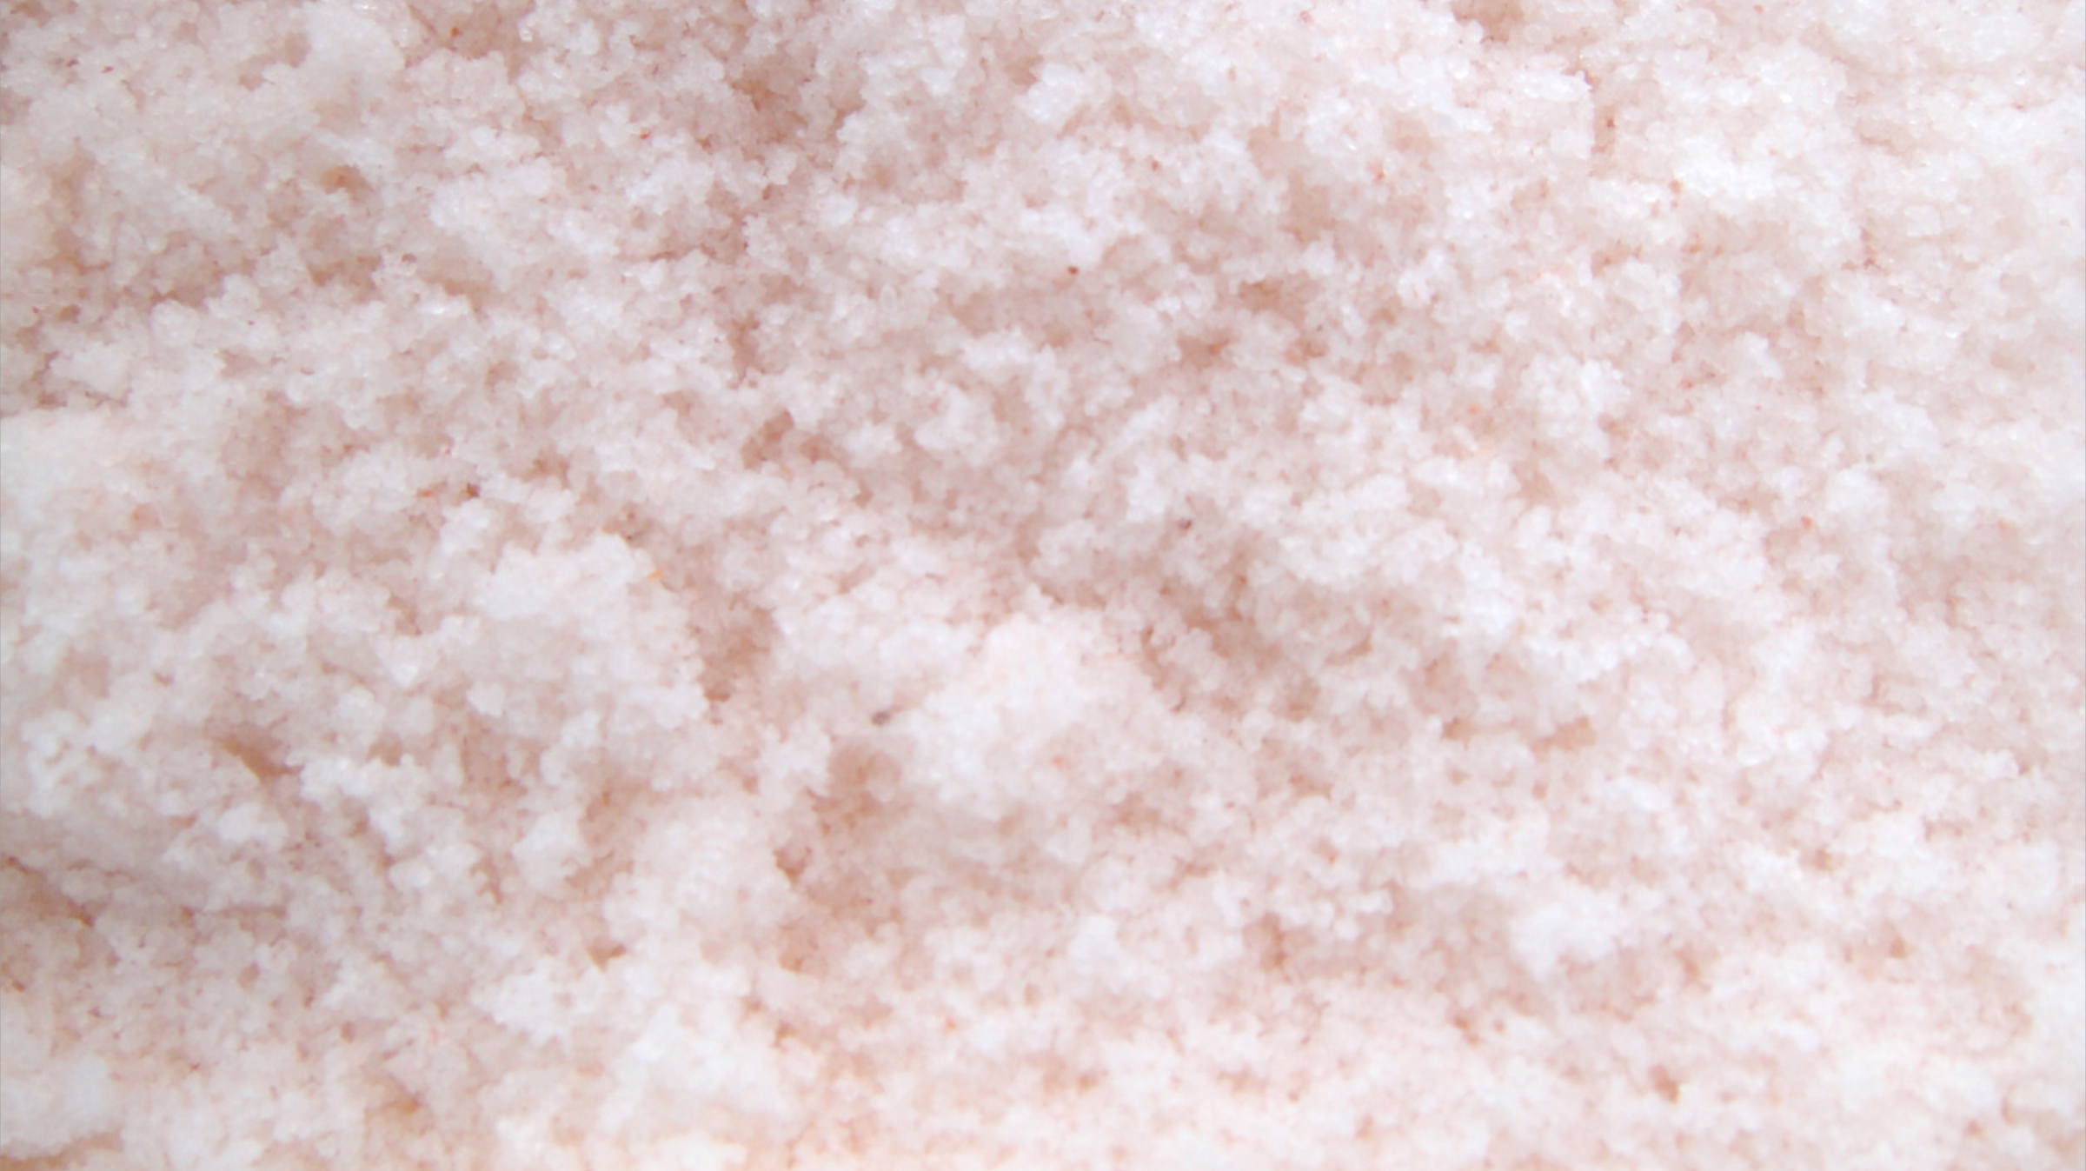
What was the first currency?

Slide 11
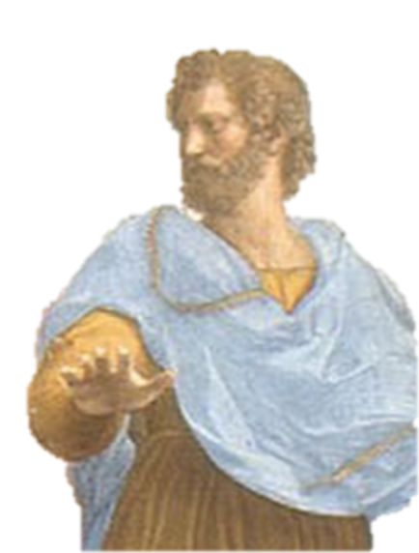
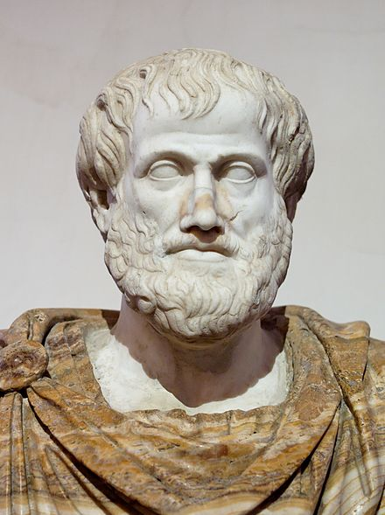

Slide 12
Aristotle’s Politics
around 350 BCE

Slide 13
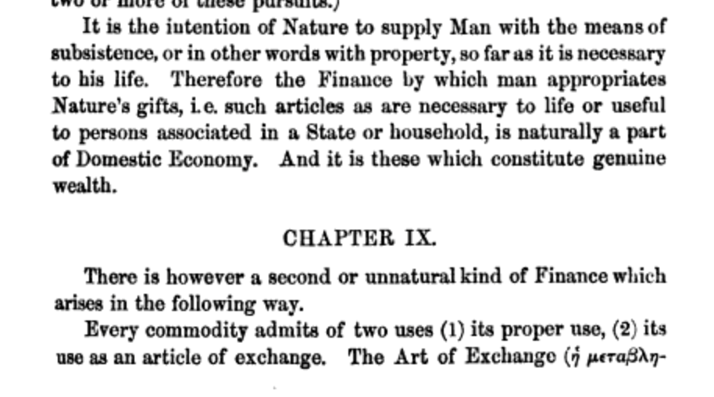
Aristotle’s Politics 350 BCE

Slide 14
Aristotle’s Politics 350 BCE

Slide 15
How well does salt work as a currency?

Slide 16
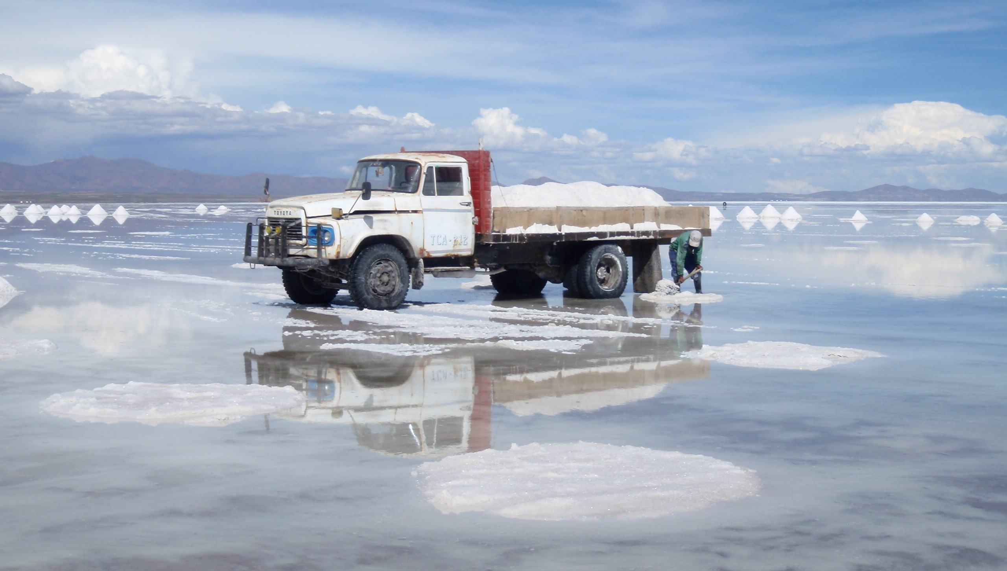
Salt Mining in Bolivia
http://solvingforzero.com/?p=804

Slide 17
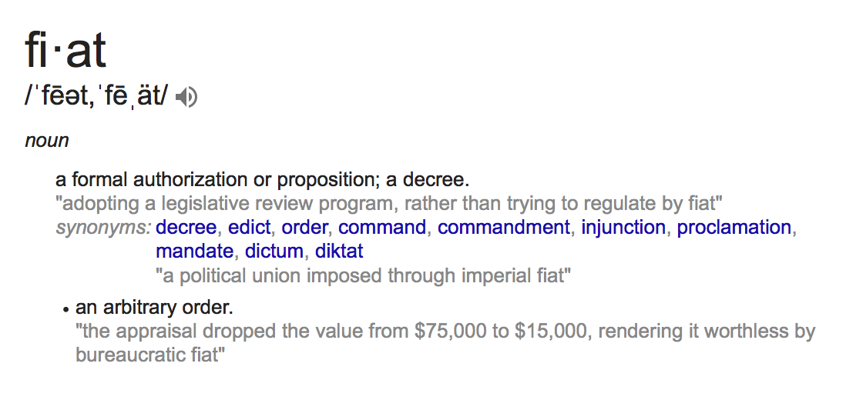
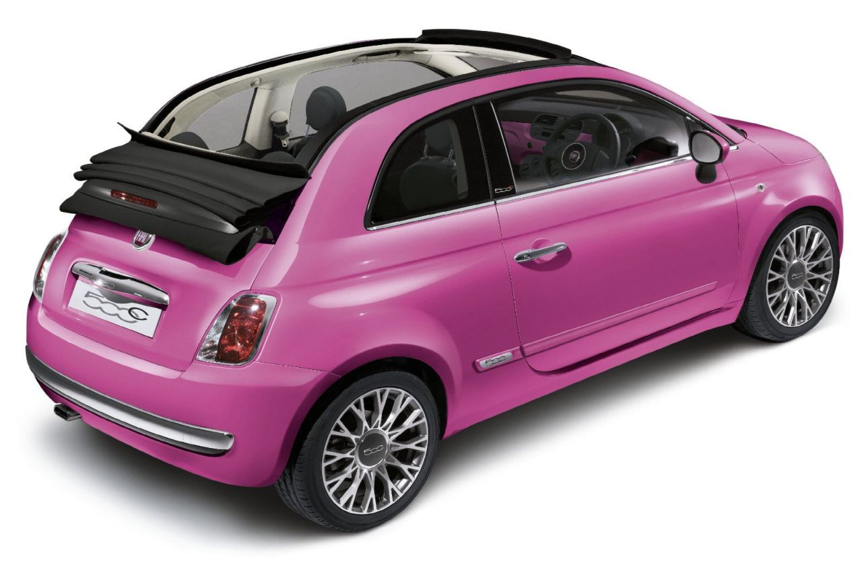
Fiat Currency

Slide 18
Requirements for Fiat Currency

Slide 19
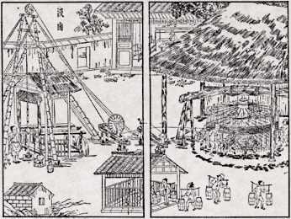
What about salt?

Slide 20
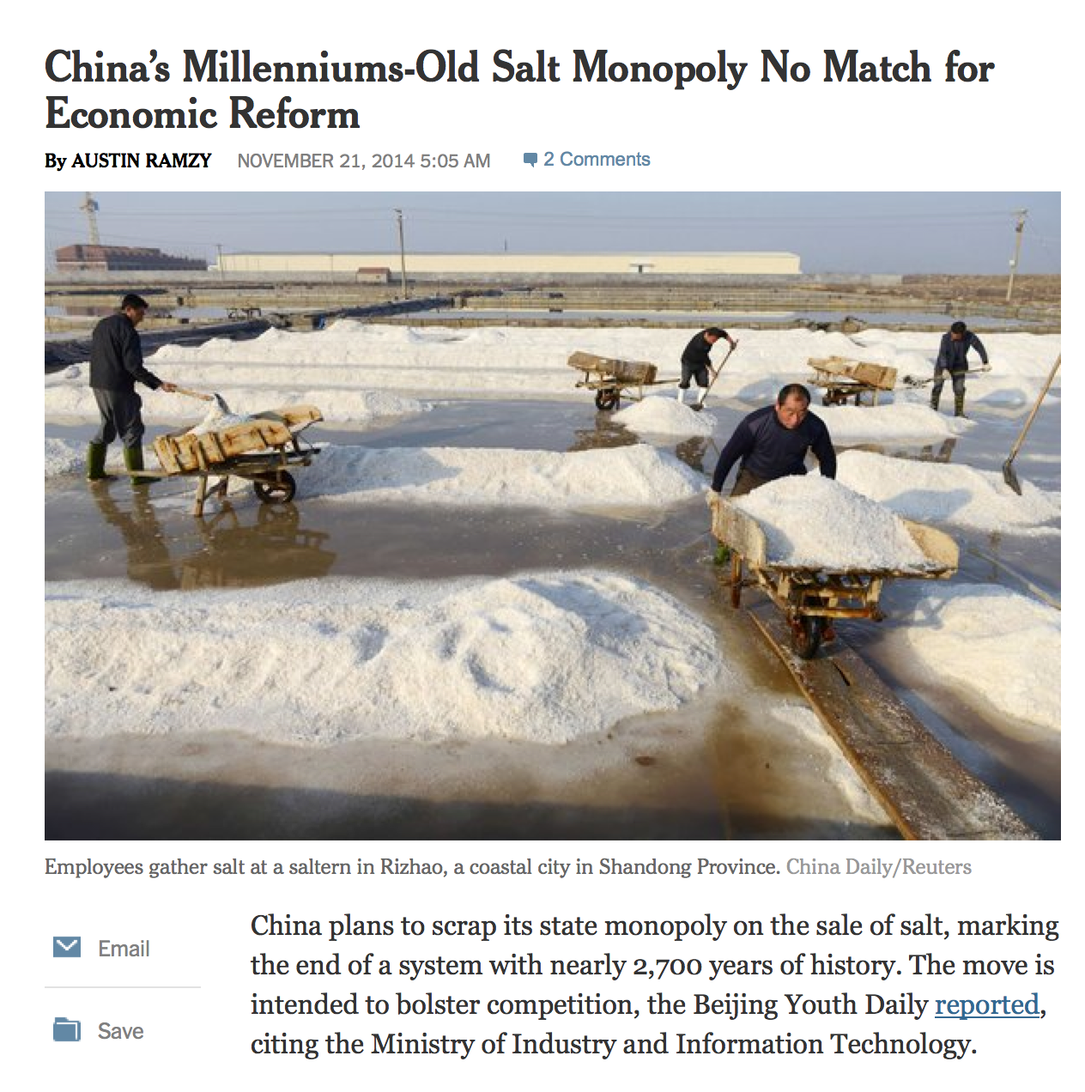
Salt Currency in China? 300 BCE – 2015?

Slide 21
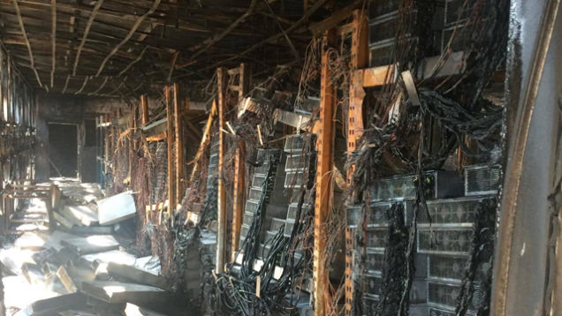
Why a Course on Bitcoin?

Slide 22
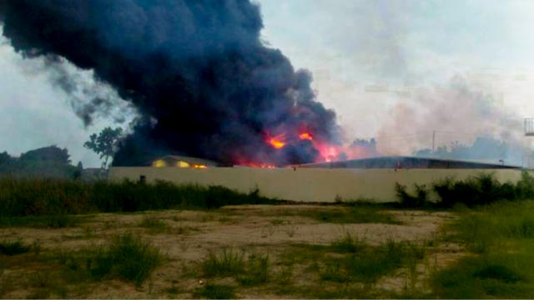
Fire at mining facility in Thailand, 14 Oct 2014
Photo credit: www.thairath.co.th

Slide 23
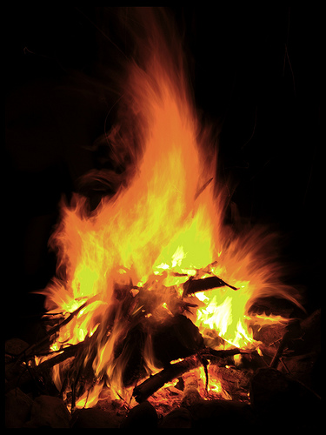
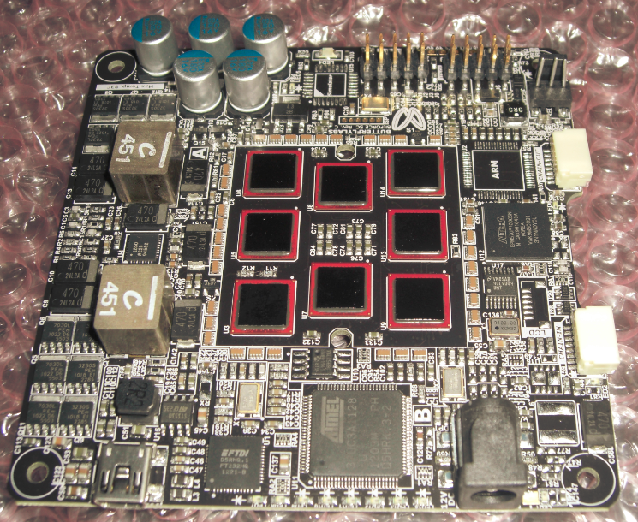
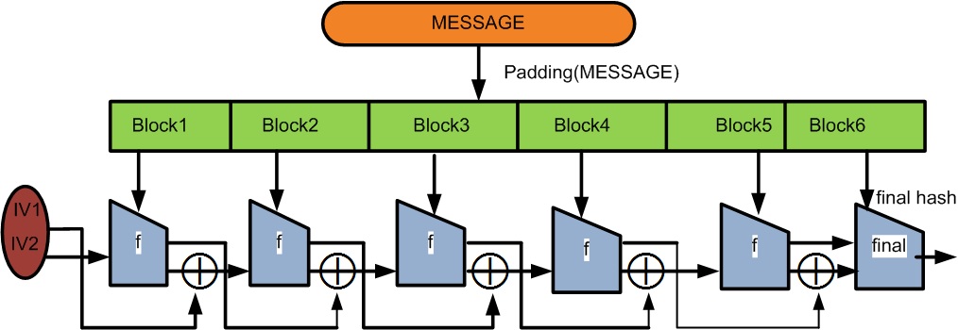
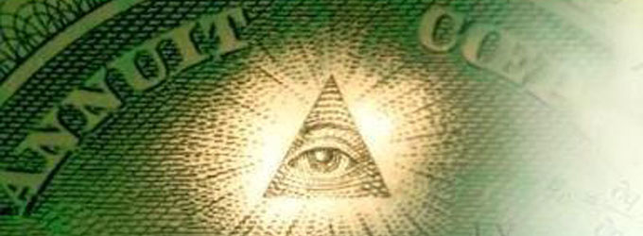
Theory of Computation
Government
Algorithms
Distributed Systems
Physics
Computer Architecture
Cryptography
Economics

Slide 24
Reasons to Take this Course
Vehicle: concrete system for learning lots of things:
Cryptography
Computer Science: Complexity, Networking, Security, etc.
Economics, Politics, Law, Anthropology, Criminology, etc.
Potential Impact and Opportunity
Web in 1995?
Fun, interesting, etc.

Slide 25
Designing a Digital Currency

Slide 26
Approach 1: “I Hereby Pay Thee”
You have earned $10
Thanks!
Boss says I can get pizza
Surrre...

Slide 27
Problems
Who is this “employer”?
Did the employer actually say that?
Is he actually rich enough?
What does Pizza guy get in exchange?
It’s all trust based

Slide 28
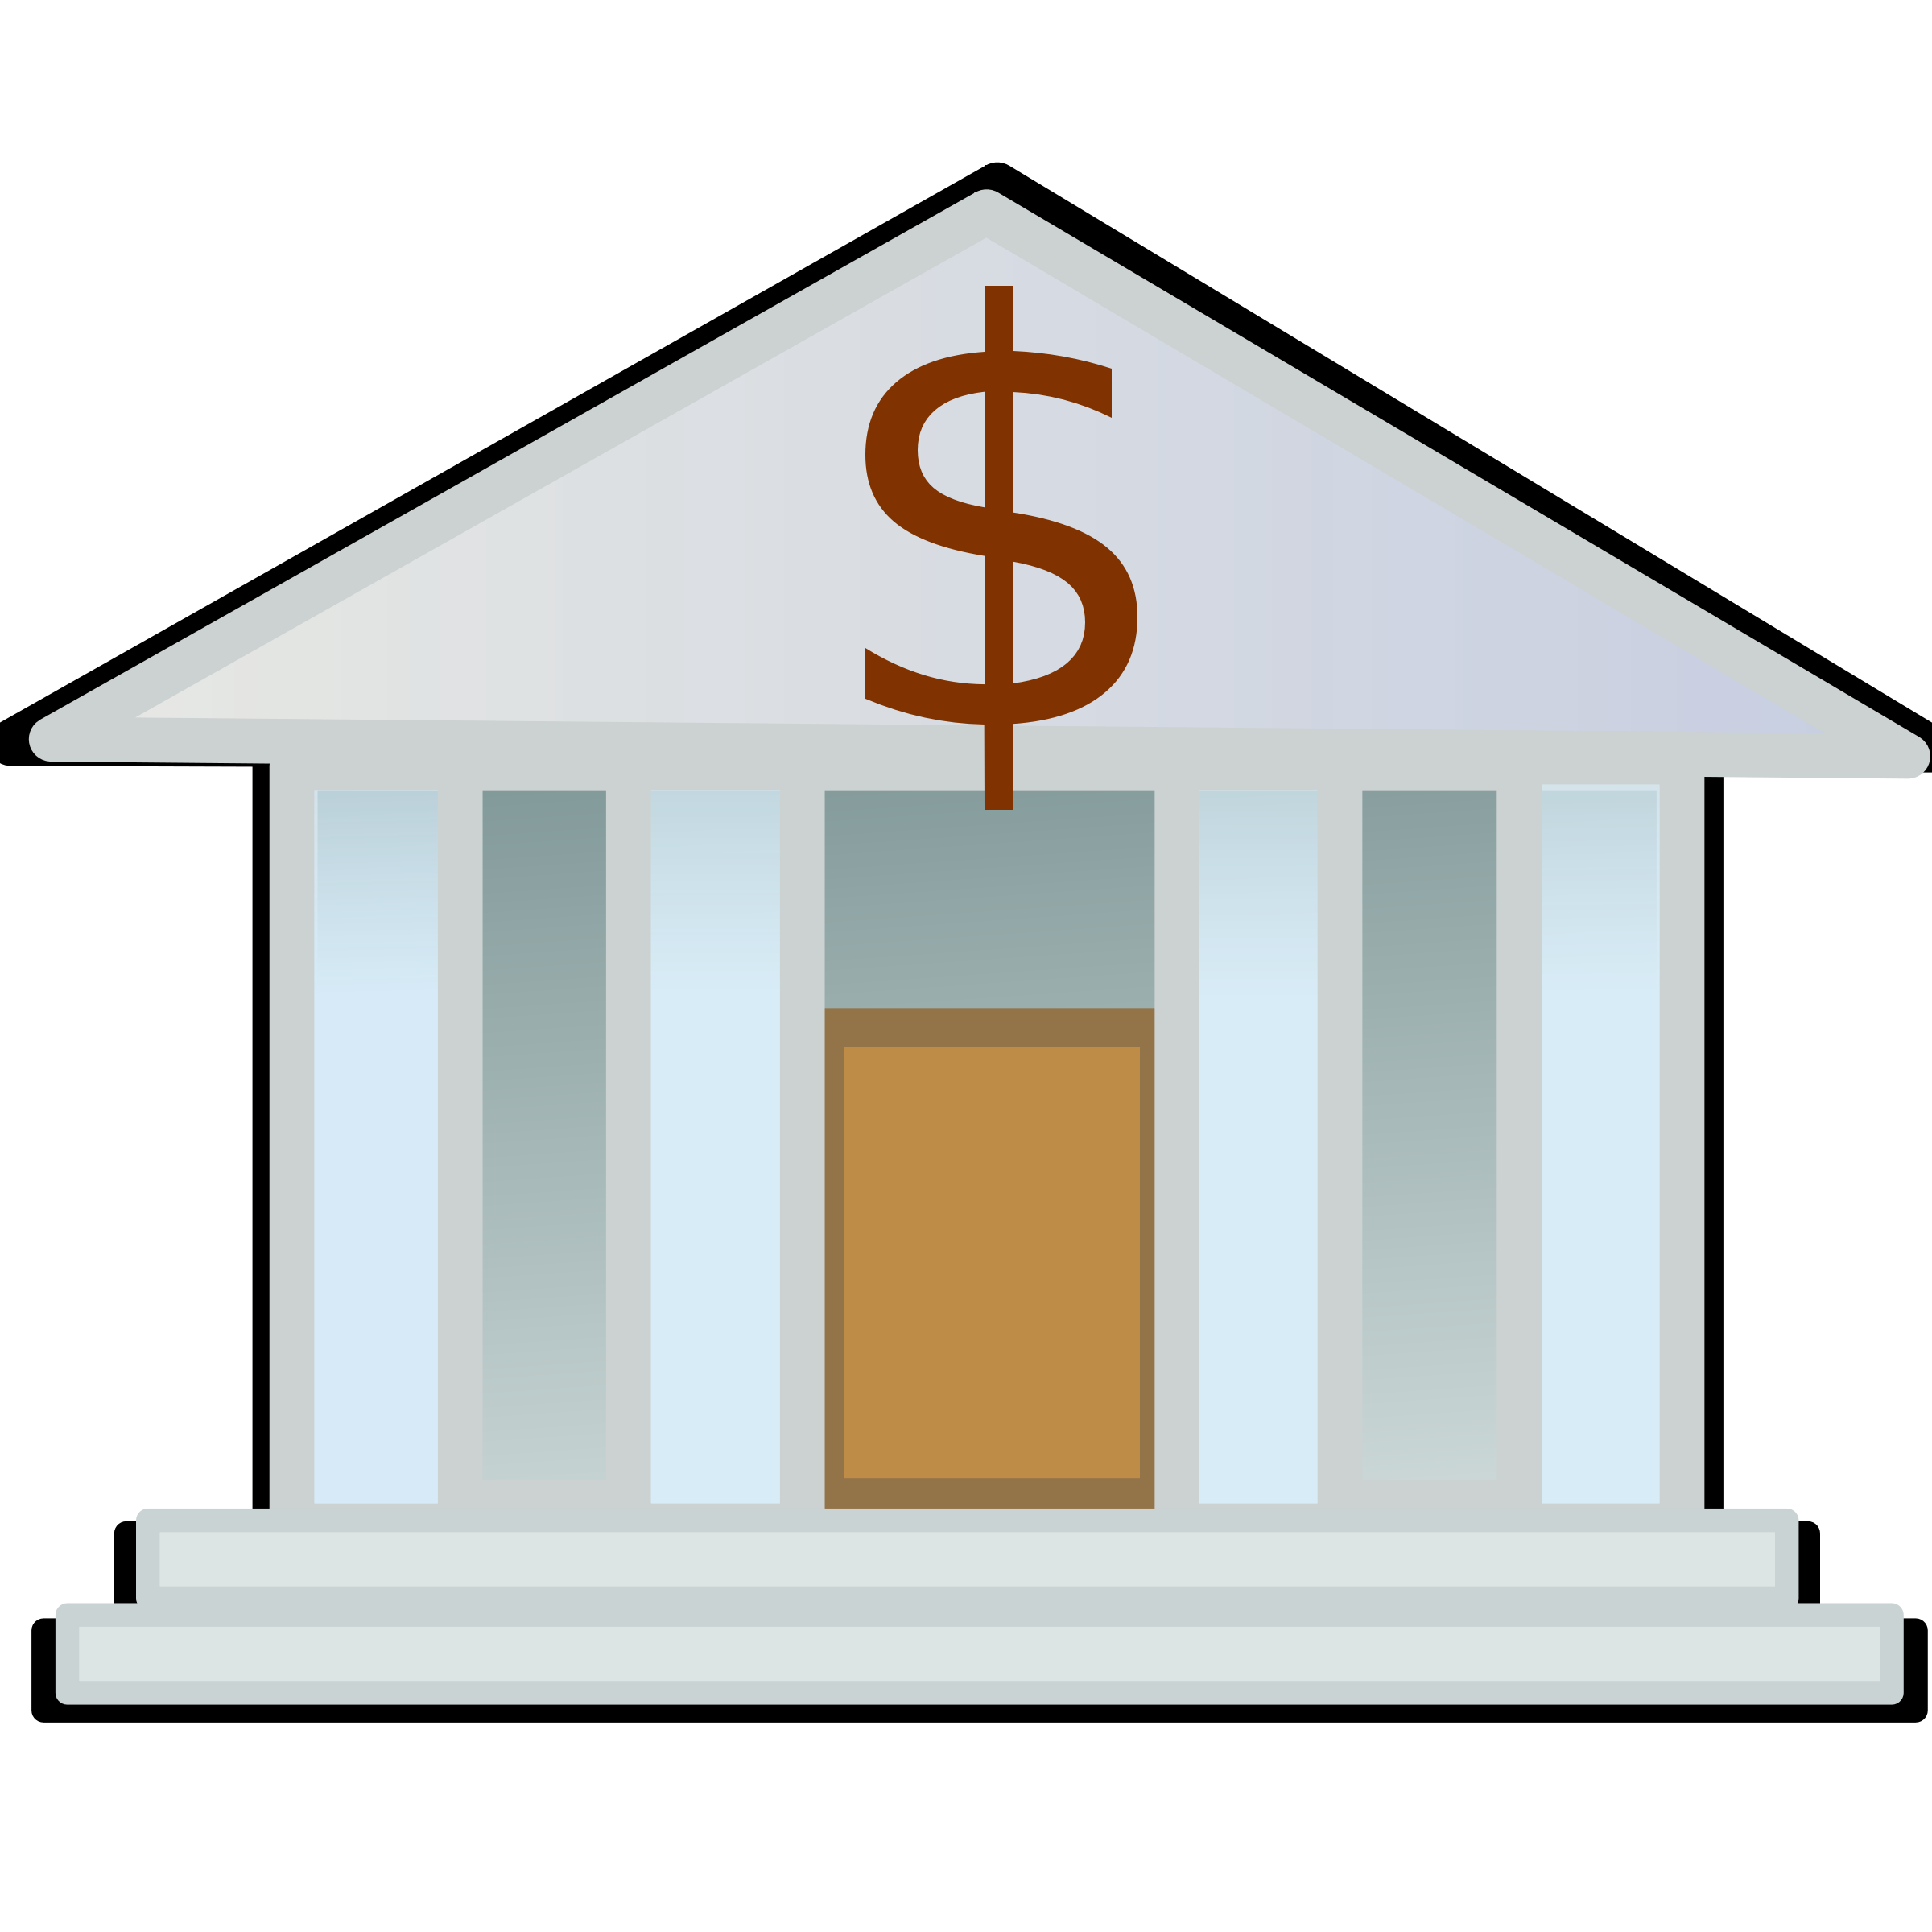
Approach 2: The Bank
Serves requests:
Does Alice have sufficient funds for purchasing this?
Please transfer $100 from my to Bob's account.
All requests/responses are signed. Everyone trusts bank.
Clipart.co

Slide 29
Better in some ways ...
If bank is well-reputed, I can trust that:
Money I get can be spent later on anything I want.
Bank won’t magically reduce my bank balance.
Bank won’t create money out of thin air for its own benefit.

Slide 30
Problematic in other ways
Centralization: harder to scale
High transaction rates: race conditions
We still trust someone

Slide 31
Approach 3: Avoiding Race Conditions
Serves atomic requests: “Please transfer $100 from my account to Bob’s.”
Transfer returns “failure” on insufficient funds.
Clipart.co

Slide 32
Problems that remain
Still trust-based, albeit centralized. Centralization leads to control. This trust means banks can:
Freeze assets
Deny transactions
Enjoy a monopolistic/oligarchic market
Know everything we do

Slide 33
Bitcoin’s Philosophy
We want the benefits of using a bank, while maintaining the decentralized nature of cash, online.

Slide 34
A Public Ledger
Keep a record of all transactions ever done by everyone. If someone wants to pay me:
I can verify if he has that much money
He can tell everyone that he paid me
Everyone now knows our new balance

Slide 35
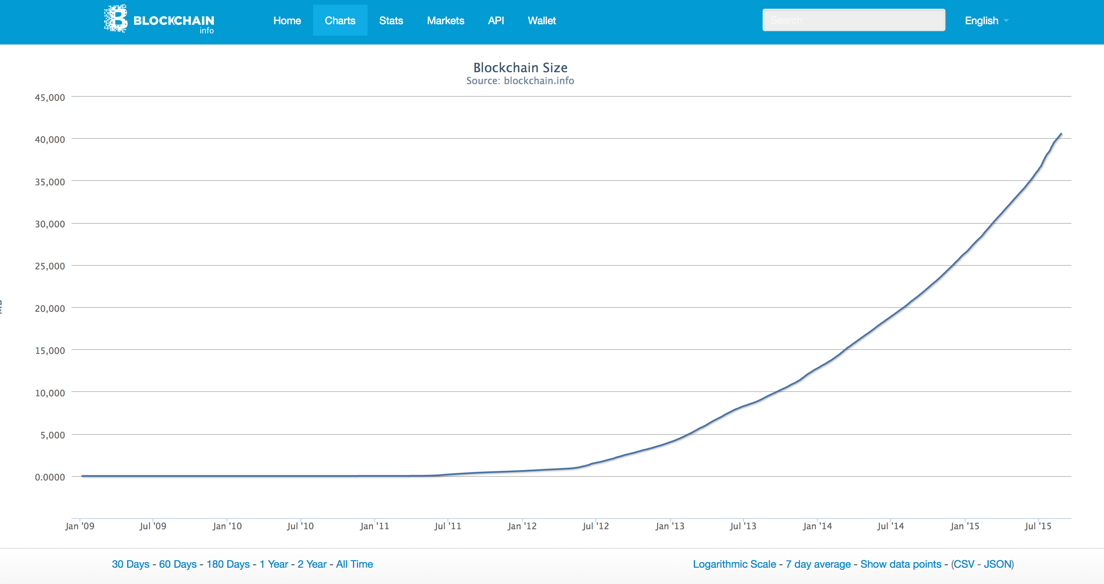
40 GB

Slide 36
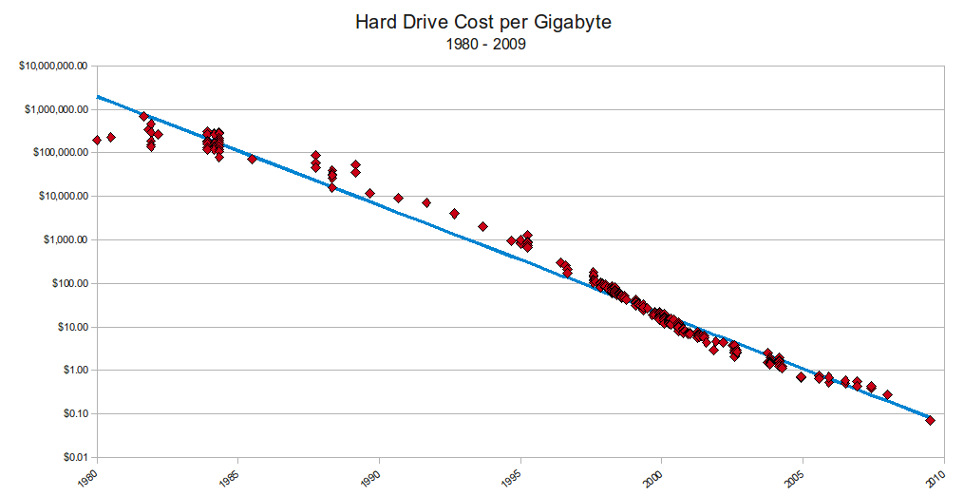
Falling Storage Cost
Source: Matthew Komorowski

Slide 37
Other Cryptocurrencies
David Chaum’s ecash (1982)
Chaum, Fiat and Naor (1990)
Micali and Rivest’s Peppercoin (2002)
None of them stored the full ledger, it was unusual for bitcoin to do this.

Slide 38
Remaining Problems
Decentralized nature gives rise to other problems as well, which Bitcoin solves:
Conflicting messages (digital signatures)
Conflicting transactions (voting/mining)

Slide 39
Charge
Visit bitcoin-class.org:
Setup your Bitcoin wallet
Submit registration before 8:29pm Saturday
Readings to do before class Monday

